Slide 1
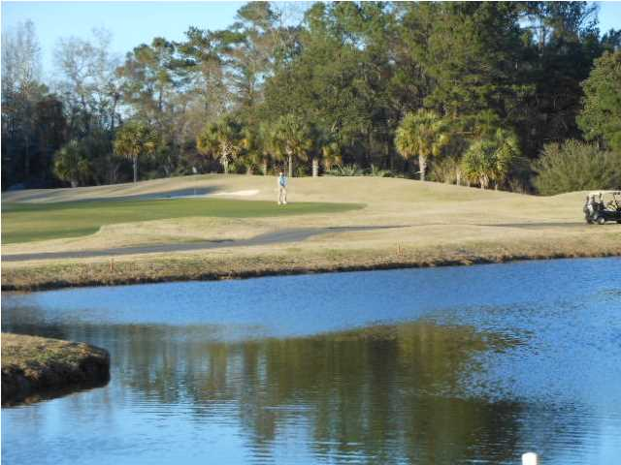
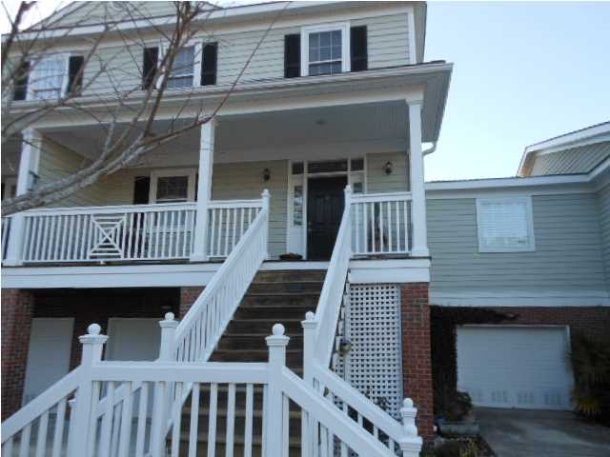
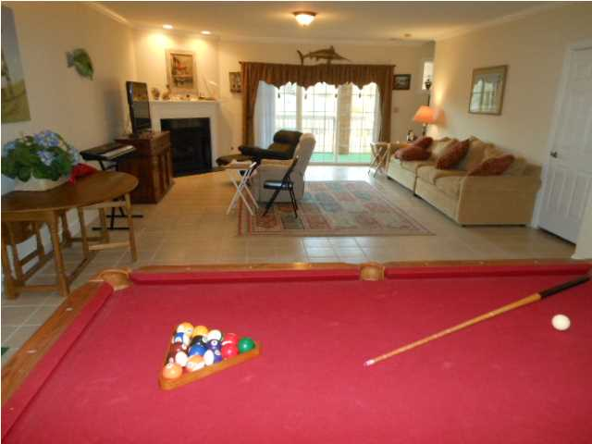
MLS# 1401930 2,829 Square Feet JUST REDUCED TO $299,900
BEST VALUE IN STONO FERRY
Sellers have over $370,000 invested in this home. Seller's loss is your gain!!Charleston's only gated golf and Equestrian Center Community! No where else in Charleston can you both golf and ride horses within the same community. This home is elevator equipped to access all floors. The largest unit in Ironwood with upgrades and additions everywhere! Yes, the square footage is correct...Owners purchased the largest unit available when new and added almost 700 sq. ft. of finished space on the ground level. The ground level was completely finished replacing one of the 2 garage spaces. Sellers will convert the downstairs areas back to another garage if buyers want another place to park indoors. The ground level family room has a gas fireplace, half bath and recessed lighting...It could easily be an additional bedroom or complete guest area. This home is complete with it's own elevator that stops on all 3 levels so you never have to walk up or down any stairs...Drive into the garage...and let your portable grocery cart and elevator take you to the first floor to unload directly into the kitchen pantry or refrigerator!! Your new home has a ground floor patio/porch that's over 38 ft. long plus another first floor screened porch also 38 ft. long along the rear of the home which overlooks both a lake and the golf course. In addition to the almost 3,000 sq. ft. of interior space you have approximately 800 sq. ft. of exterior porches and covered patios including a third covered area on the front porch!....This is the largest and most upgraded home in the community. The owners will also hold a first mortgage with terms to be agreed upon! This home has hardwoods or ceramic tile floors throughout (No carpet) Your new home has stainless steel appliances, 9 ft. ceilings with crown molding everywhere. The regime fee includes all lawn maintenance, pest control, roof replacement, pressure washing and exterior painting...And seller can do owner financing with terms to be negotiated! Make an appointment to see this fabulous property today! To see lots of photos click on photo then click smaller individual photos to enlarge....And NO FLOOD INSURANCE is required!
Rick Willis
843-327-3017
rwillisteam@gmail.com
The Group, LLC

