Slide 1
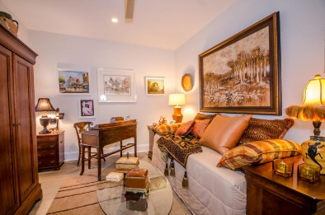
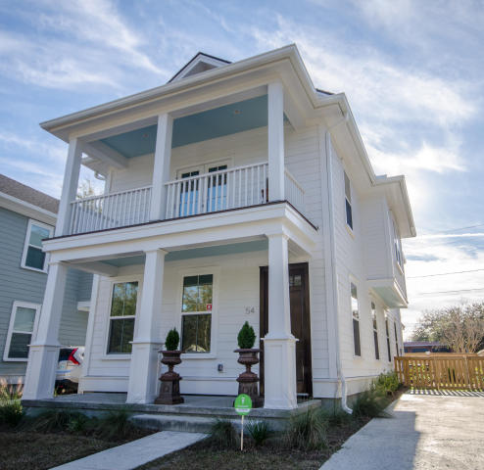
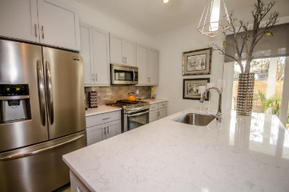
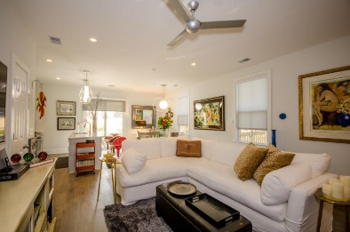
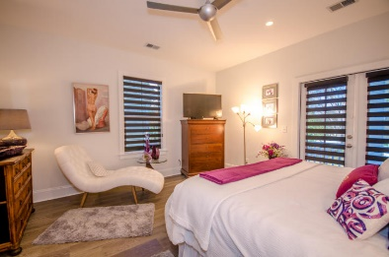
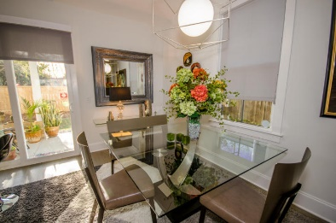
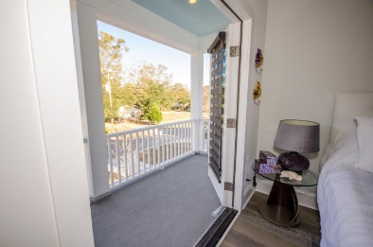
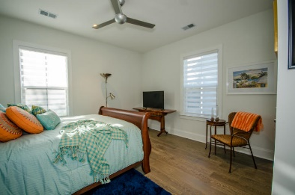
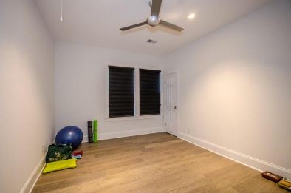
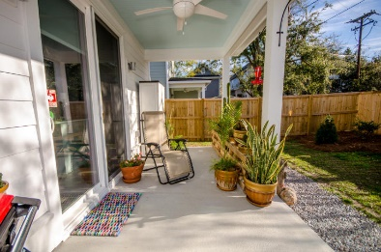
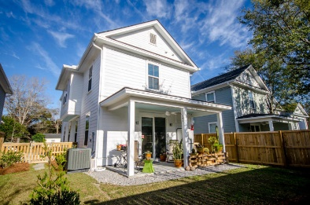


ALL THE BELLS AND WHISTLES!
New Price!
54 Shem Drive
Brookgreen Meadows ~ Mount Pleasant
MLS# 17002175 ~ $570,000
Beautiful double front porches make this house a summertime delight! Walk into the hall from the front porch; to the left is a study/bedroom with a full bath. Down the hall you come into the great room with lots of windows, a huge pantry and island, with doors that take you into the fully fenced private backyard. You can sit out on the porch or putter in your garden. Both front and back yards are large enough to enjoy without a lot of yard work. Quartz countertops, stainless appliances, gas stove, tankless water heater, wide plank engineered hardwoods throughout. Head upstairs to the three bedrooms and two full baths. Washer/dryer upstairs. Master has front porch across the whole front of the house. Please see documents for add'l information.
Susan Woodworth Kraber
Mobile - (843) 779-9655
susankraber1@gmail.com
ERA Wilder Realty, 125-F Wappoo Creek Dr, Charleston, SC 29412

