Slide 1
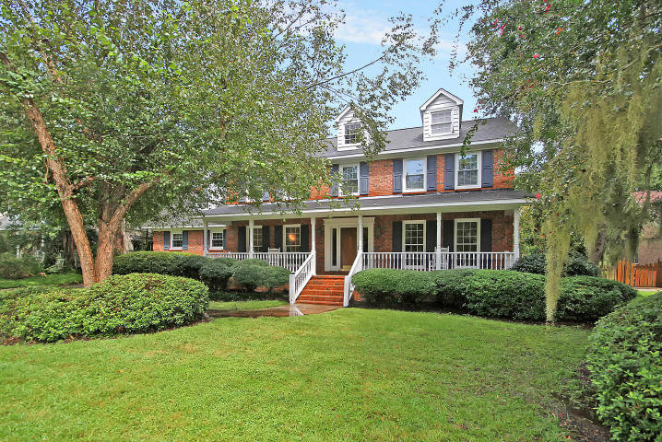
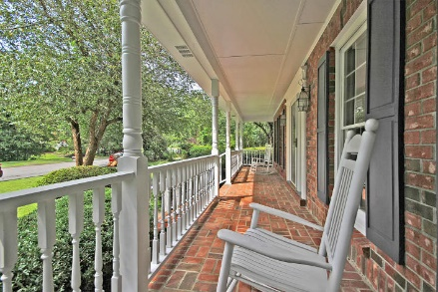
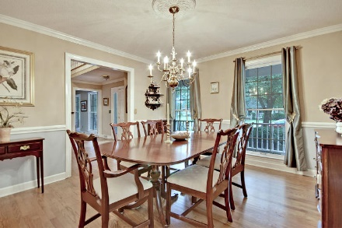
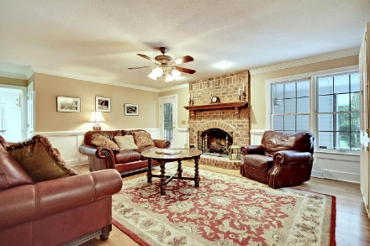
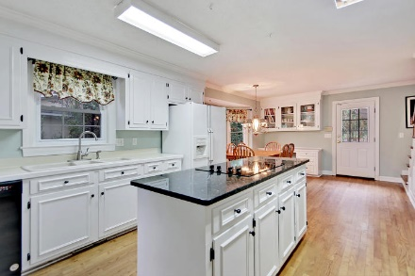
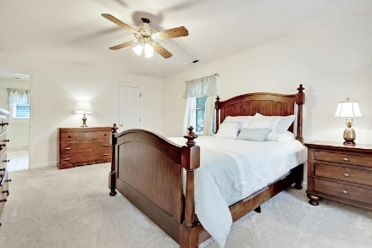
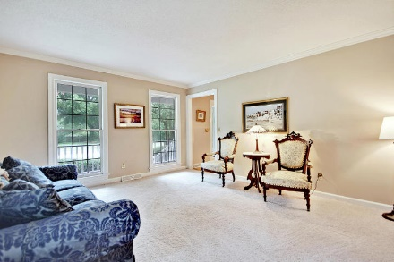
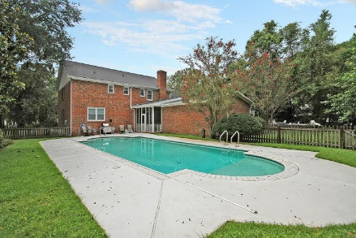
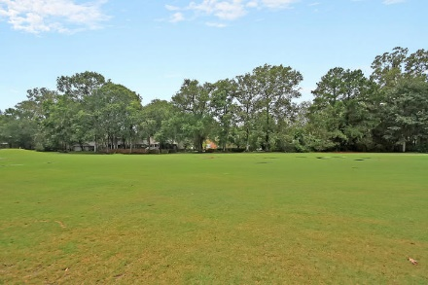
Don’t Miss Your Chance!
Reduced $200k!
54 Still Shadow Drive
Shadowmoss ~ Charleston ~ MLS# 17023021 ~ $469,000
What do you get when you combine a sparkling in-ground pool with a classic low country front porch and a gorgeous custom home that backs to the fairway in Shadowmoss Plantation? You get this amazing home in this desirable West Ashley location that simply won’t last!
This home is set to impress on all fronts, when you walk in you’ve got gleaming hardwood floors, chair rail molding in the dining room, a living room that great for entertaining, an enormous eat-in kitchen with a granite center island and built-in desk area and a family room with a cozy brick fireplace. A bedroom and full bath on the first floor make for great guest accommodations or an office. The owner’s retreat features a walk-in closet and huge en-suite bath with dual vanity, jetted tub and walk-in shower.
Come by today!
Additional features include:
Rinnai gas water heater
Newer HVAC units on both floors –
2014 (first floor) and 2015 (second floor)
New outside lighting
New fence in 2015
New pool pump in 2016
New paint and carpet in 2016
Roof replaced in 2010
Kitchen includes lots of counter and cabinet space, natural light, and a new dishwasher in 2017
Screened breezeway with tile flooring
Four bedrooms and a room over the kitchen
Great location! Close to shopping, dining, school, and I-526
Shadowmoss Plantation offers optional golf and pool memberships
Tyler Hawkins tyler@mattoneillteam.com (843) 908-2734

