Slide 1
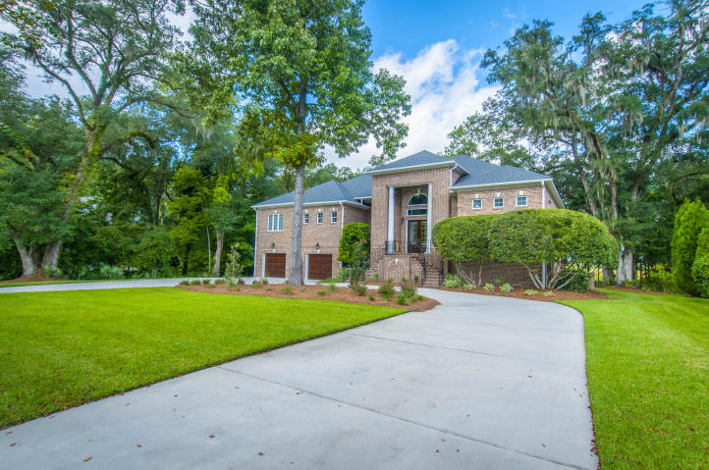
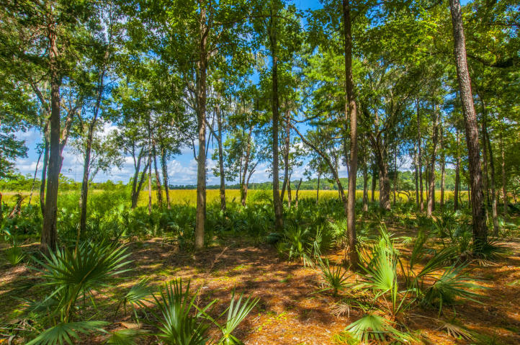
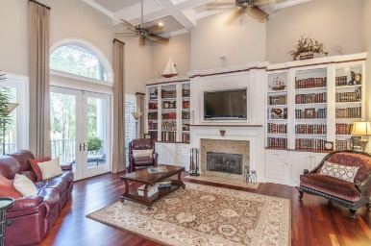
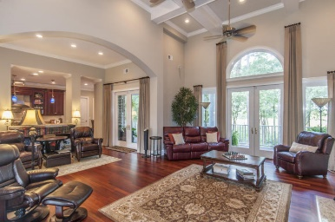
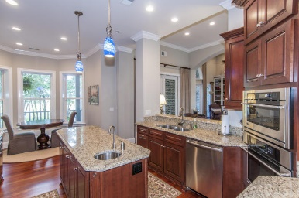
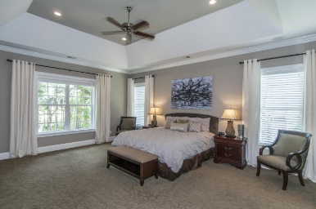
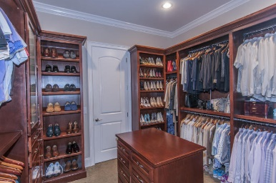
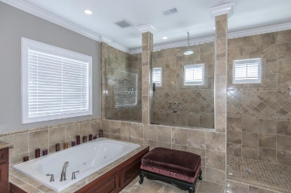
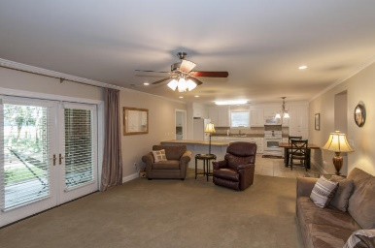
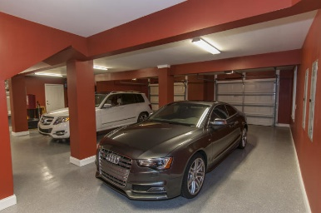


5501 Clearview Drive North Charleston ~ MLS# 15023626 ~ Reduced to $650,000
Reduced for Quick Sale! Open House 8/6 ~ 2-5pm Custom Marsh Front Home in Cedar Grove
As you pull in to the over sized horseshoe drive you will notice this Executive Brick home sits on a premium marsh front lot. It's irrigated and professionally landscaped. Almost an acre on the Ashley River side with relaxing live oaks. On the ground floor is a finished, epoxy floored garage, ELEVATOR and a 1500 sq ft 2 bedroom, full kitchen, in-law suite/apartment. Upstairs you will quickly notice the attention to detail in every aspect of this home. Over 3000 sq ft, chef's kitchen,48''sub zero, marble, granite, Solid cherry cabinets, Brazilian cherry hardwood floors, central vac system, UV windows, surround system, tray ceilings, incredible Master suite/custom closet, Master bath is a must see! Leaf guard gutters. If you are looking for a centrally located, fine luxury home, this is a must see!
Christopher McCormick
Office - 843-974-6200
Cell - 843-224-3204
cjmccormick@carolinaone.com
Carolina One Real Estate
900 N Main St
Summerville, SC 29483

