Slide 1
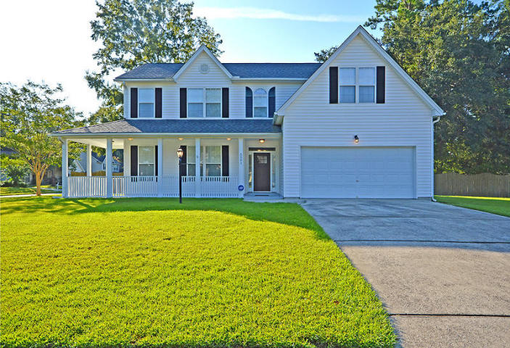
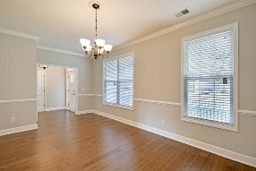
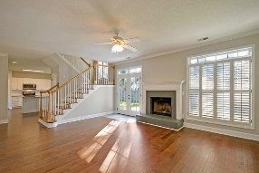
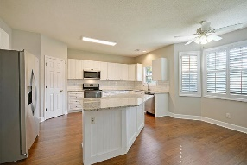
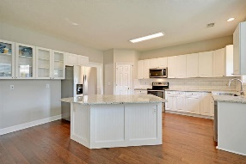
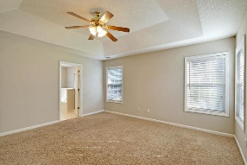
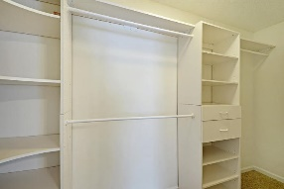
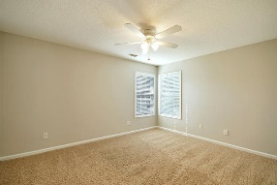
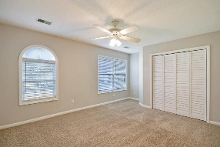
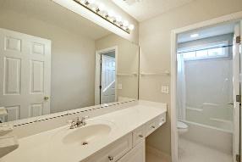
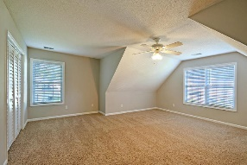
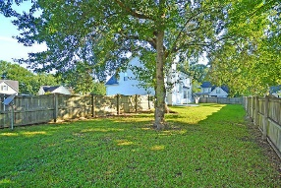
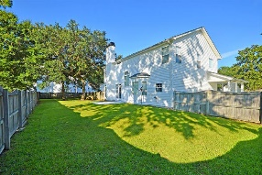


Totally Renovated - Under $300k!!
5501 Lindo Terrace
Indigo Fields
North Charleston, SC 29418
MLS# 18022309
$294,900
4 Bedrooms | 2 ½ Baths | 2,578 sf
Why wait for new construction when you can move in to like- new home immediately! New HVAC, two year old roof, new wood flooring on first floor, new granite countertops, sink and appliances in kitchen, entire interior freshly painted!!! All of this with an amazing location!!! Just minutes from Bosch, Boeing, AFB, Airport, shopping centers! Be close to it all! This home has great curb appeal! Located in a cul-de-sac, you'll immediately notice the large front porch. Upon entering in to the welcoming foyer, the very large dining room will be to your left. Perfect size for entertaining. Off the dining room is the renovated kitchen with the subway tile backsplash, granite countertops, large island that can accommodate at least three chairs and a good size eat in area with plantation shutters.
The family room is located off the kitchen and has a fireplace with doors leading to the large fenced in backyard. Upstairs, you'll find the large master bedroom with a walk in closet and master bath offering dual vanities, separate tub and shower. Back down the hall you'll see the laundry area, two good sized bedrooms, full bathroom and a bonus room. This very large room can be used as a fourth bedroom, media room, work out room, the possibilities are endless! This house has it all and is zoned for Dorchester District 2 schools! Come see it today!
Larry & Kathy Mazalatis
Larry Cell 843-693-0529
Kathy Cell 843-693-0159
Office 843-871-9133
AGENTOWNED PREMIERE GROUP | 1800 TROLLEY RD | SUMMERVILLE, SC 29485

