Slide 1
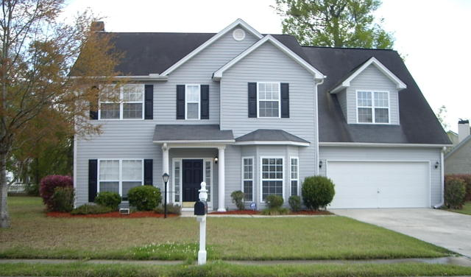
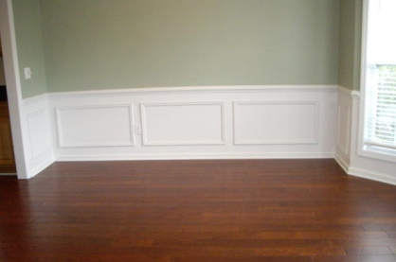
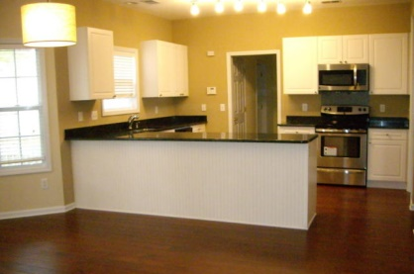
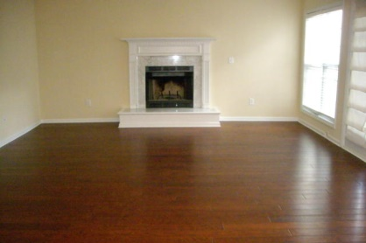
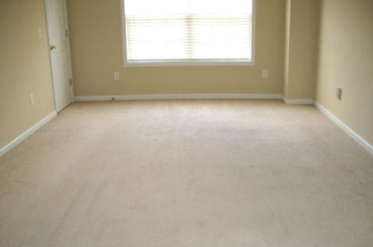
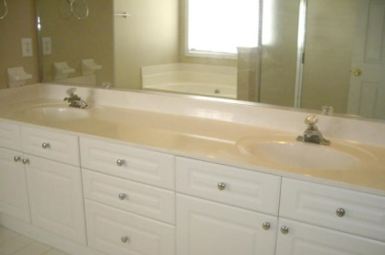
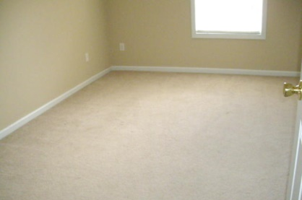
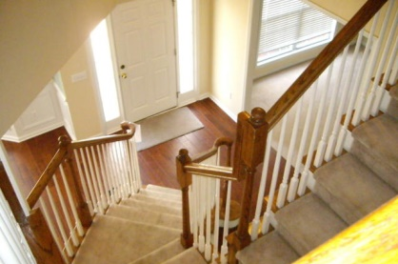
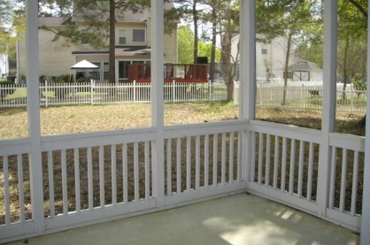
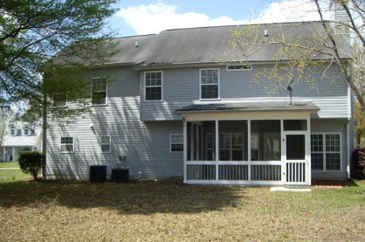


5505 Copper Trace Indigo Fields North Charleston, SC 29418 MLS# 15008091 $265,000
This very spacious home with open floor plan is located in beautiful Indigo Fields, this four bedroom and 2 1/2 bathroom home is close to Boeing, Bosch, the Airport and Charleston Air Base.
All new hardwood floors in downstairs except the living room or study. Once in the foyer you see a curved stairway with formal rooms on either side. Large family room with fireplace and is open to the breakfast area. Out door access to the screen porch.
Beautiful kitchen with all new stainless steel appliances and granite counter topes and tones of storage and two pantry space. Upstairs has a 4 large bedrooms and 2 full bath. The master bedroom and master bath is very large. Large 4th bedroom(frog)has walking-in closet.
Dorchester School District two. Great family home in a great neighborhood.
Cathy Rosenblum
843-817-7869
crosenblum@comcast.net

