Slide 1
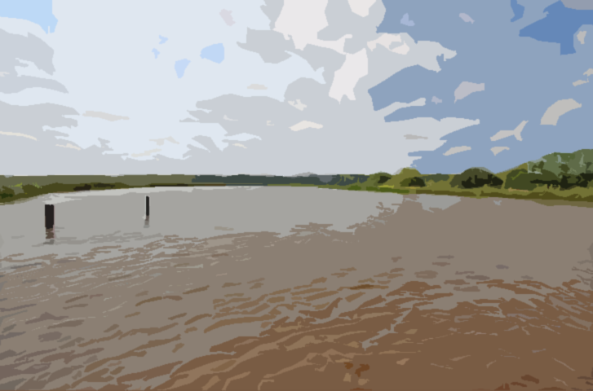
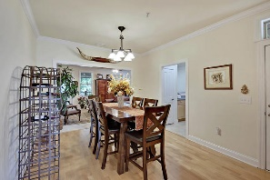
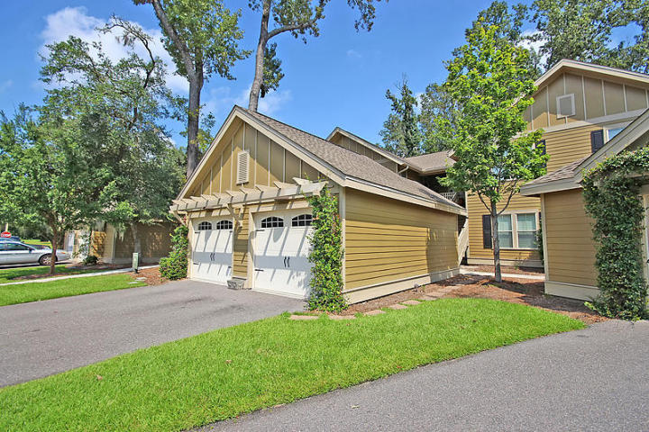
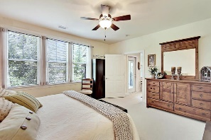
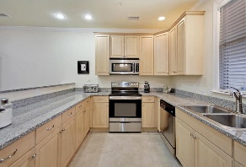
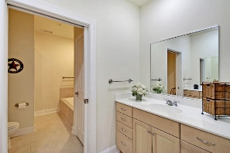
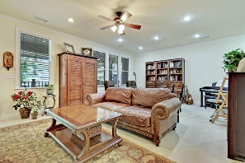
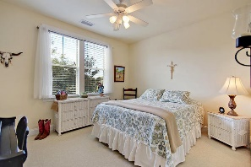
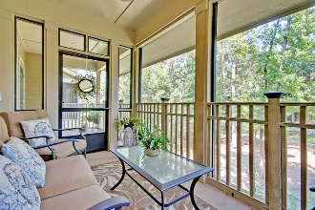
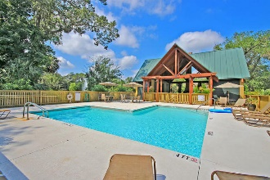
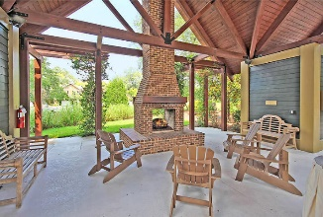
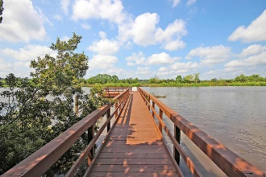
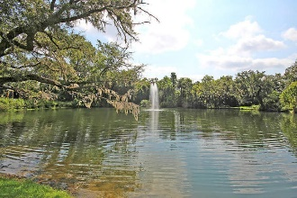

5508 Colonial Chatsworth Circle North Charleston, SC 29418 | MLS# 17023899 | $185,000
The Only Deep Water home on Daniel Island
Just Listed in Summers Bend on the Ashley
GORGEOUS, meticulously maintained, light filled, second floor one level living, one owner, pet-free, three bedroom, two bath flat has 1,600 sq.ft. of living space and is steps from the Ashley River. When you walk into the three bedroom flat, you enter into the foyer and dining area with handsome hardwood floors. Off of the open concept dining room is the chef's kitchen with maple cabinets, granite counters, stainless steel appliances, pantry and tile floors. The kitchen opens into the grand room with a granite breakfast-bar top that seats four. The large master bedroom has an abundance of natural light, walk-in closet, and an ensuite bath. The master spa-like bath has separate his and hers cultured marble vanities, ceramic tile floor, glass enclosed shower, and a relaxing soaking tub. The home is completed by two nice sized guest bedrooms (one could be a media room, office, craft room, or play room) that share a three piece guest bath. Other features include , 9 foot ceilings, recessed can lighting, glass-filled door with built in blinds leading to deck, ceiling fans, pocket doors, private front porch, and an OVER-SIZED detached garage with an automatic door opener. Summer's Bend on the Ashley is located on the banks of the Ashley River across from Middleton Plantation. Summer's Bend has an abundance of open green space, walking trails throughout, freshwater pond, summer kitchen, outdoor fireplace, pool, and a community dock overlooking the Ashley River. From the community dock, take in breathtaking views of the Lowcountry and Middleton Plantation while crabbing or fishing. The neighborhood is close to local shopping and is a short drive to downtown Charleston with 5-star restaurants, world class shopping and iconic history and a very short drive to the beaches, the airport, and Boeing! Call today to see-first class amenities and a condo that offers so much!
Stan Huff
843-670-2835 stan.huff@agentowned.com
Jill Marcacci
843-297-5590 jill@agentowned.com
www.agentownedrealty.com
AgentOwned Realty Co. Preferred Group, Inc. | 824 Johnnie Dodds Blvd | Mt Pleasant, SC 29464

