Slide 1
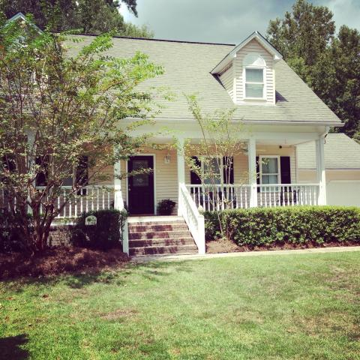
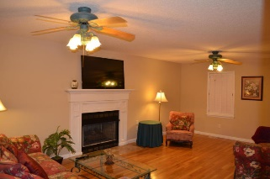
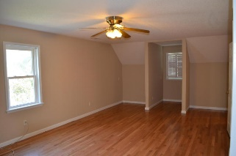
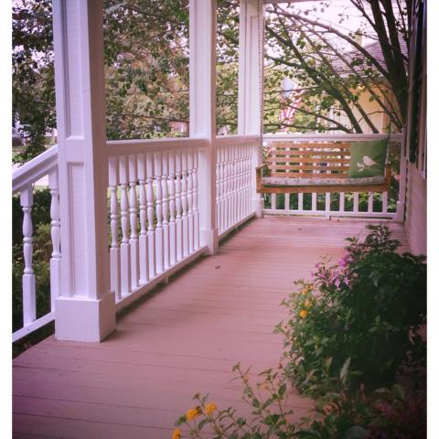
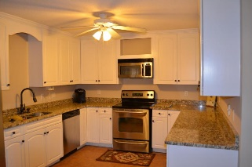
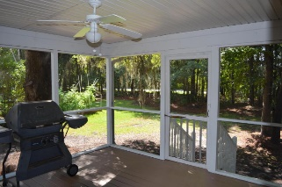
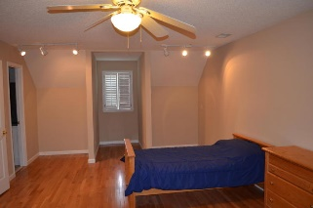
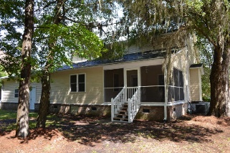


Beautiful traditional 3 bed 2 1/2 bath home in Whitehall Plantation in desirable Dorchester District 2 school district. Covered full front porch and large screened-in porch in the back. Mature trees and a wooded back yard give you extra privacy. Fresh, neutral Sherwin Williams paint throughout the inside and outside of home. New ceramic tile in bathrooms and hardwoods throughout the first and second floor. The lovely master bedroom is conveniently located on the first floor. Upstairs you will find 2 oversized bedrooms with gleaming hardwoods and a Jack and Jill bathroom to share. The lovely upgraded kitchen comes complete with stainless steel appliances, upgraded countertops and has a large eat-in area perfect for a dining room table. The separate laundry room is located off the kitchen. All of this plus an oversized, attached 2-car garage. Schedule your private visit to this lovely home today.
$1,000 Buyer Agent Bonus with Ratified Contract by September 30th Home Warranty Included ¤ Pre-listing Inspection Complete
5516 Gallatin Lane
Whitehall ~ North Charleston ~ MLS# 15022084 ~ $240,000
Jessica Nieper
(843) 226-2077 - jessica@lifetreerealestate.com
LifeTree Real Estate, LLC | 3094 Hwy 17 North | Mt. Pleasant, SC 29466 | (843) 375-5900 | www.lifetreerealestate.com

