Slide 1

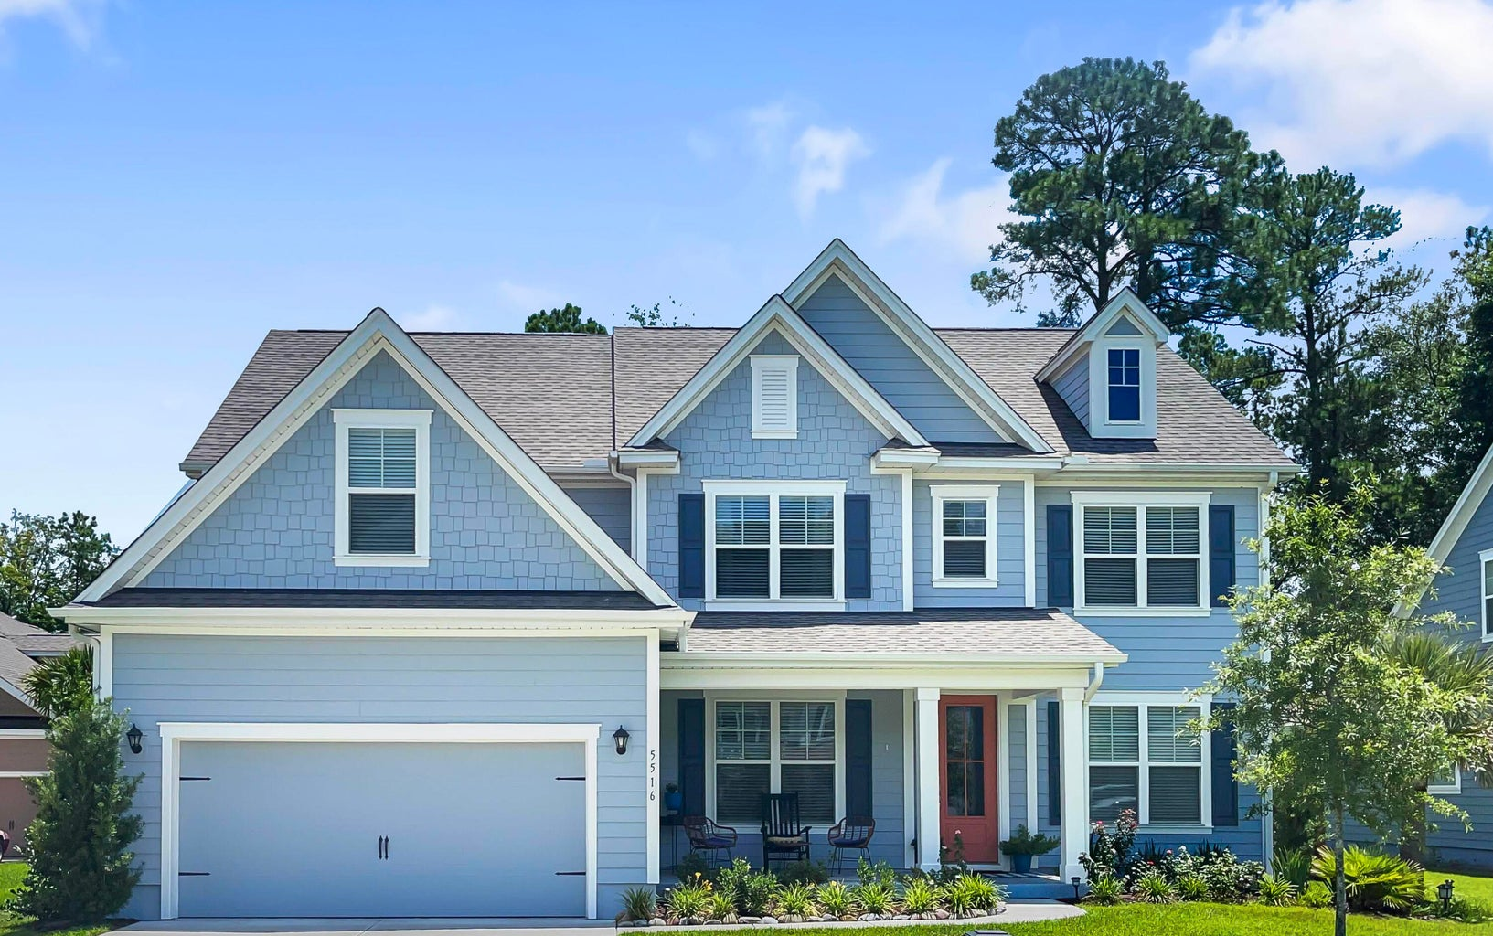

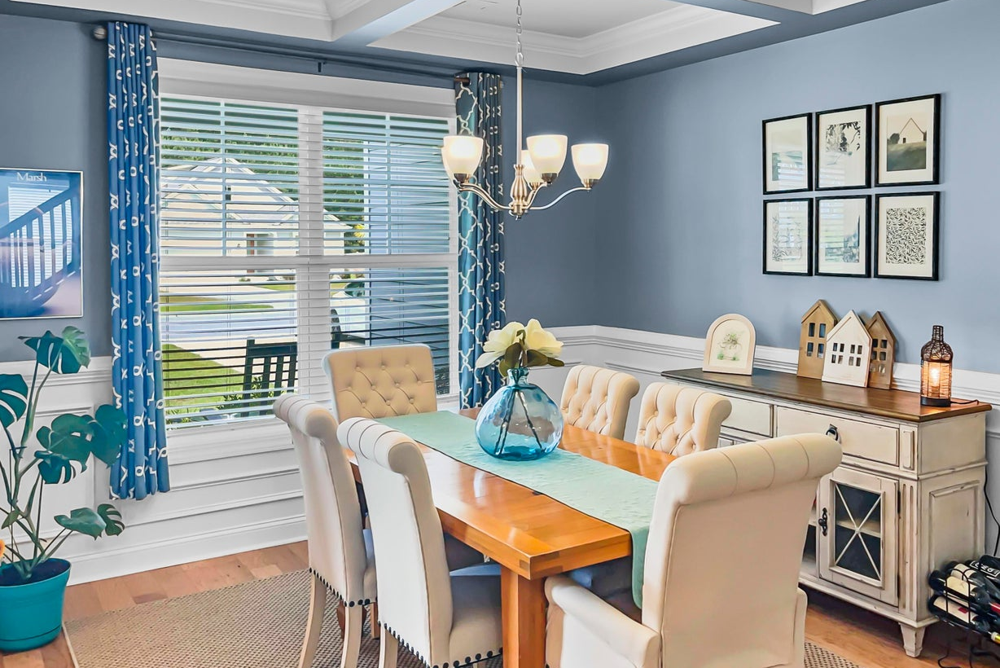
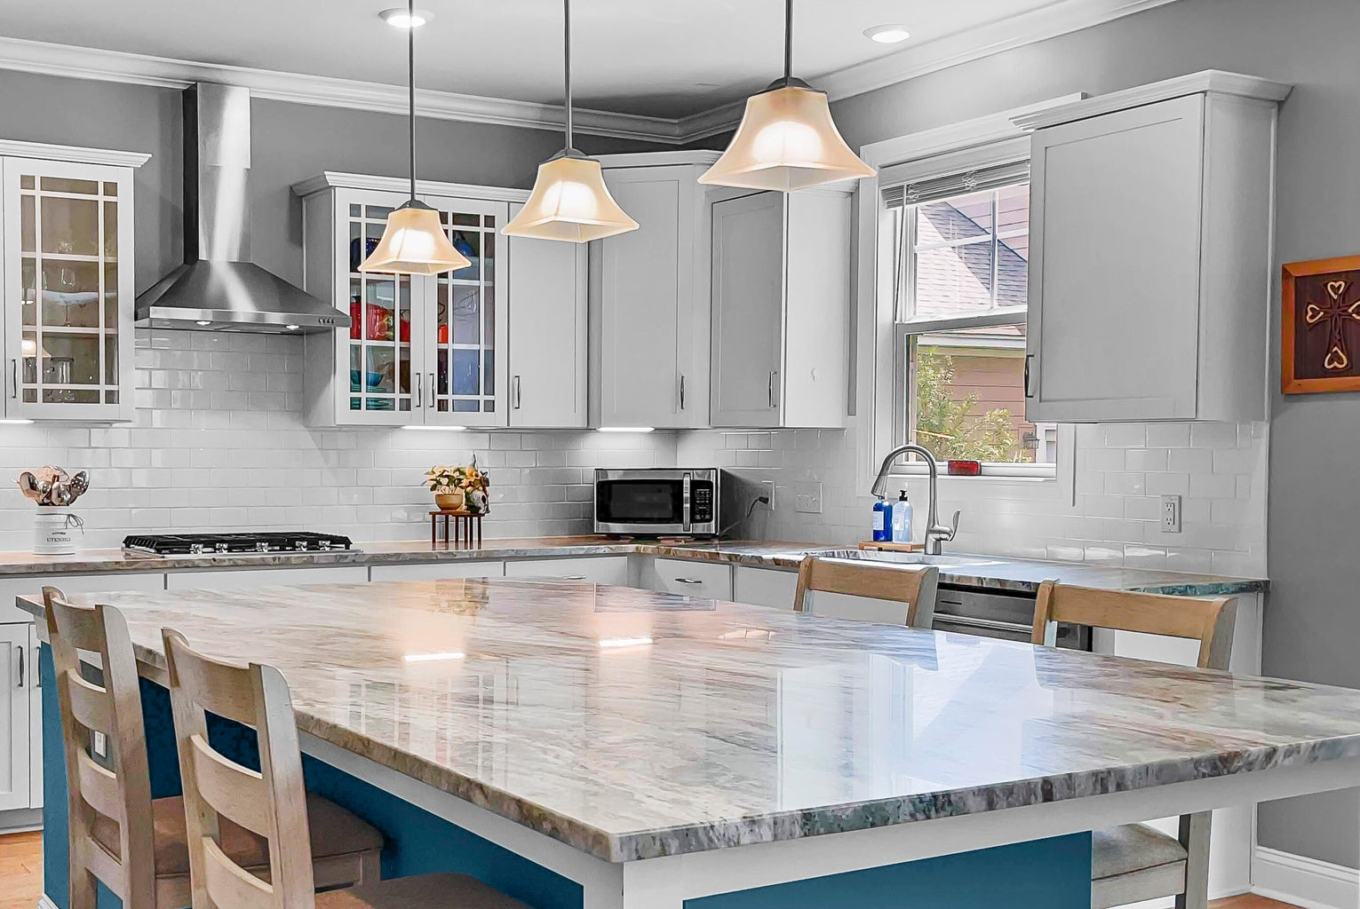



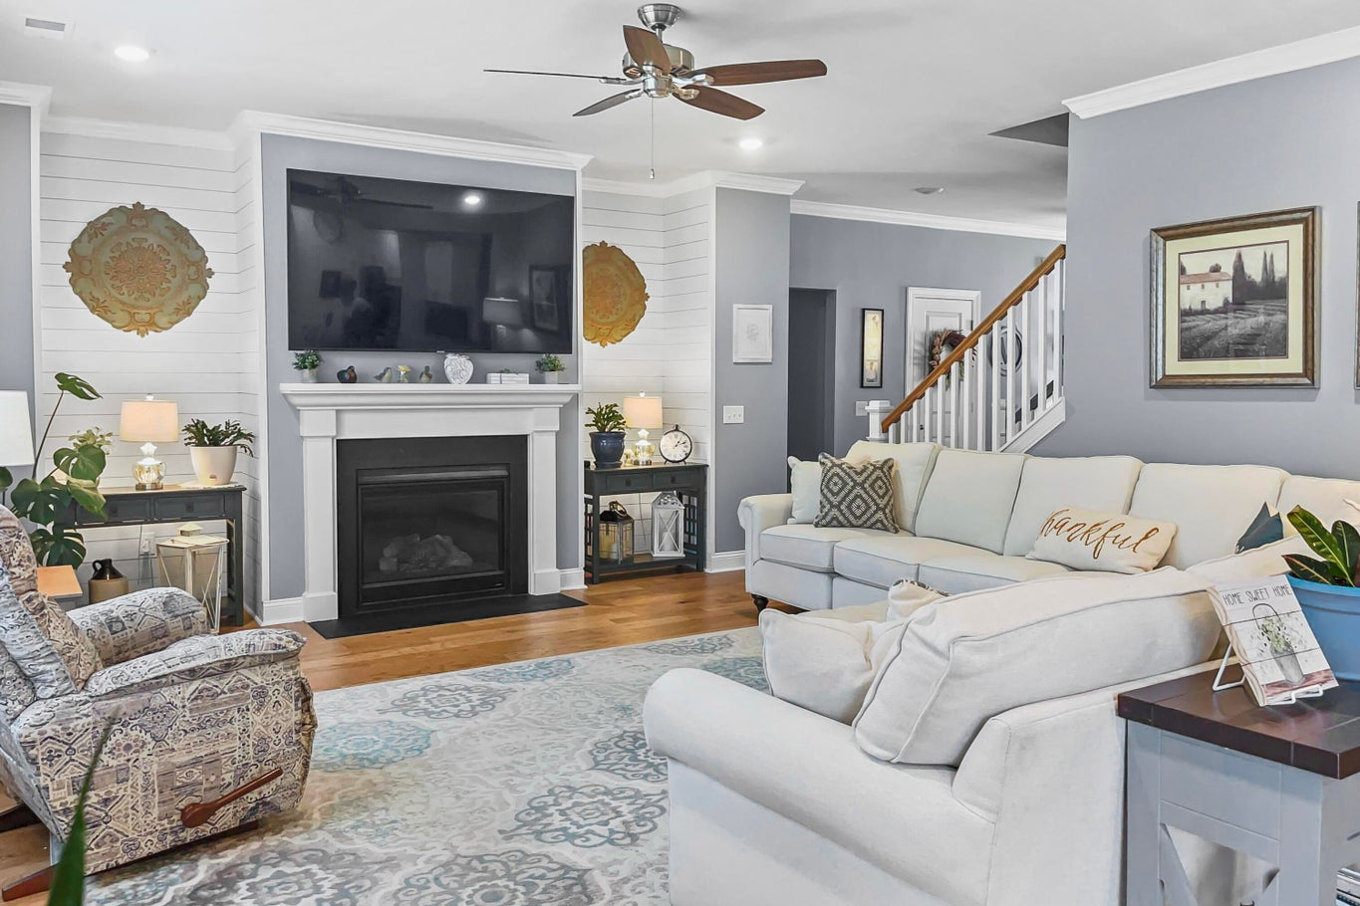
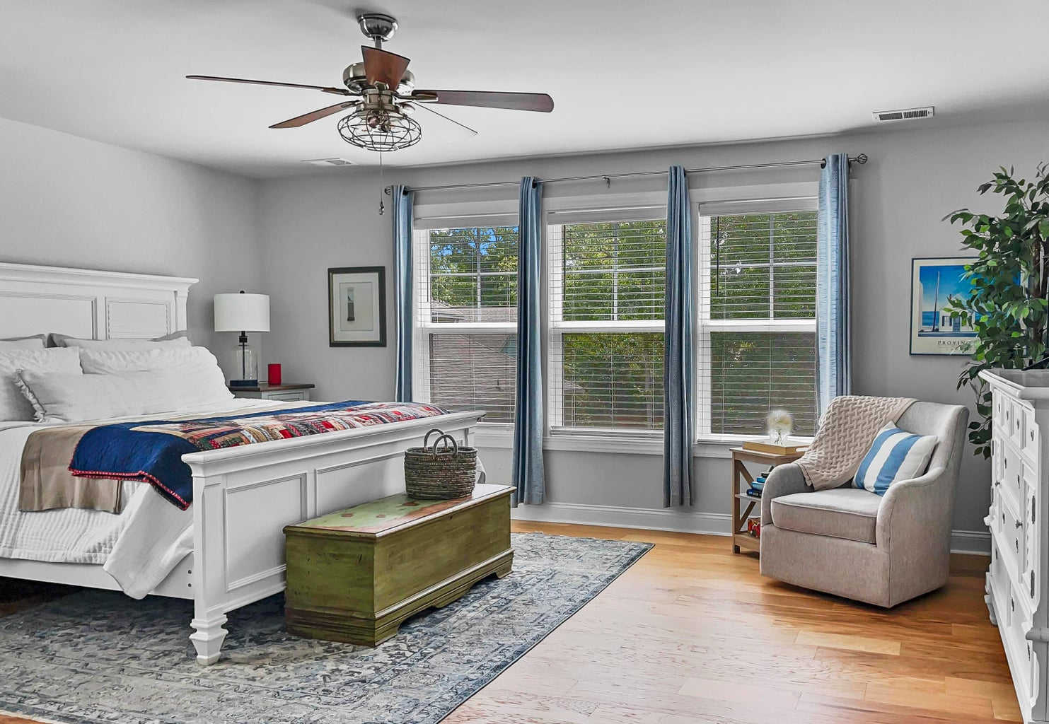



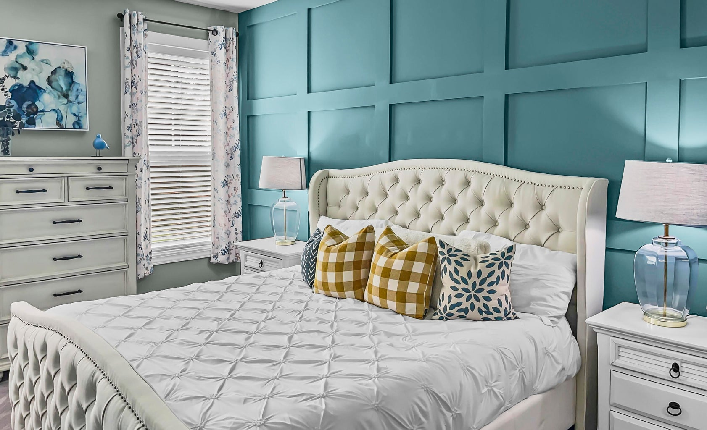
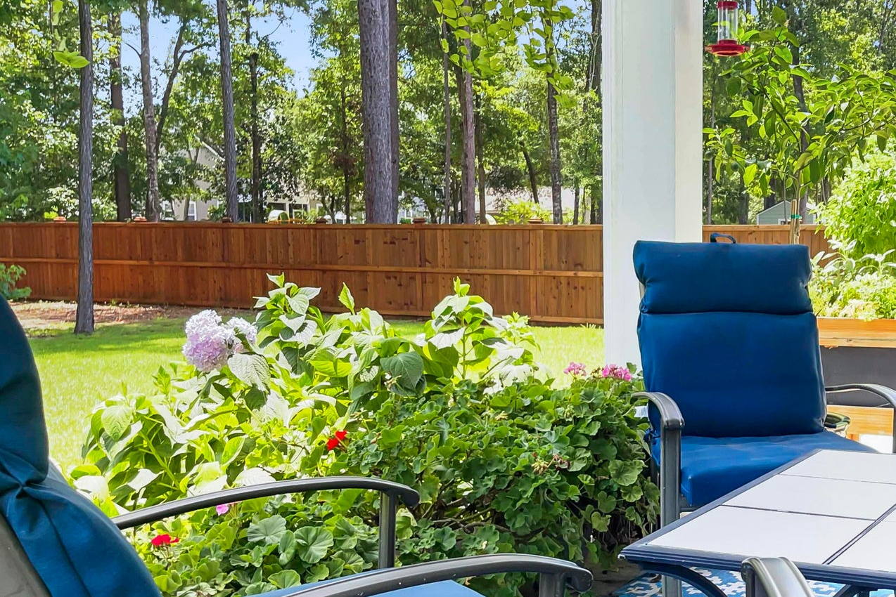
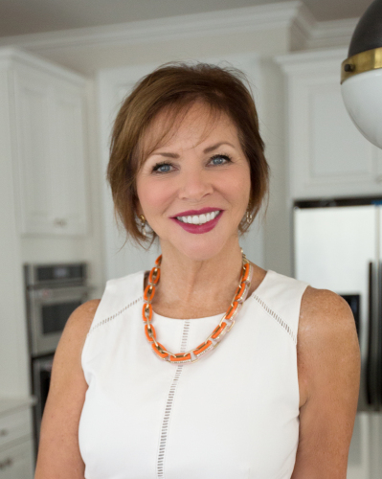
New Listing
5516 Alpine Drive
Summerville, SC 29483 | MLS# 24017264 | $825,000
A $2500 Lender Credit is available!
Welcome to luxury living in the highly sought-after Summerville neighborhood of The Summit! Prepare to be impressed by this large upgraded and meticulously cared for home. The spacious layout is accentuated by great light, hardwood flooring on both the 1st and 2nd floor, wainscotting, shiplap and coffered ceilings. Perfect for multigenerational living or accommodating guests in style, this home proudly offers not one, but TWO primary suites, each with ensuite baths and generous closet space. The upstairs primary suite is bathed in natural light and boasts approximately 600 square feet including the enormous walk-in closet. The large gourmet kitchen features tons of cabinet space, a huge island with seating for 6 or more, a spacious pantry, KitchenAid Appliances, gas cooktop, and electric double ovens.
Relax and unwind by the gas fireplace in the family room, or retreat to the back porch to enjoy the outdoors.
5 Bedroom
4½ Bath
3,649 sf
The Summit
Kim Chambers
843-371-9047
kim.chambers@carolinaone.com
www.carolinaone.com
Carolina One Real Estate | 191 Rutledge Ave | Charleston, SC 29403

