Slide 1
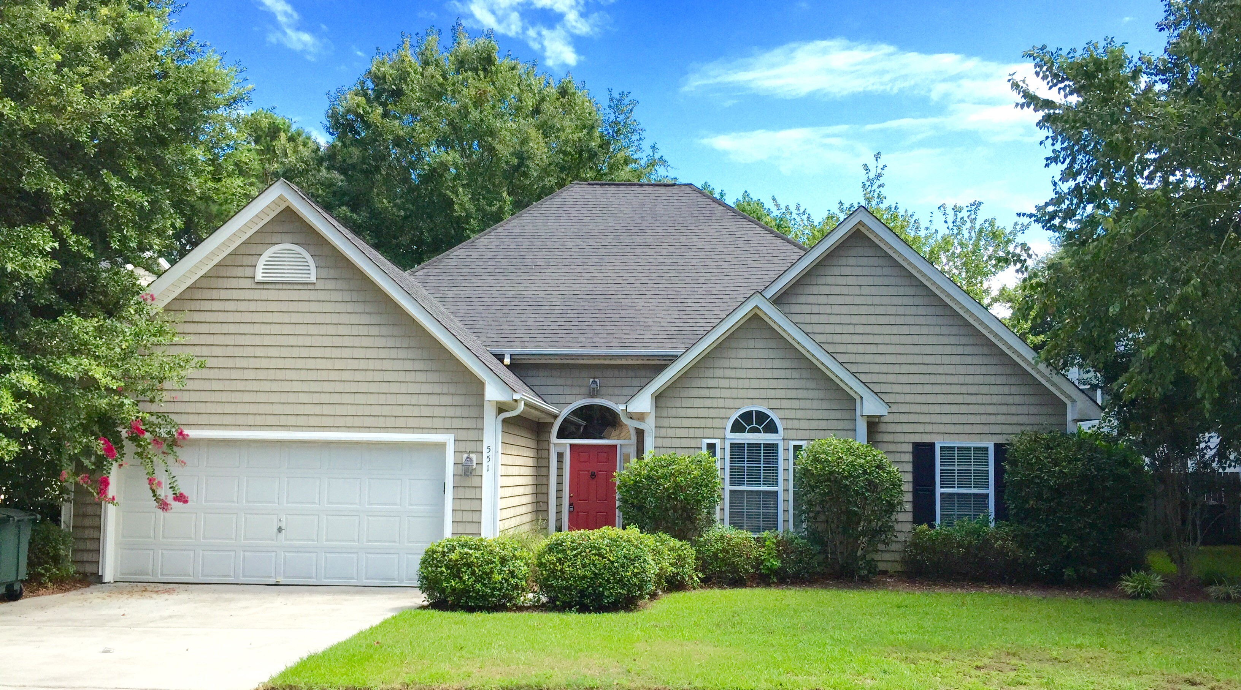
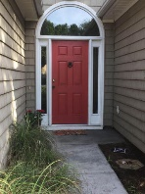
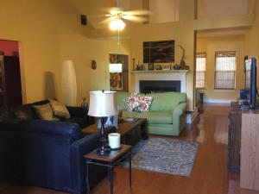
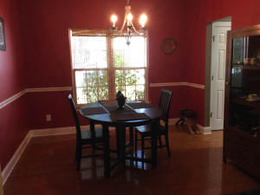
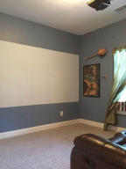
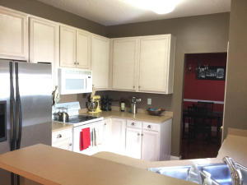
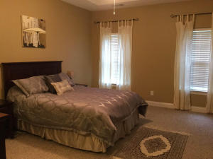
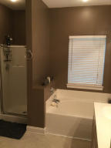


New Price! Wonderful James Island Neighborhood
Price Reduced!
551 Cecilia Cove Drive
Lawton Harbor ~ Charleston ~ MLS# 15018328 ~ $320,000
Lovely bright Lowcountry home on a quiet tree lined street. This home has an open floor plan that captures and fills this cottage-feel home with natural light. This low maintenance 1 story home in Lawton Harbor is only minutes to downtown Charleston and MUSC. Also, featuring a spacious great room and den with cathedral ceilings that share a dual-sided gas fireplace. The Master BR has vaulted ceilings and a separate office/study area. Dual sink vanities in both bathrooms with a garden tub in the master bath. Home is wired for sound with surround speakers in the great room and bedroom features a 3D Projector that will convey. Hardwood floors and Berber carpet throughout, vinyl in bathrooms. All in a terrific neighborhood- plenty of routes to jog, and within walking distance to the grocery store, restaurants, school and rec center!
Eric Bickel
Office - (843) 284-3959
Mobile - (843) 633-1744
eric@bigrealtyllc.com
B.I.G. Realty, LLC
1540 Patterson Ave
Charleston, SC 29412
www.bigrealtyllc.com

