Slide 1
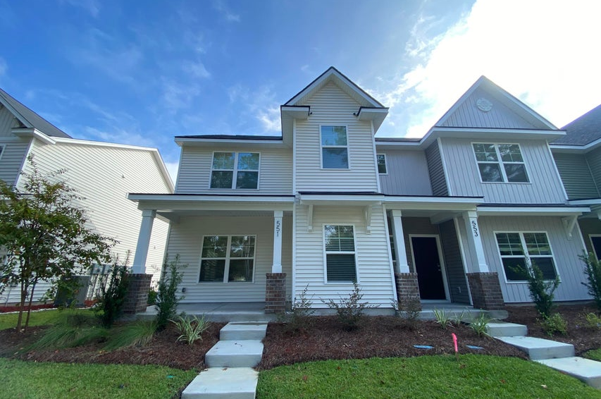
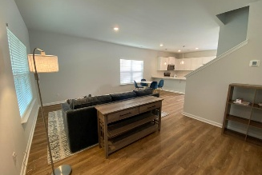
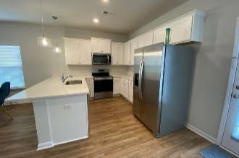
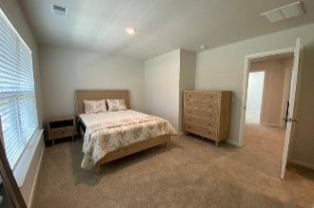
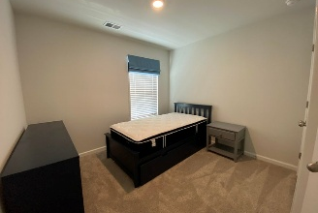
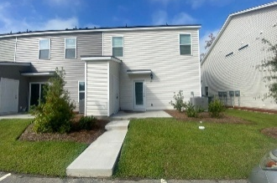


$10K AGENT FEE+$15K TOWARD CLOSING COSTS
$15,000 Agent Bonus
with ratified contract by 4/15/18
551 Gahagan Road
Garbon Townhomes
Summerville, SC 29485
MLS# 25027784
$302,000
$12,100 Under
Recent Appraised Value
Seller WILL PAY $15K toward BUYER'S CLOSING COSTS with acceptable OFFER. This fantastic Townhome is BRAND NEW ! Owner had a change in needs and has decided to sell. It is quality throughout: fresh paint, luxury vinyl flooring and insulated windows. Plantation width blinds throughout, pendant lighting in kitchen, newly installed bath fixtures and bath medicine chest. All kitchen appliances are brand new and included side by side refrigerator, dishwasher, electric range, microwave, disposal. Washer and dryer are installed in laundry room. Private 1/2 bath on the main floor. Electronic front entry. Really a nice front porch and this end unit offers so much light and yard to enjoy. Back entry is an insulated glass door and the storage room to the side has a brand NEW strapped-in water heater which is housed there but leaves you room for much more. All 3 bedrooms are upstairs. Primary bedroom has a spacious walk-in closet plus another double door closet. Walk-in shower is spacious and terrific double vanity. Linen closet in the upstairs landing easily accessed by all 3 bedrooms. Full compliment of smoke detectors and ample HVAC returns for excellent air flow. There is attic access from a shuttle in upstairs hall. Owners even acquired new furnishing that could be negotiated to stay in place. Great location. Ride your bike to Gahagan Park and Ball Fields. Great commuting roads available and easy access to all shopping needs. No yard work as that is all taken care of by the HOA. Priced well below appraisal. COME see this great opportunity to live IN TOWN SUMMERVILLE.
Candace Pratt
843-696-5508
candace@prattandco.com
www.prattandco.com
RE/MAX Southern Shores
9209 University Blvd, Charleston, SC 29406

