Slide 1
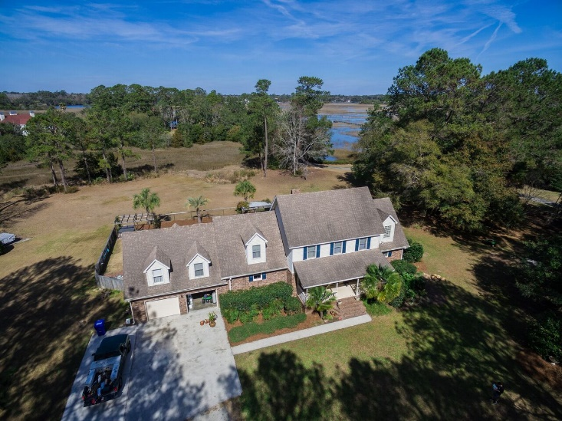
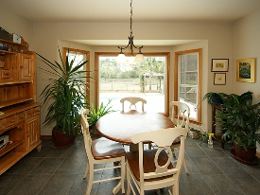
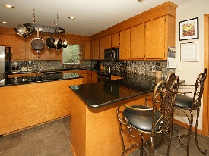
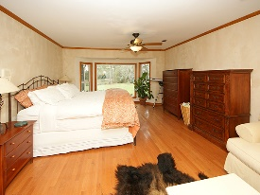
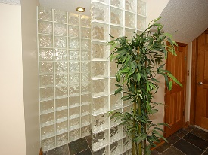
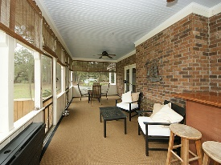
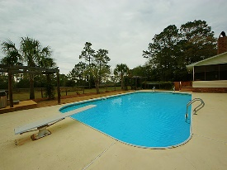

5532 Stonoview Drive
Chisolm Green
Johns Island, SC 29455
MLS# 17006483
$599,000
2 Acre Private Oasis
LOWCOUNTRY LIVING AT ITS FINEST.
The marsh views from this property are lovely, and the private community dock is only a short stroll away. The porch and swimming pool area are perfect for crabcracks after pulling your crabpot from the creek. 100 yd. chipping green will keep golfers in perfect form while eagles soar by from the Stono River. The screened-in porch is a quiet place to read and listen to resident owls at night.
This residence is perfect for entertaining with a large, eat-in kitchen, separate dining room, open floor plan and a large bonus room for kids’ playroom or overflow guests. Dual master bedrooms with upgraded bathrooms, hardwoods and tile. Please stop by and experience tranquility at its finest.
15 miles to Downtown Charleston
4.5 miles to Limehouse Bridge, and Public Boat Landing
Gerri Sandford
(843) 817-8762
gsandford29455@gmail.com
Anchor Line Realty LLC
1619 Samuel Rd
Charleston, SC 29412

