Slide 1
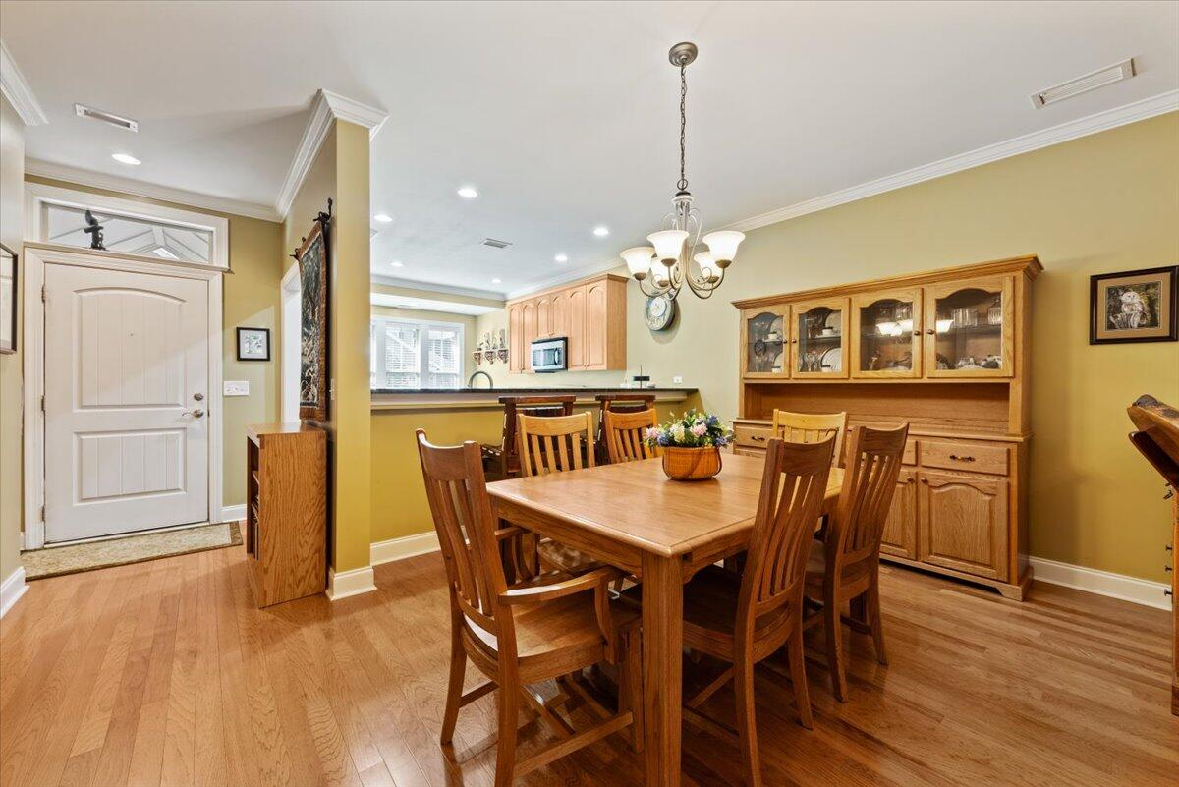
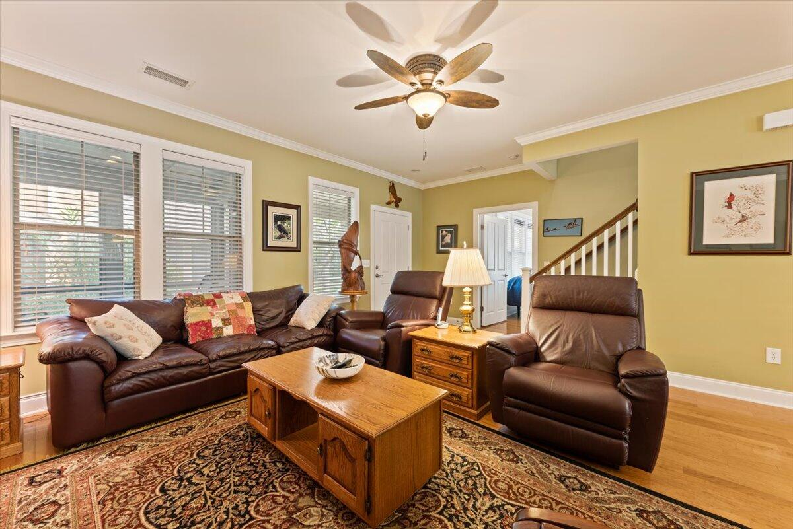
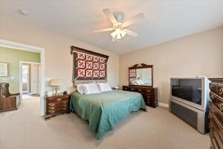
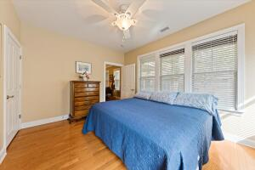
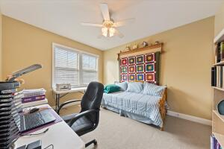
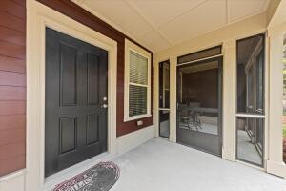
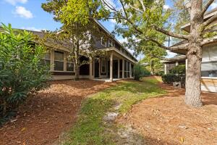

OPEN HOUSE SATURDAY FROM 11-1PM
5536 Colonial Chatsworth Circle
Summers Bend on the Ashley · North Charleston · MLS# 23022779 · $303,000
Two story townhome style which has the primary bedroom on the first floor, an open concept kitchen and living area, and a screened in porch! Two large bedrooms are upstairs each with large closets. Enjoy the back screened porch and patio. The neighborhood is a charming marshfront community tucked away from the hustle and bustle, and yet so close to conveniences including the military base and ariport. Amenties include a pool, and a kayak launch to the Ashley River! The subdivision is a hidden gem where you will feel like you are in a different world of peace and tranquility! VA financing is approved here and minimum 6 month rentals are allowed. Flood insurance and lawn care included with HOA dues.
Take a Virtual Tour
Therese Jenkins
(843) 568-9748
therese@beautifulhomesllc.com
Beautiful Homes Realty
130 River Landing Dr #7322
Charleston, SC 29492
www.beautifulhomesllc.com

