Slide 1
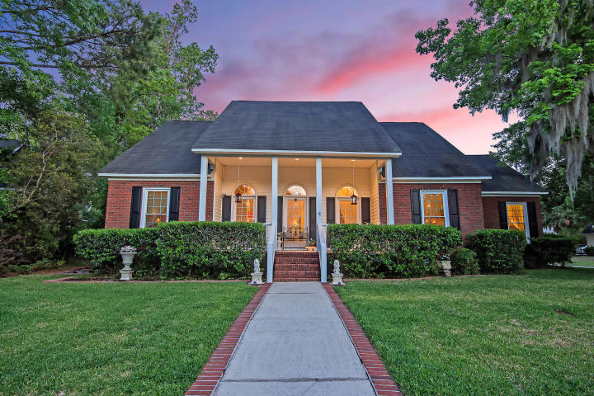
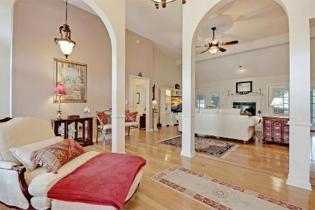
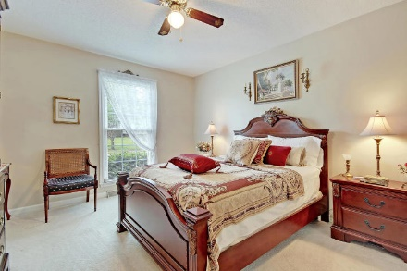
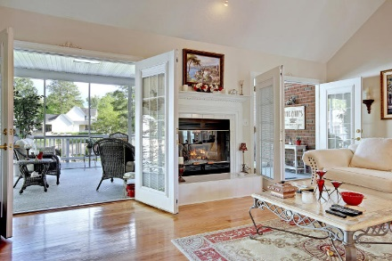
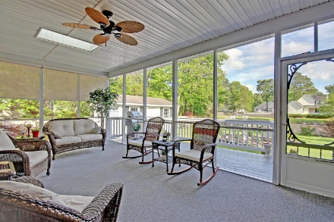
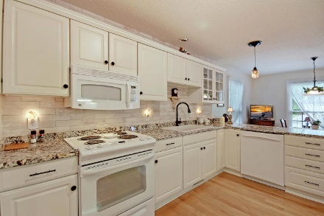
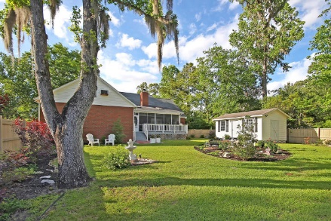
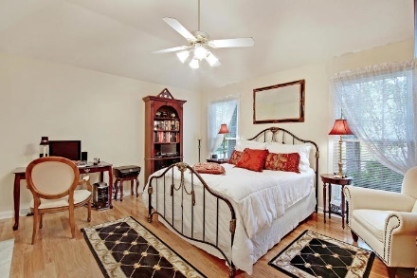
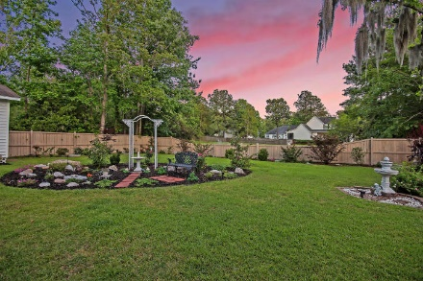
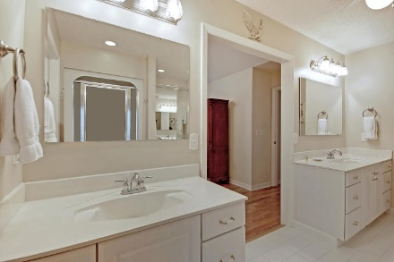
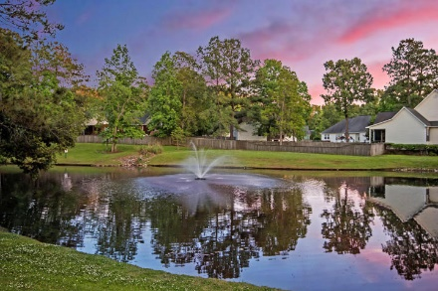
AMAZING HOME ON POND!
EVEN MORE AMAZING LOW PRICE!
Price Reduced!
5537 Indigo Fields Boulevard
Indigo Fields ~ North Charleston, SC 29418 ~ MLS# 18012174 ~ $339,900
The original buyers lost their financing so this lovely Southern Transitional Ranch is back on the market. Walk in the door to the beautiful hardwood floors, spacious open floor plan, 2 double patio doors & beautiful fireplace for cool SC nights. Stroll through the double patio doors to the spacious screened patio & sit down and put your feet up! Not only will you overlook a beautiful pond & fountain, but the large fenced back yard is immaculate. Wander through this well planned home to the crisp updated kitchen...the white cabinetry, granite countertops, & a granite sink will make any chef happy! Regardless if you have a big family or just love to entertain, this house will fit all of your needs with its split bedroom floor plan and private guest suite, complete with its own bathroom!
Additional upgraded and super special features include:
New windows throughout home
New Granite Farmer sink in kitchen
New French Doors leading to Screened-in porch
New Water Heater
New commercial-grade kitchen garbage disposal
Upgraded Kitchen Faucet
New granite countertops
Young Kitchen GE appliances: range, fridge and
Manicured landscaped yard and pond with fountain
New Beautiful easy care hardwood floors
New cabinets in laundry room
2 and one half car garage for extra storage
ADT Alarm system that conveys
Well maintained property
Ease of access to shopping and services in the popular Dorchester Road Corridor and Summerville
Book your showing today!
Chip Walsh chip@mattoneillteam.com 843-822-4663

