Slide 1

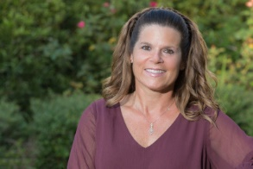
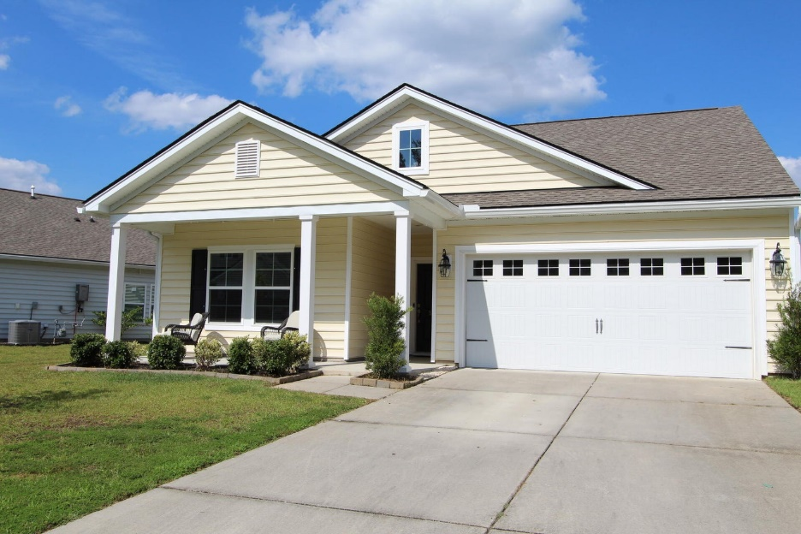
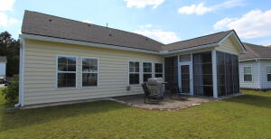
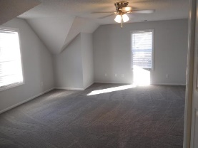
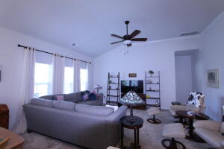
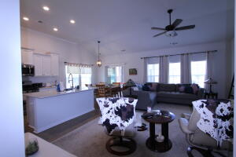
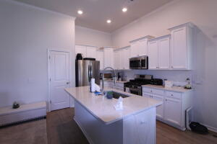
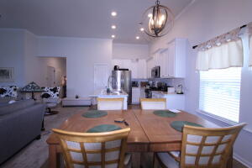
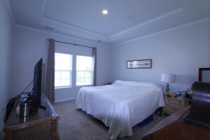
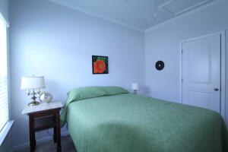
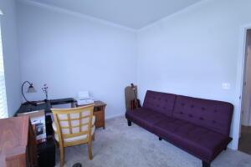
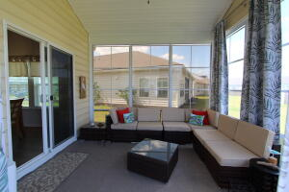
Kim Katich
(843) 754-8060
kimsellschs@gmail.com
Price Reduced
553 Mountain Laurel Circle
Liberty Village
Goose Creek, SC 29445
MLS# 23021598
$345,000
Welcome to this Beautiful home in Liberty Village. This is one story living with an open concept floor plan. The large kitchen offers Quartz countertops, gas range, SS Appliances, subway tile backsplash with a large island and eat in kitchen area. The kitchen is open to the large family room area for easy entertaining. The spacious master bedroom is located off of the family room and has a trey ceiling the bathroom has dual sinks, a large shower and walk in closet. The additional 2 bedrooms are located at the front of the home and share a full bath. The home has crown molding throughout the entire home. There is an all-season sunroom off the back of the house which leads out onto a patio area which is great for entertaining.
Flat Rate Real Estate
1150 Hungryneck Blvd | Ste C314 | Mt. Pleasant, SC 29464

