Slide 1
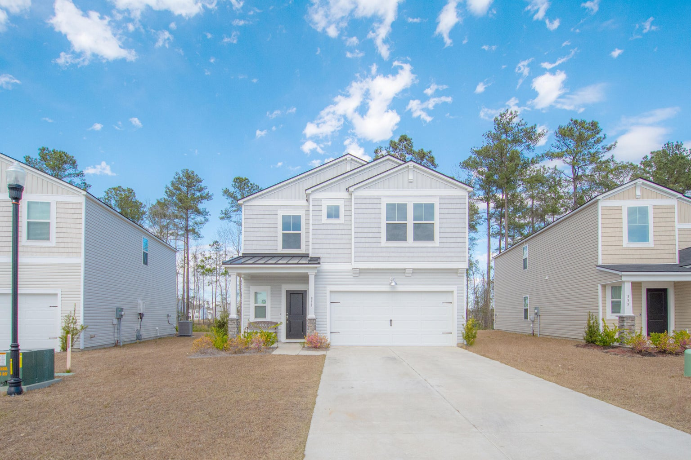
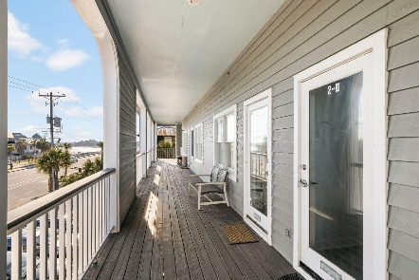
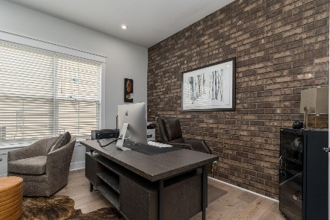
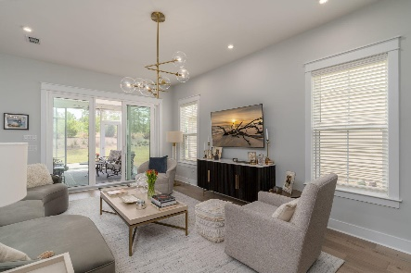

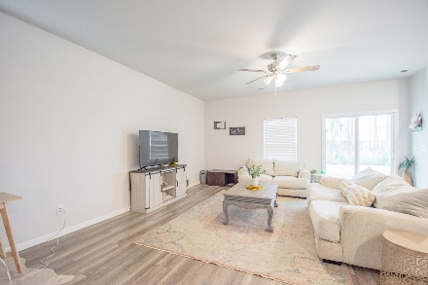
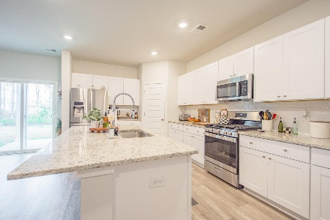
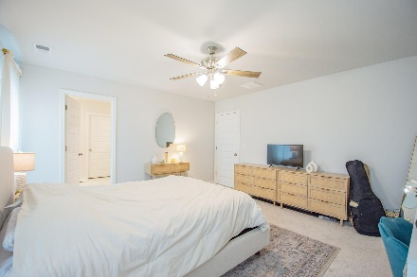
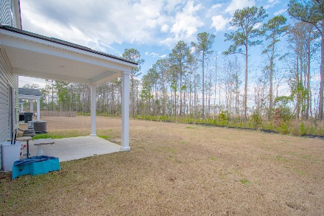
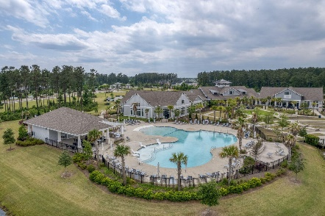
553 Spanish Wells Road Cane Bay Plantation | Summerville, SC 29486 | MLS# 24004472 | $364,999
Darrell Creek Elevated Home With Elevator & Salt Pool
Spacious 5 Bedroom
In Lindera Preserve
Co-sponsored by
Offering $3000
Lender Credit
Welcome to your dream home! This nearly new gem boasts 5 spacious bedrooms and 2 1/2 bathrooms, providing ample space for you and your family. The open floorpan makes entertaining a breeze and you won't miss out on the fun. The modern kitchen is equipped with stainless steel appliances and stunning granite countertops, making meal prep a breeze. And let's not forget the convenience of a dedicated laundry room. All of the bedrooms are located upstairs, perfect for keeping the living areas separate and creating a quiet retreat. The loft area is an added bonus, perfect for a game area, cozy reading nook or office, The backyard has a small wooded buffer, creating a peaceful and private oasis for outdoor gatherings. Don't miss your chance to live in this amazing home! Close to amenities, such as a pool, park and walking trails. Close to I-26, Nexton and all the growth that is happening around Berkeley County!
Rochelle Rennert
843-847-9694 | rochellesellscharleston@gmail.com | www.RochelleSellsCharleston.com
AgentOwned Premiere Group, Inc. | 219 N Highway 52 Ste A | Moncks Corner, SC 29461-3926

