Slide 1
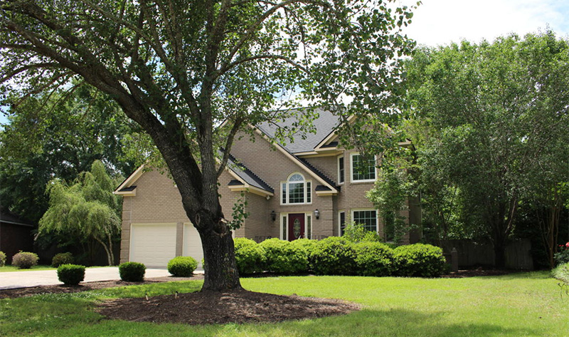
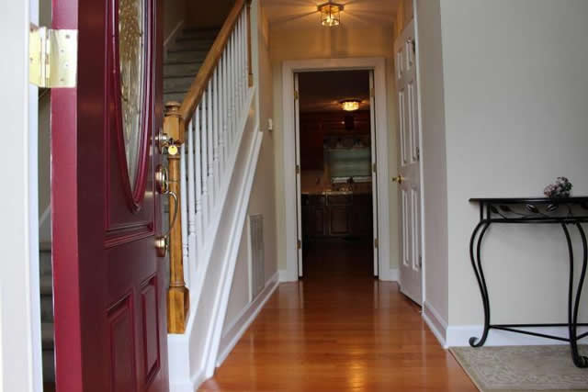
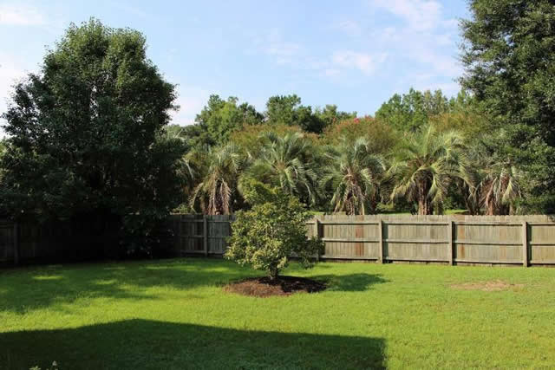
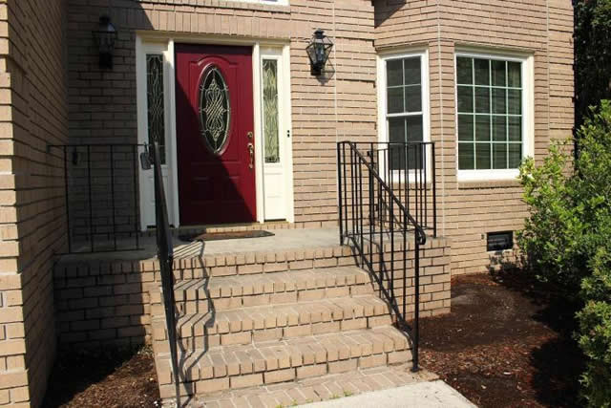
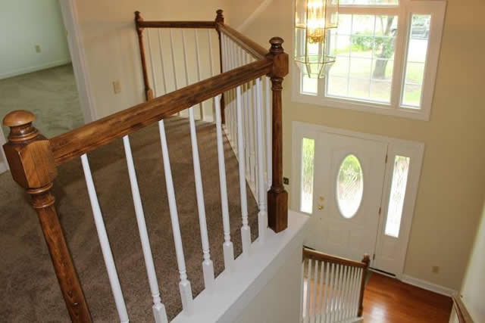
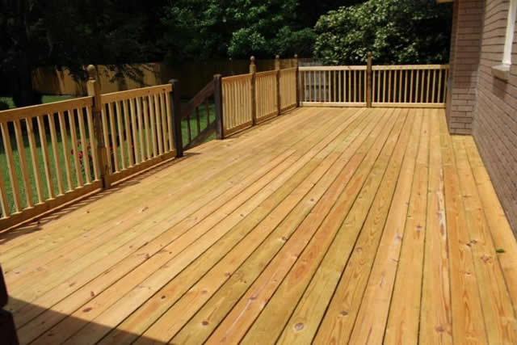
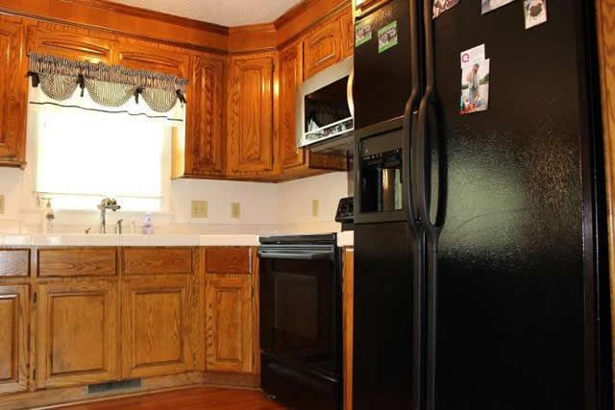
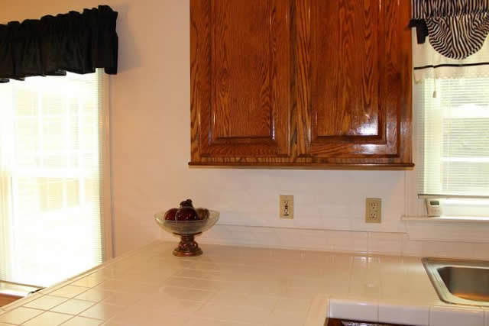
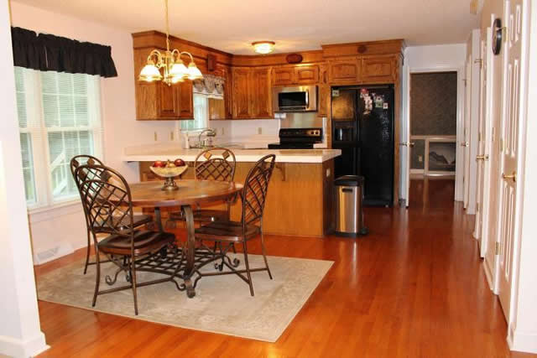
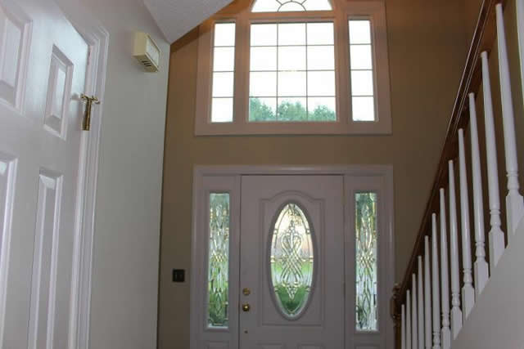


5540 Gallatin Lane Whitehall North Charleston, SC 29420 MLS# 15012294 $289,900
Stunning 2,820 sq.ft. Home in Dorchester II School District! Charleston’s best kept secret in highly sought after Whitehall Plantation neighborhood. Upgrades galore featuring new roof, new carpet, new vinyl flooring in laundry room, new gutters, new front door and sidelights, new garage doors, new garage entry door, new sunroom exterior door, updated guest bathroom upstairs, updated main floor bathroom, newer HVAC system with a 13 seer, over $20,000 Pella windows for Energy Efficient throughout home and more! Spectacular “Custom Built All Brick Home” nestled on a large lot and has an all season sunroom that leads out onto a huge deck that is the length of home and has a great view of beautiful trees. Enormous back yard that allows for the ultimate outdoor living space! Nice kitchen with custom built cabinets and two pantries. Large countertop great for cooking and entertaining. Awesome master bedroom with vaulted ceilings, huge walk-in closet, spacious master bathroom with skylights and boxed window with lots of natural lighting, double sinks, jetted tub and separate shower. Currently there is a Home Warranty. Fantastic location that is only minutes from I-26, Parks, Charleston Air Force Base, Boeing, Charleston Int'l Airport, MUSC, Downtown Summerville, Downtown Charleston and Beaches. You will enjoy living close to lots of shopping and dining. Come see this fantastic home today! Simply beautiful! Truly a must see!
$5,000 Agent Bonus
Gina Brammer
Realtor, CNE, ABR, Seller Listing Agent
843-437-7828
ginabrammer1@gmail.com

