Slide 1
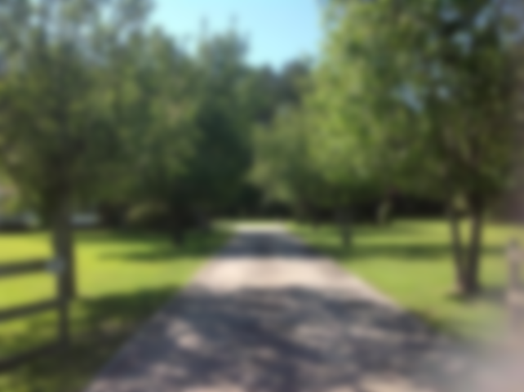
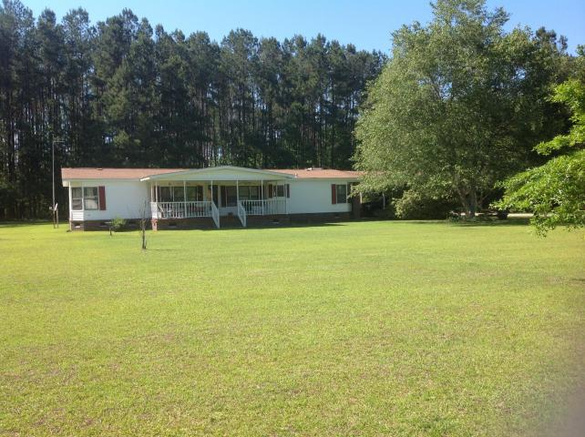
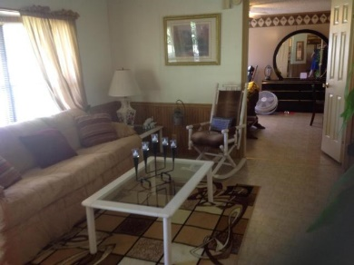
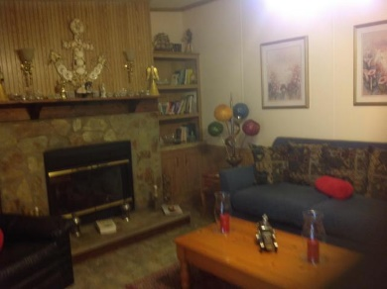
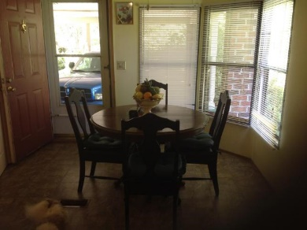
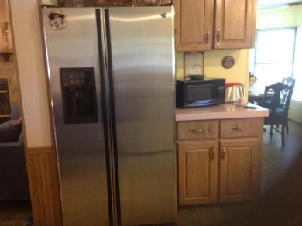
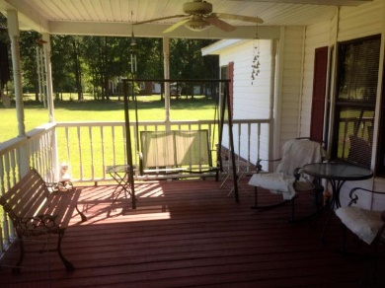
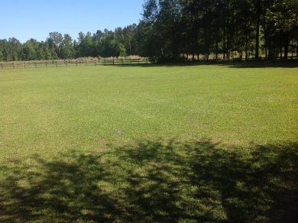
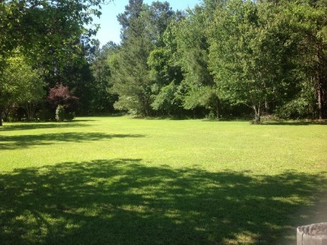
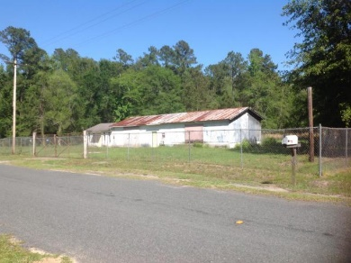

Large Home In Saint George
On Almost Three Acres With Workshop!
554 Old St George Road
Saint George, SC 29477 | MLS# 17012792 | $150,000
3 Beds | 2 Baths | 1,728 Square Feet
Great Opportunity!!! Double wide mobile home with large workshop/shed on additional parcel across the street. It maybe possible to live in one and work out the other if you need space for a business. Property backs up to I95. Well maintained 3/2 mobile home with 2 car carport.
This property is located almost to a dead in street so not much traffic. Buyer and Buyers agent please verify all information of importance.
Carla C Davis
Mobile - (843) 437-4873
gaweber@tds.net
AgentOwned Premiere Group
141 A N. Main Street
Summerville, SC 29483

