Slide 1
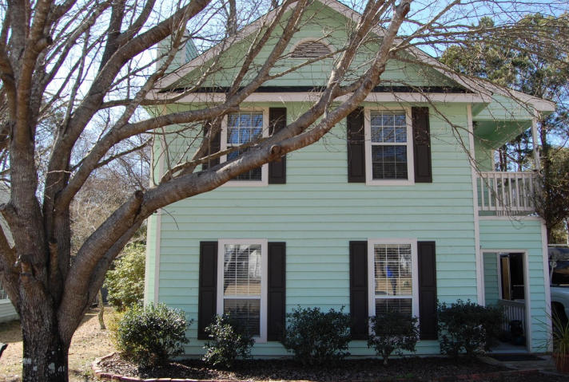
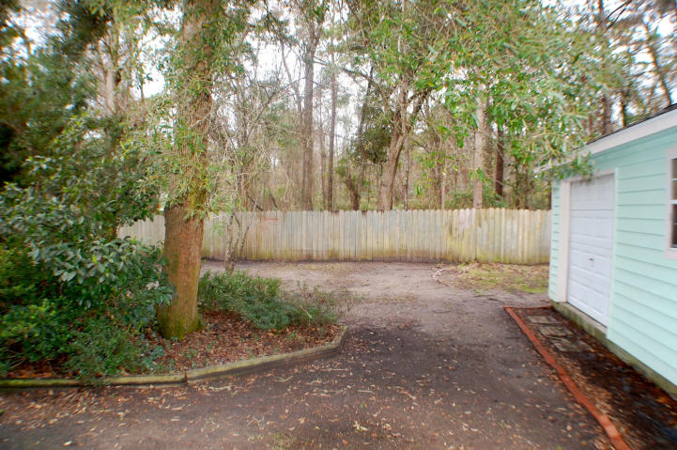
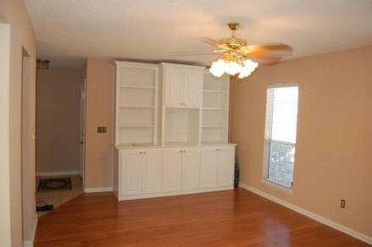
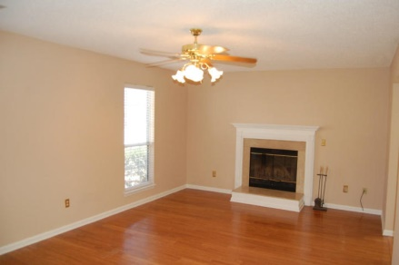
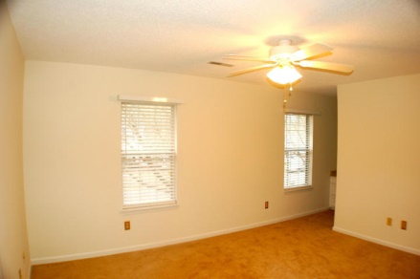
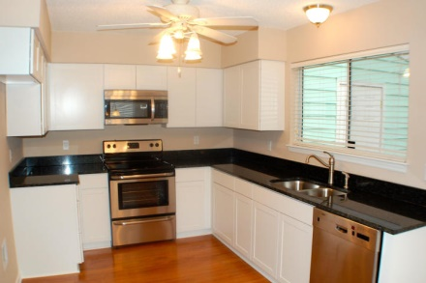
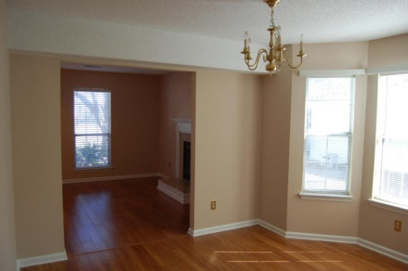
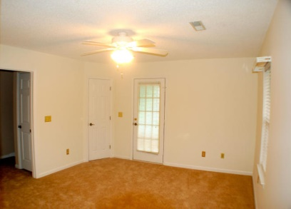
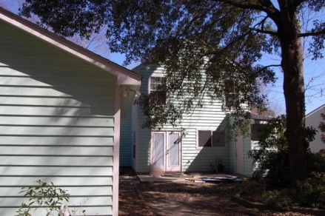
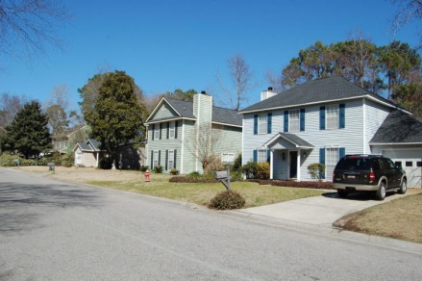


Move Right In!!
555 Castle Hall Rd
Longpoint
Mt Pleasant, SC 29464
MLS# 15004477
$310,000
3 Beds | 2½ Baths
1,478 Square Feet
New Granite & Stainless Steel Eat In Kitchen, New 2013 ROOF, New Carpet and Paint! Walk to the county park. Amazing amenities, pool soccer field, basketball. This one will be gone in 60 seconds!! Large living room 21x14 with wood fireplace opens to dining room w bay window. Charming master up 15x13 with lovely balcony & large walk in closet. Master bath has a soaking tub. Secondary bedrooms both 12x10. HUGE GARAGE 1 1/2 car detached is a wonderful plus! Termite bond in place. No Flood. (per tax docs) 5 minutes to 526. 20 minutes to Boeing. If square footage and schools are a concern please measure and double check.
Di Johnson
843-270-6448
dijohnsonsc@gmail.com
www.agentownedrealty.com
AgentOwned Premiere Group
100 Crowfield Blvd
Goose Creek, SC 29445

