Slide 1
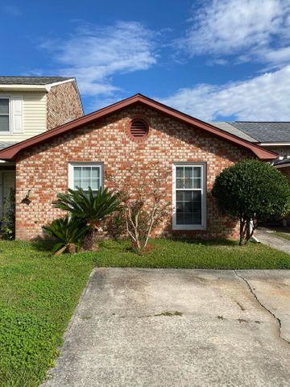
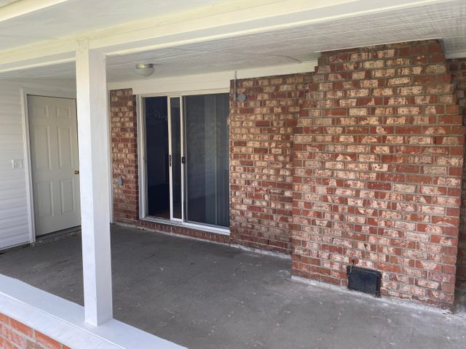
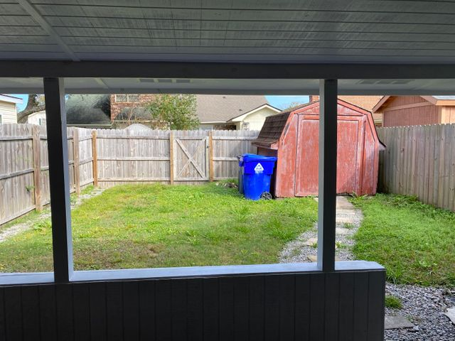
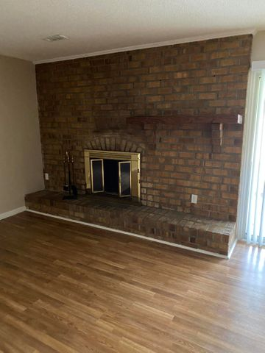
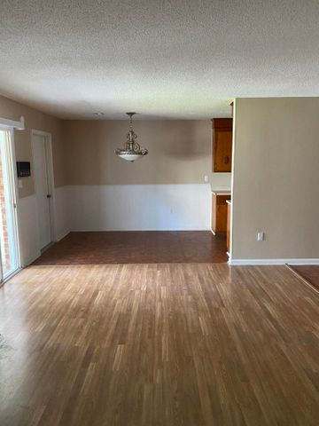
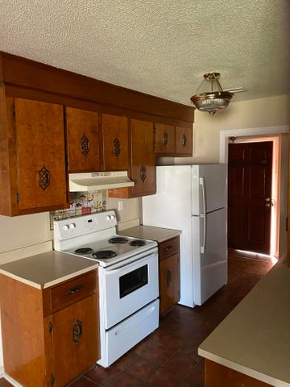
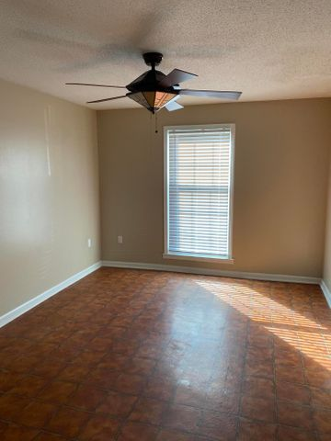
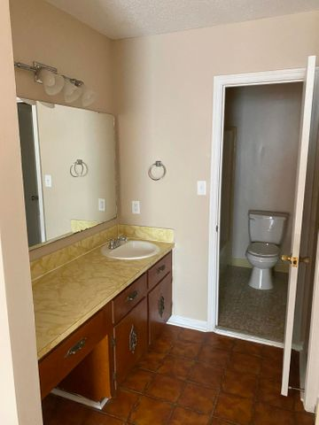
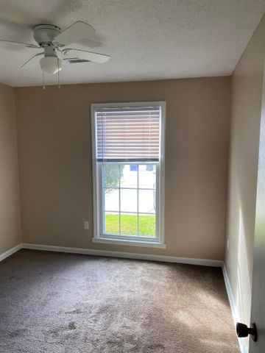


5564 W Shirley Dr Ashley Villas North Charleston MLS# 20031922 $144,500
Open House Saturday
12:00 until 4:00
Lovely 2 BR Townhome In A Perfectly Convenient Location
Open House Saturday 8/24/19
12:00 until 4:00
This is a Lovely 2 BR townhome in a perfectly convenient location. Nicely sized rooms freshly painted, and the Kitchen has solid wood cabinets, new fridge, new dishwasher. The cozy family room includes a brick wood burning fireplace, there is a large laundry room. The back door leads to a covered porch for a nice outdoor setting. The covered porch opens to a small back yard with a wooden privacy fence. The master bedroom has a full bathroom, while the 2nd bedroom has access to a 1/2 bath. You will enjoy barbecues in your backyard. Located Just a few minutes to the Charleston International airport. Conveniently located; shopping, restaurants and interstate nearby and just minutes to Air Force base, Boeing or down town Charleston! Low Regime fee!
James Hopkins
(843) 708-5930
James.Hopkins@AgentOwnedRealty.com
AgentOwned Premiere Group
1800 Trolley Rd
Summerville, SC 29485

