Slide 1
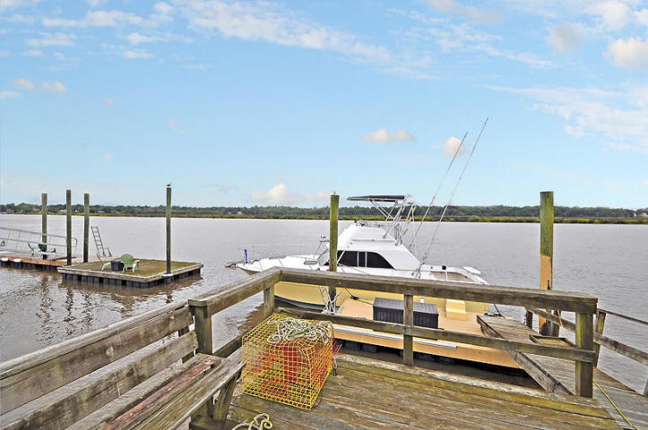
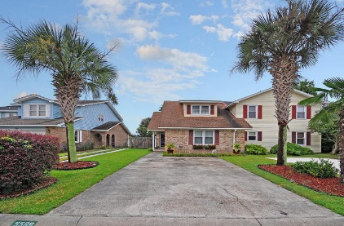
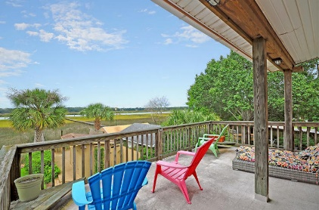
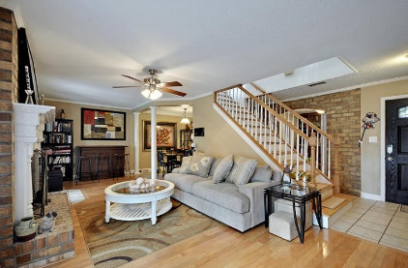
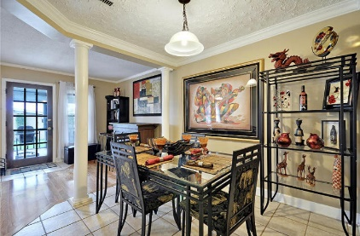
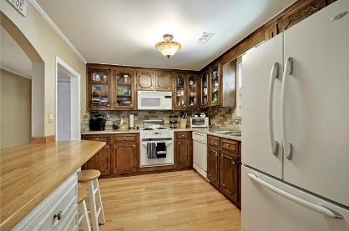
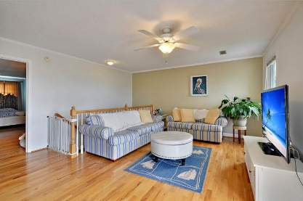
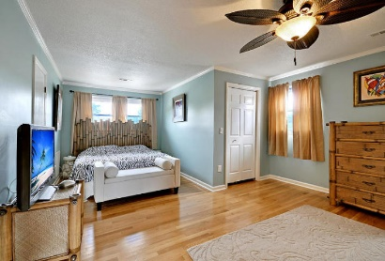
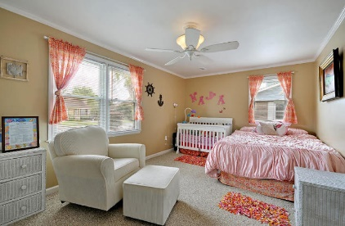

5569 W Shirley Drive
Ashley Villas | North Charleston, SC 29418 | MLS# 15025443 | $319,000
Spectacular Views!
Incredible price for townhouse with PRIVATE DEEP WATER DOCK! Gorgeous 2bed/2bath updated home. The great room has beautiful wood floors and a gas brick fireplace with white wood mantle and leads to a private dining room. The gourmet kitchen has refinished countertops and new tile backsplash, and a beautiful arch brick entrance. Also on the main floor is an oversized bedroom with an abundance natural light. This bedroom has access to the first floor bathroom that has white painted brick. The first floor has glass doors that lead to the screen porch with new ceramic tile and entry to the wonderfully landscaped backyard and private dock with floater. The second floor has a master bathroom with a large walk in closet and private spa like bath with jetted tub and separate shower. In addition, the second floor has a bonus room with wet bar and refrigerator to use while having guest on the second floor deck. There is plenty of room to entertain on the upstairs deck or enjoy a cup of coffee in the morning while enjoying the magnificent views of the Ashley River. Ashley Villas in North Charleston is close to local shopping and grocery stores and is a short drive to downtown Charleston with 5-star restaurants, world class shopping and iconic history as well as only MINUTES to drive to Boeing, the airport, Daniel Island and the beaches. Come take a look, because you will not find another home with a deep water private dock that offers as much as this one: a boater's delight and entertainer's dream!
Stan Huff
843-670-2835
stan.huff@agentowned.com
Jill Marcacci
843-297-5590
jill@agentowned.com
www.agentownedrealty.com
AgentOwned Realty Co. Preferred Group, Inc. | 824 Johnnie Dodds Blvd | Mt Pleasant, SC 29464

