Slide 1
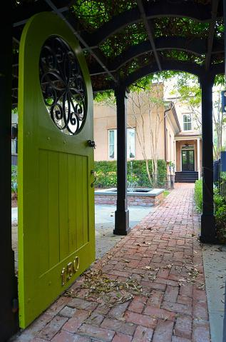
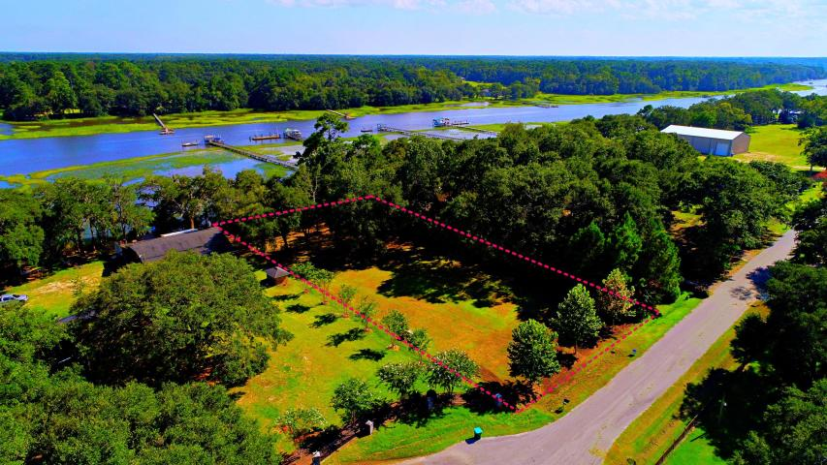
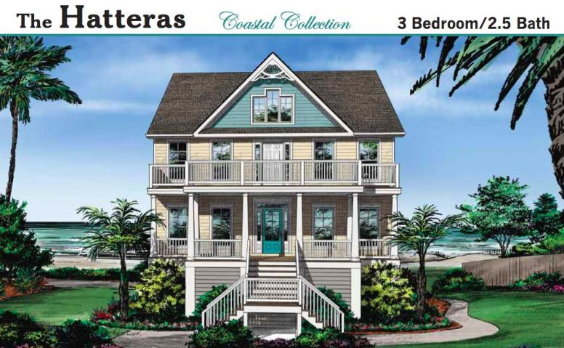


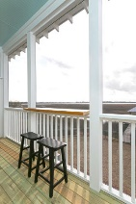
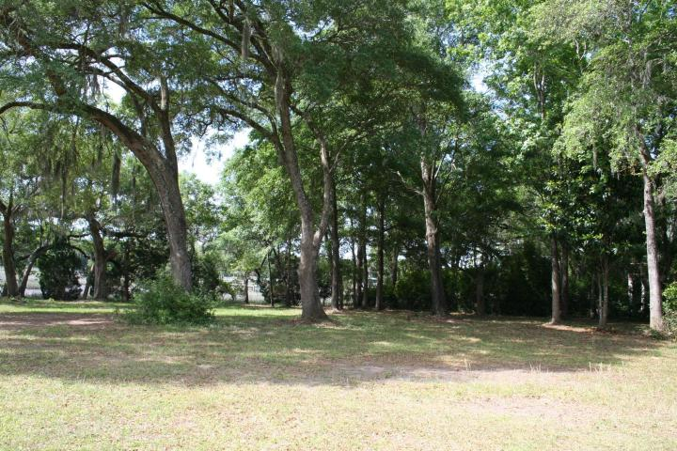
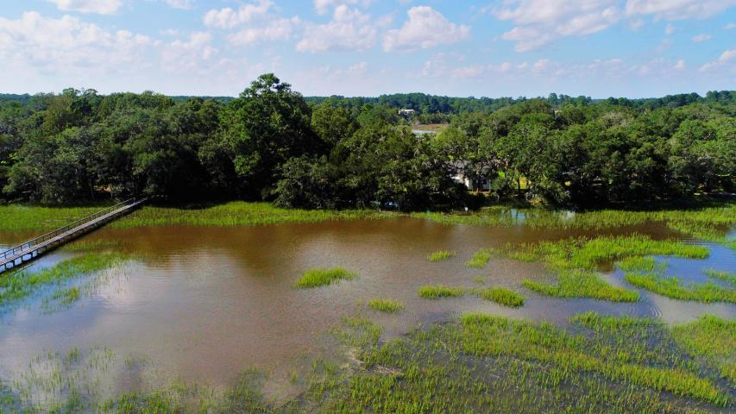
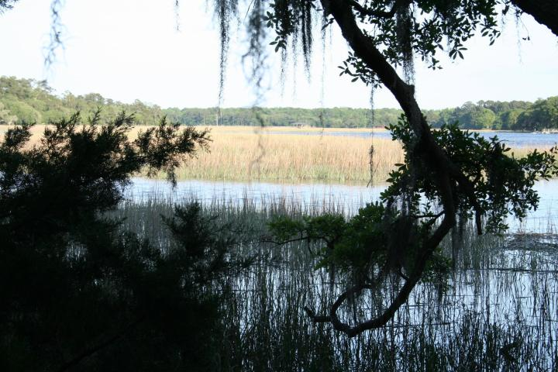




5576 Frisco Lane
Ravens Point Plantation ~ Johns Island, SC 29455
MLS# 17022622 ~ $419,000
Build Your Dream Home on This Beautiful Deepwater Lot
Just Listed
+
Open House
Saturday, March 24th 11-1
**PRICE REDUCED**
Stunning Deep Waterfront lot on Church Creek. Beautiful mature oak trees and magnolia trees are providing wonderful shade to enjoy in the summer months. A Dock permit is in hand. The views of the water are breathtaking and it is very private on the creek. This quiet community is nestled away with what seems like a private paved road. Lot is partially fenced. Flood Maps show located in Flood Zone AE and X minimal. There are NO HOA fees. Trash pickup service is available. Septic System is needed. Electricity is available near road and City water is also accessible. Need to see in person today how gorgeous it really is. Associated Licensee is daughter-in-law of seller.
Andrew Sorrentino
(843) 371-6218
andrew.sorrentino@agentowned.com
Kelly Rozier
(843) 209-3129
kellyscreations00@gmail.com
Brand Name Real Estate
4 Carriage Lane Suite 106
Charleston, SC 29407

