Slide 1
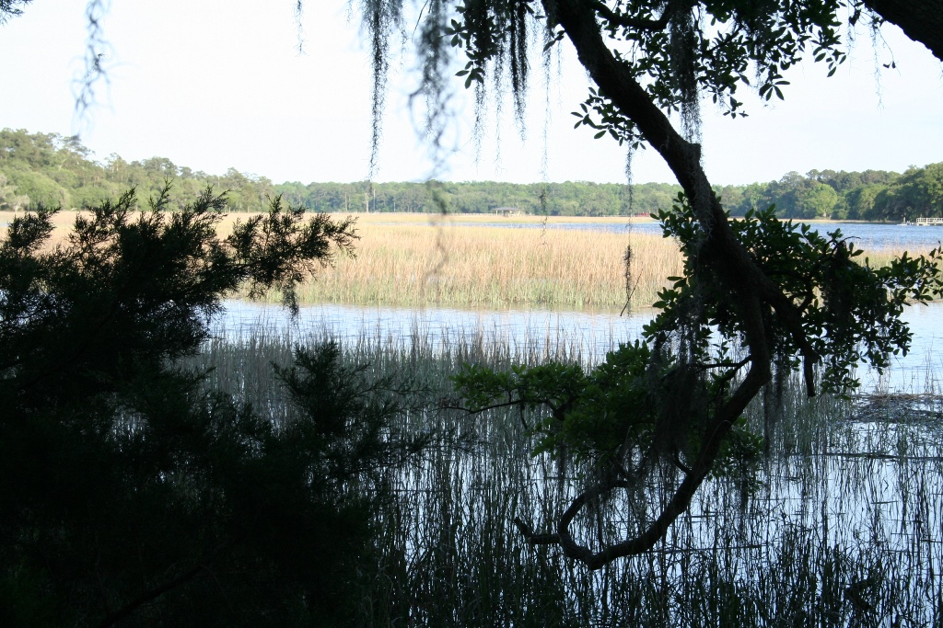
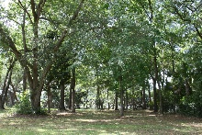
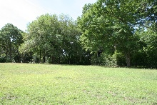
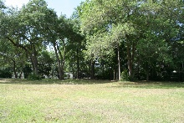
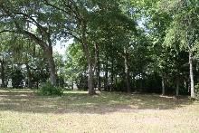
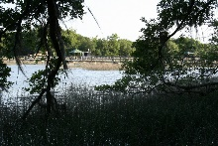
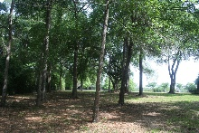
5576 Frisco Ln
$515,000
TMS 220-00-00-099
DEEP WATER LOT FOR SALE ON JOHNS ISLAND!!
Just Reduced!
FOR SALE BY OWNER
If you are looking for a peaceful, waterside location to call home, without the hassle of living in a neighborhood with expensive HOA dues, you don’t want to miss this one! Seldom do properties this nice come on the market. This beautiful, semi-private 0.82 acre waterfront lot is located on Church Creek with easy access to the Intracoastal Waterway. A great home site with a cleared field as well as a wooded area with live oaks and beautiful views of the marsh and water. Dock permit in hand! Visit the location to imagine yourself living in your dream home on this property.
Elbert Rozier
Ph: 843.442.2126
emrozier@bellsouth.net

