Slide 1
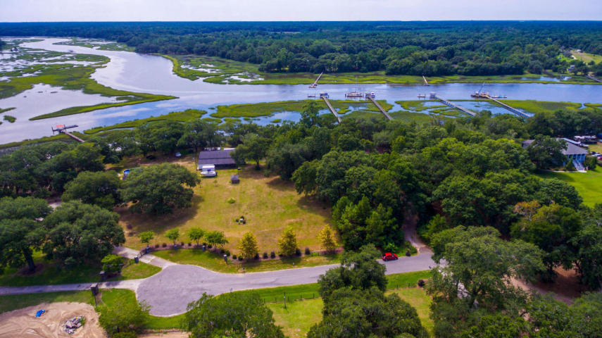
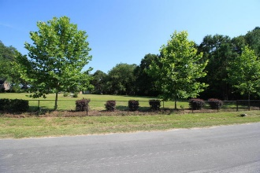
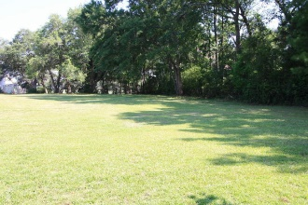
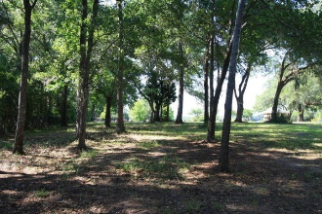
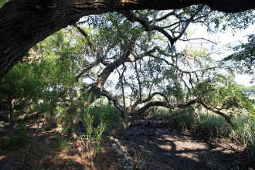
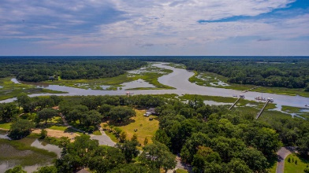
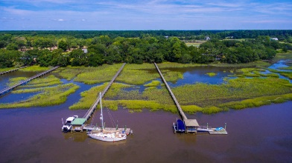
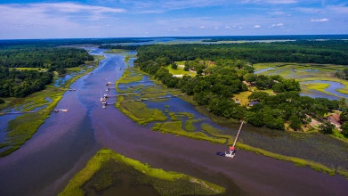
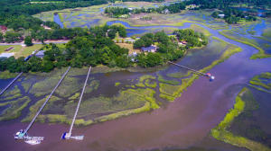
5576 Frisco Ln
Ravens Point Plantation
MLS# 17008862
$475,000
Deep Water Lot For Sale On Johns Island!!
Beautiful deep water lot on Church Creek with easy access to the Intracoastal Waterway. Dock permit in hand! Dock will need to be in the 200+ ft. range. Rare opportunity. Stunning views from homesite. Partially fenced. Beautiful old oaks. Partially cleared with established lawn. Electricity is available and water, but a septic system is needed. The quiet community is only one street long. Flood maps state part of the lot is flood zone AE, while the other part is X, minimal. No HOA fees. Trash pick up is available for a small fee.
Crystal Carlson
(843) 270-8080
crystaljcarlson@hotmail.com
Brand Name Real Estate | 4 Carriage Lane Suite 106 | Charleston, SC 29407

