Slide 1
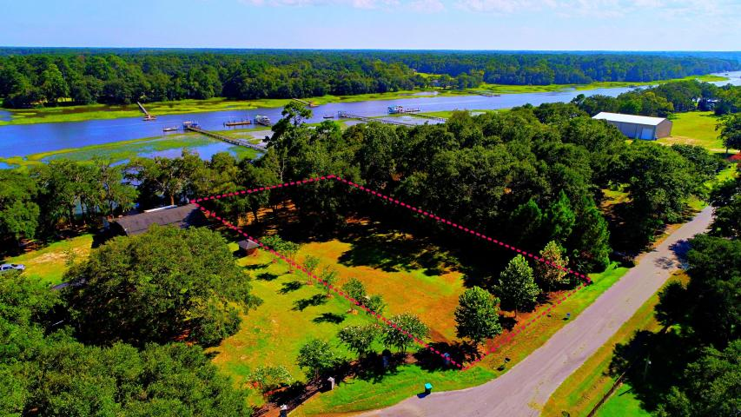
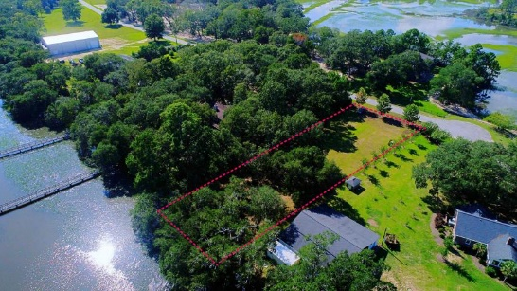
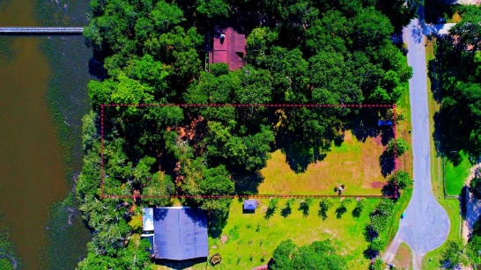
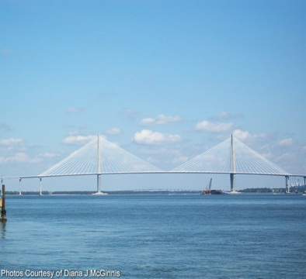
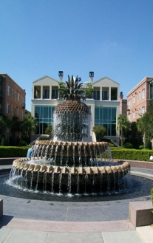
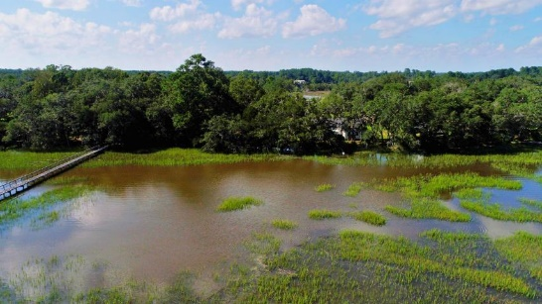
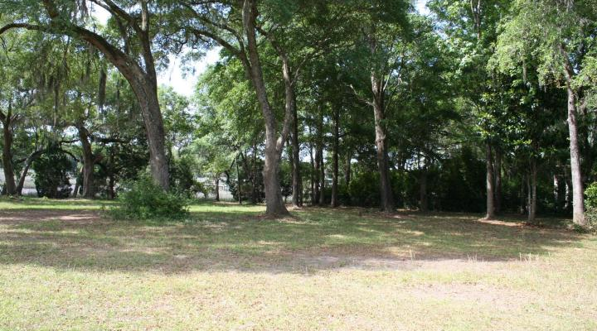
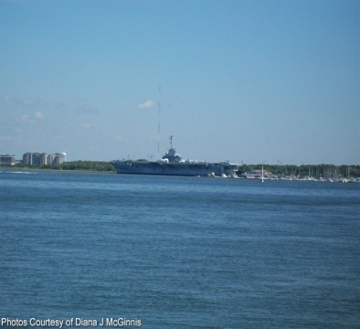


OPEN HOUSE
Sunday April 23
2:00-5:00
$450,000
5576 Frisco Lane
Ravens Bluff · Johns Island, SC 29455 · MLS# 17022622 · $475,000
$450,000
Kelly Rozier
(843) 209-3129
meghankellyteam@agentownedrealty.com
Stunning Deep Waterfront lot on Church Creek. Beautiful mature oak trees and magnolia trees are providing wonderful shade to enjoy in the summer months. A Dock permit is in hand. The views of the water are breathtaking and it is very private on the creek. This quiet community is nestled away with what seems like a private paved road. Lot is partially fenced. Flood Maps show located in Flood Zone AE and X minimal. There are NO HOA fees. Trash pickup service is available. Septic System is needed. Electricity is available near road and City water is also accessible. Need to see in person today how gorgeous it really is. Associated Licensee is daughter-in-law of seller.
AgentOwned Charleston Group
902 Savannah Hwy
Charleston, SC 29407
Real Estate ● Mortgage Insurance ● Business Brokerage

