Slide 1
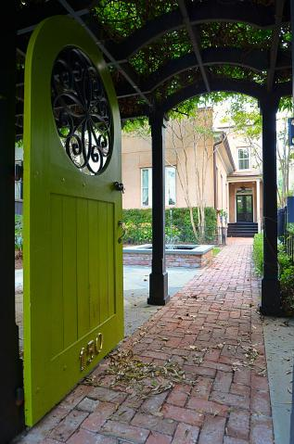
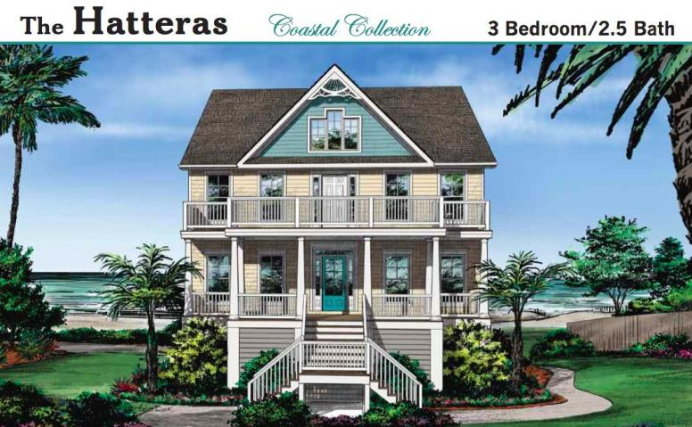

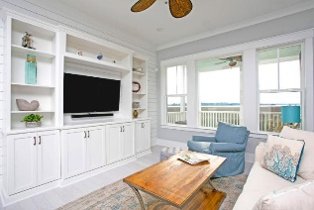

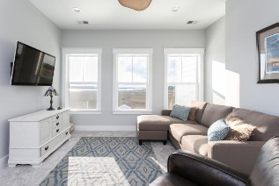
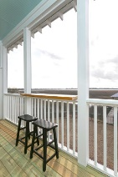



5576 Frisco Lane
Ravens Point Plantation ~ Johns Island, SC 29455
MLS# 17029719 ~ $895,800
Build Your Dream Home on This Beautiful Deep Water Lot
Just Listed
+
Open House
Saturday, March 24th 11-1
Your custom dream home awaits! Enjoy morning coffee with stunning views of Church Creek from the back porch of this one of a kind home. Whether its entertaining or a private retreat, there is plenty of space for both in the Great Room complimented with all of your personal finishing touches. The Master Bedroom has its own private deck, and a huge bathroom with dual master closets. This three bedroom home features separate dining room and study, and an eat in kitchen. Since this home is a proposed construction home, your imagination to design and layout is as large as your wildest dreams.
Andrew Sorrentino
(843) 371-6218
andrew.sorrentino@agentowned.com
Kelly Rozier
(843) 209-3129
kelly.rozier@agentownedrealty.com
The AgentOwned Realty Co | 902 Savannah Hwy | Charleston, SC 29407
Real Estate • Mortgage • Insurance
www.AgentOwned.com

