Slide 1
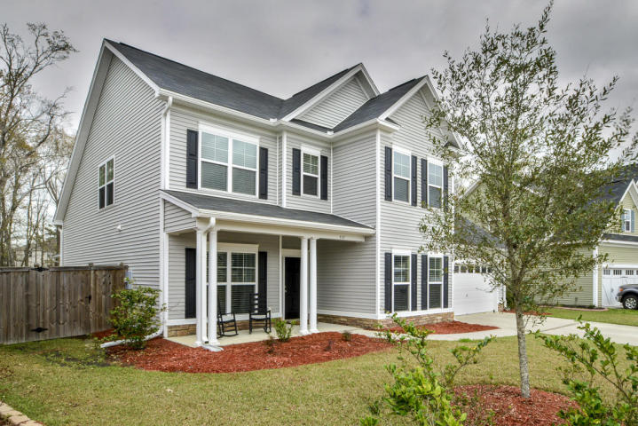
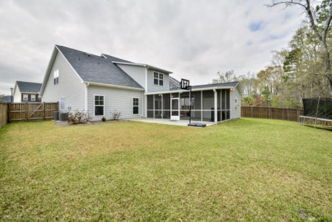
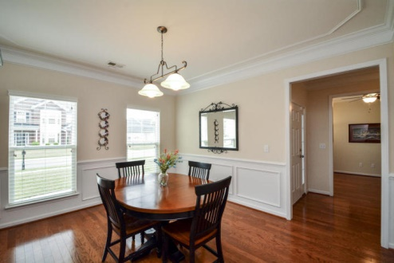
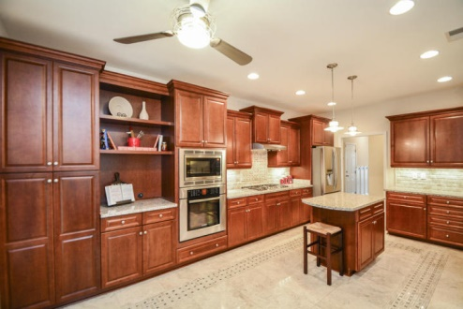
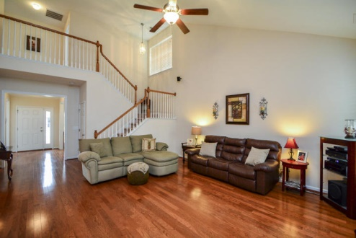
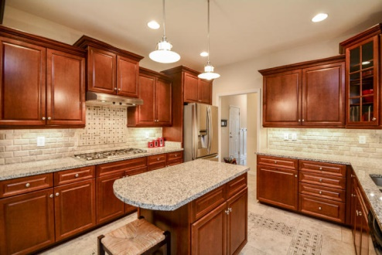
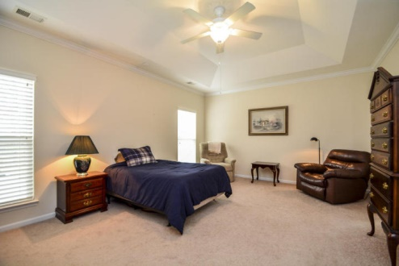
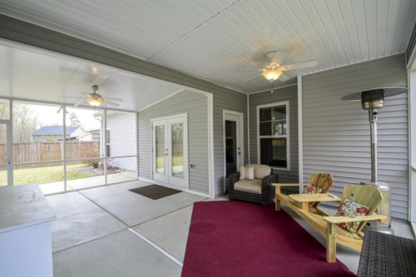
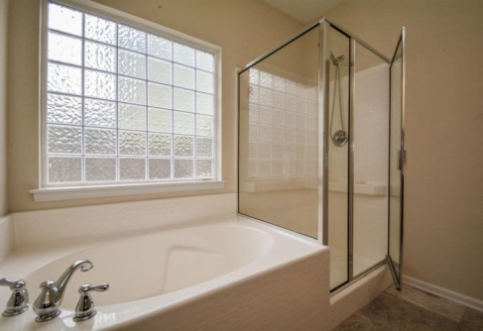
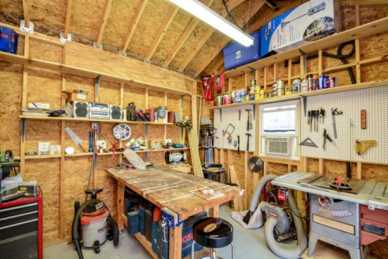

This One Won’t Last!
Price Reduced!
557 Chaff Lane
Spring Grove Plantation ~ Moncks Corner ~ MLS# 15007663 ~ $299,000
This gorgeous 5 bedroom, 3.5 bath family home with over 3,200 square feet of living space, located in the quiet Fishers Wood subsection of the Spring Grove Plantation, is sure to impress guests and family members alike. The floor plan includes dual master suites (one upstairs, one downstairs), a bonus room, formal living and dining rooms, 2-story great room, a spacious laundry and walk-in pantry, office, and plenty of storage space. Throughout the home, you’ll find amazing high-end touches, such as the stunning Italian marble flooring in the kitchen, breakfast area, bathrooms, and laundry room, and gleaming hardwood floors throughout the living area, as well as intricate molding. This home is ideal for entertaining. The spacious eat-in kitchen features granite countertops, granite-top island, top-of-the-line stainless steel Bosch appliances, custom tile backsplash above the Bosch 5-eye gas range, and gorgeous wood built-in cabinetry. Additional custom cabinetry and built-in shelving throughout the kitchen and breakfast area mean you never have to go into storage to locate fine china, or additional dishes and cookware. The kitchen opens up to the downstairs living room, which provides a welcoming, cozy feel with its natural gas fireplace and ample windows that provide natural lighting. The office boasts tons of space and features an oversized window looking out to the full front porch, and comes equipped with 2 dedicated phone lines. The laundry room is an absolute dream with loads of cabinetry, granite countertops, and hanging space. Natural light floods into the expansive dual master suites, which both have access to incredibly spacious walk-in closets to please even the biggest shoe lover! The master baths impress with large oval soaking tubs and enormous stand-up showers. In addition, 4 of the bedrooms have walk-in closets, and each full bath features convenient dual sinks. There is even a climate-controlled storage space off this bonus room! One of the most spectacular areas of this home is the spacious 24x32 screened-in outdoor living space wired for cable TV. It's your own private oasis with a panoramic view of the peaceful, private wooded backyard as well as the extended patio… there is even a large 12x12 workshop room attached with its own electric and water line. Other home features include 2 HVAC units with 3 zones (1 just for the master bedroom), 2-door garage, and tankless hot water heater. Call to view this absolutely amazing home today…it won't be on the market long!
Nate Gainey nate@mattoneillteam.com 843-513-2038

