Slide 1
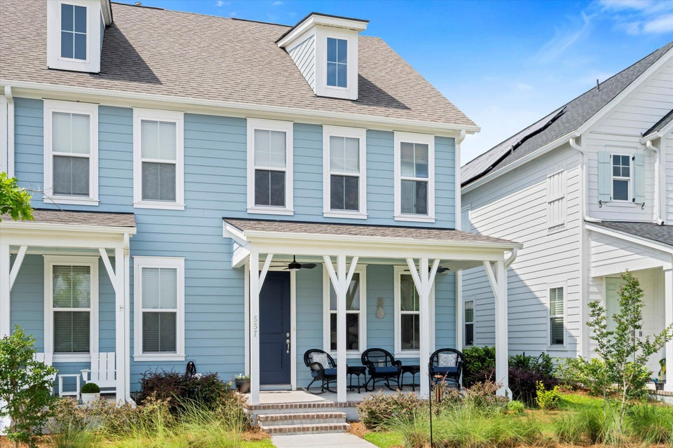
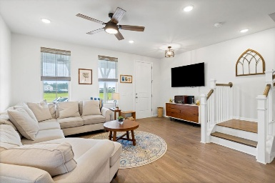
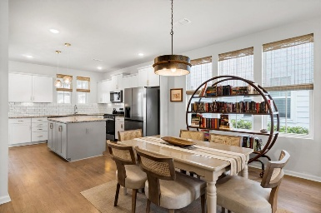
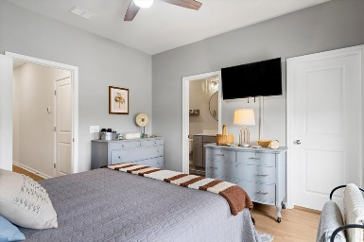
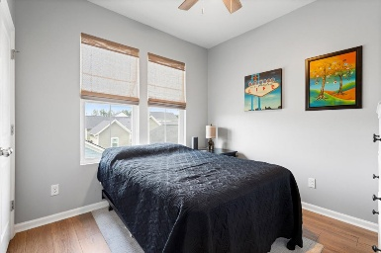
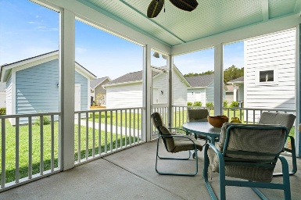



557 Blueway Avenue Nexton | Summerville, SC 29486 | MLS# 25015003 | $374,500
Just Listed - Midtown at Nexton
Welcome to 557 Blueway Avenue in Midtown at Nexton. This charming and modern home is a perfect blend of style and functionality, ideal for comfortable living. Step inside to discover a spacious open-concept first floor, creating an inviting atmosphere. The dining area is highlighted by updated lighting, perfect for gatherings. The kitchen shines with white cabinetry, a granite countertop, stainless steel appliances including stainless steel appliances, gas stove, and a convenient island, making meal preparation a delight. Retreat upstairs to the serene master bedroom, featuring newly installed flooring for a relaxing escape. A second bedroom is accented with vibrant artwork, adding personality to the space. The home includes a well-appointed laundry area with a stacked washer and dryer, ensuring practicality. The bathroom features a clean, modern design with a bathtub and tiled walls. Outside, the inviting front porch and well-maintained lawn enhance curb appeal, set against the backdrop of a peaceful neighborhood with detached garage in the back. With the brand new Nexton Middle School under construction nearby, don't miss this opportunity to own a beautifully designed home
Lehe Fender 803-664-1129
lfender@carolinaone.com
Carolina One Real Estate
628 Long Point Rd.
Mt Pleasant, SC 29464

