Slide 1
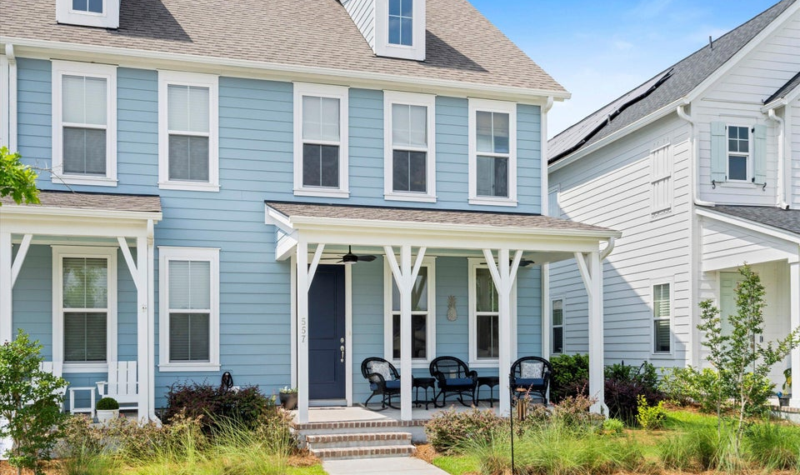
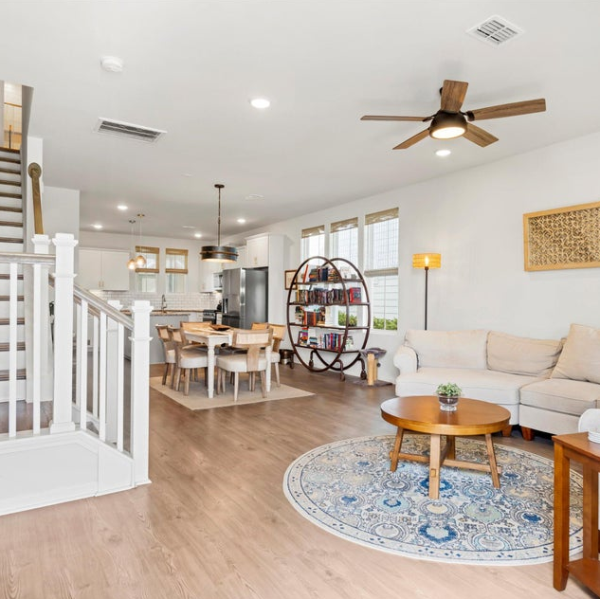
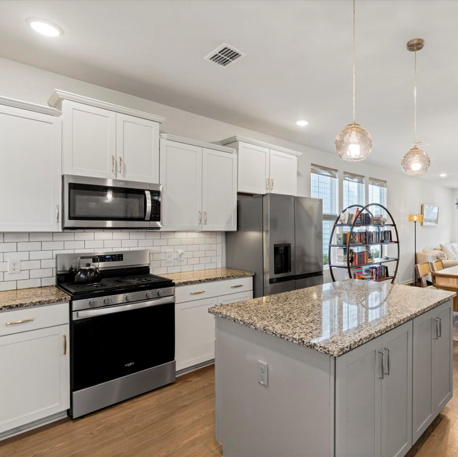
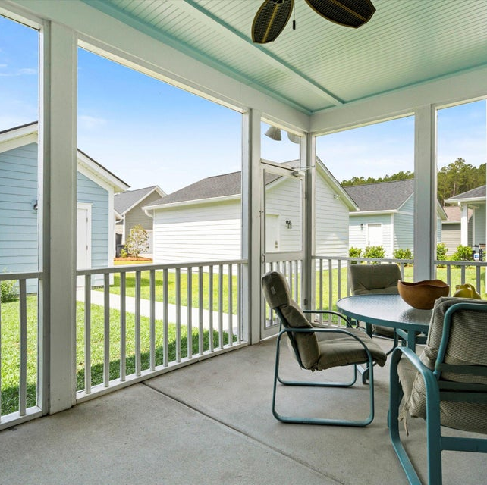



'■•■••
-- ---� -
I I
I I
OPEN HOUSE SATURDAY 12-2PM
ABOUT THE PROPERTY
557 Blueway Avenue, Summerville, SC 29486
Welcome to 557 Blueway Avenue in Midtown at Nexton. This charming and modern home is a perfect blend of style and functionality, ideal for comfortable living. Step inside to discover a spacious open-concept first floor, creating an inviting atmosphere. The dining area is highlighted by updated lighting, perfect for g atherings. The kitchen shines with white cabinetry, a granite countertop, stainless steel appliances including stainless steel appl iance s, gas stove, and a convenient island.
$370,000
3 BEDS
e 2.5 BATHS
3 BEDS
2.5 BATHS
1440 SQ FT
$370,000
Luxe Living
� 1440 SQ FT
www .Iehefender.ca roIina one. com

