Slide 1
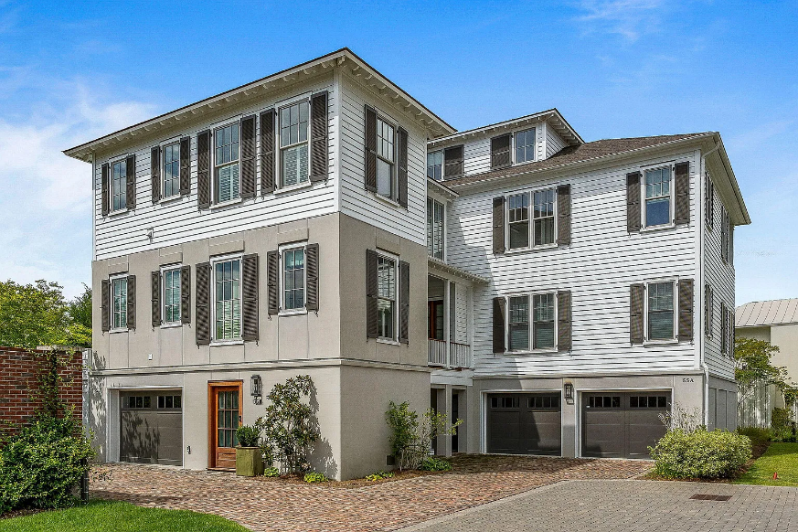
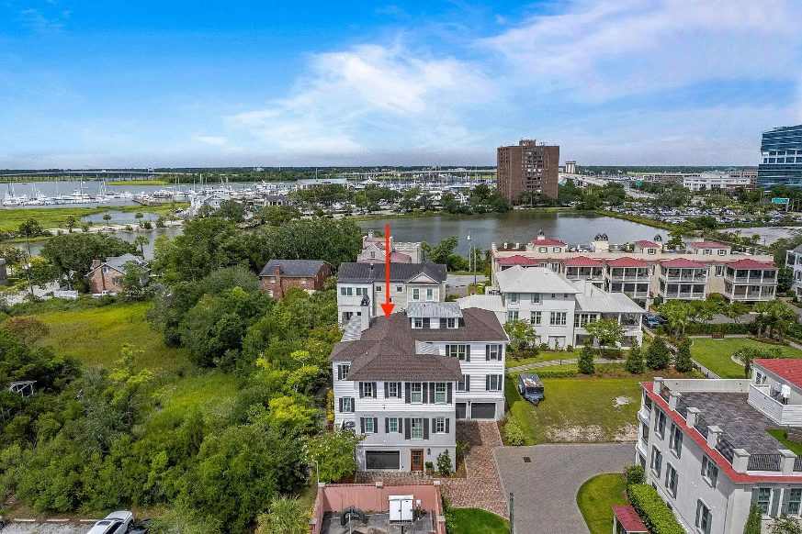
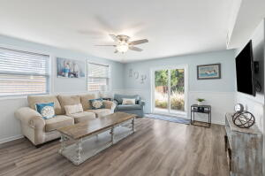
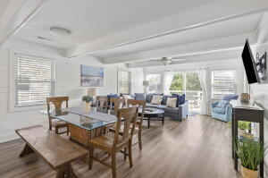
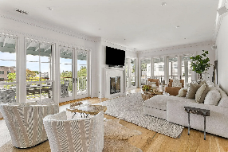
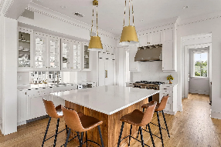
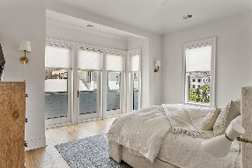
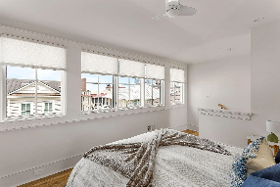
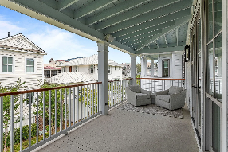
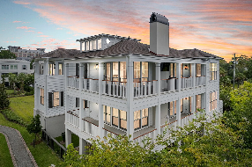
55 Barre Street B
Harleston Village | Charleston, SC 29401 | MLS# 24022811 | $2,220,000
Darrell Creek Elevated Home With Elevator & Salt Pool
Downtown Charleston-- 3/2 condo Stylishly FURNISHED
OFFERED FULLY FURNISHED. Stunning and stylishly furnished condo (in two-unit building) with sleek, high-end design in beautiful Halsey Park -- near the Ashley River and south of Calhoun St. Designed and built by renowned architect, Beau Clowney, and Bennett Hofford Construction respectively. Enter from the ground level and take stairs or elevator to the main floor of the home. Upon entry, you'll notice walls of windows that provide for an abundance of natural light and picturesque Lowcountry views. The home features beautiful hardwood floors that carry on throughout the home (except in the baths, which have tile flooring) as well as custom lighting and plumbing fixtures and custom cabinetry throughout. Central to the family room is a gas fireplace with stone surround and hearth.
French doors on two walls access the wrap around piazza. The family room is open to the kitchen and its adjacent dining area. The kitchen features high end cabinetry; Quartz countertops; an island with ample seating; and high end appliances, including a Wolf range and paneled Sub-Zero refrigerator. Beyond the kitchen is a multi-functional Butler's pantry that includes an abundance of cabinet storage space, a wet bar, beverage refrigerator, and built-in desk. The primary bedroom features a vaulted ceiling and accesses a small private porch with views of the lake. The primary bathroom has a double-sink vanity, soaking tub with wainscoting surround, and separate shower with tile surround and flooring. The hallway to the 2nd bedroom has a bank of built-in cabinets for plenty of storage space. The 2nd full bathroom is shared among guests. The private, sunlit 3rd bedroom and en suite bath are upstairs and feature views of the marsh and the Ashley River. Custom Sonos sound system and security system convey.
Just blocks from the Ashley River, the city marina, Colonial Lake, several parks, Medical University of South Carolina, and many downtown shops and restaurants. Very special property!
Check out the listing for more details and photos!
Andrea Rogers
(843) 532-3010 | andrearogers1@gmail.com | www.andrearogersrealtor.com
AgentOwned Preferred Group | 1400-G Palm Blvd | Isle Of Palms, SC 29451

