Slide 1
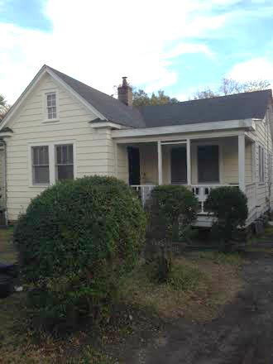
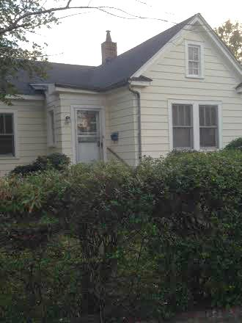
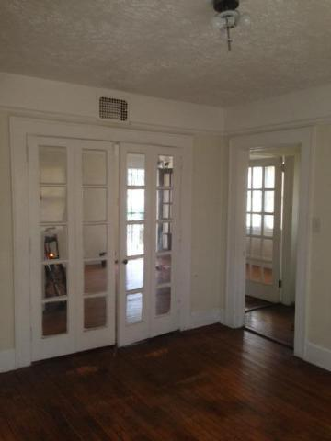
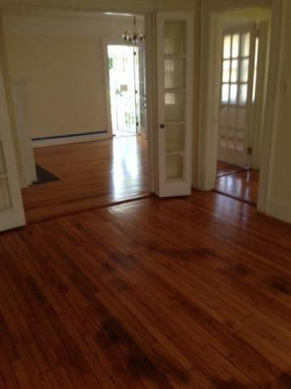
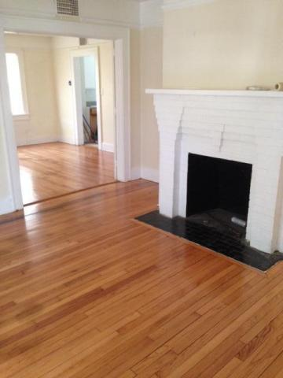
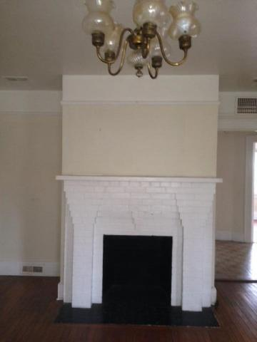
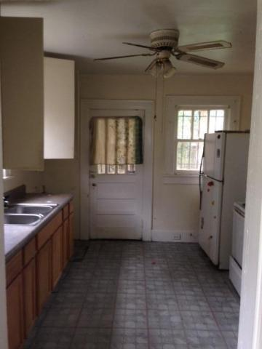
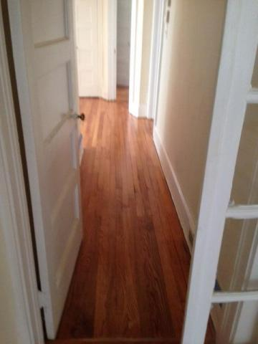
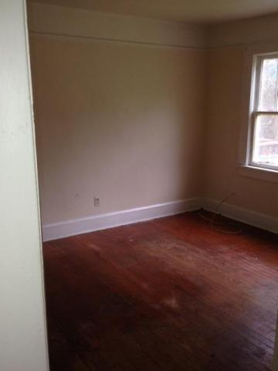
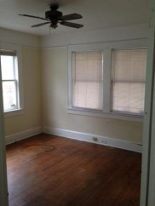
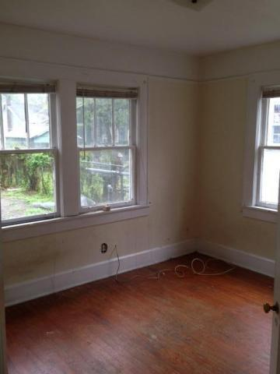
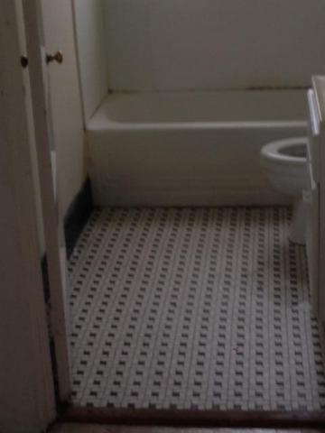
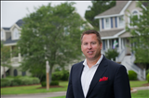

Ready to Show ~ Hardwoods Refinished
55 San Souci St
North Central
Charleston, SC 29403
MLS# 14031666
$389,800
Floors just refinished! Beautiful and well maintained home in well sought after North Central. Mature landscaping and great opportunity to customize this home. Great flow of space, galley kitchen and large back yard. Unique custom features and transoms. This home is in the heart of the extremely sought after North Central and Wagener Terrace areas. 3 bedrooms, 1 bath and can be modified (verify changes with builder/architect). Home is listed at higher taxes because it is currently a rental property.
Danielle Cook (843) 425-9357 danielle.cook@agentownedrealty.com
Bryan Thompson
Office - (843) 769-5100
Mobile - (843) 452-1686
bryan.thompson@agentownedrealty.com
www.bryanthompsonrealestate.com
AgentOwned Charleston Group | 902 Savannah Hwy | Charleston, SC 29407-7802

