Slide 1
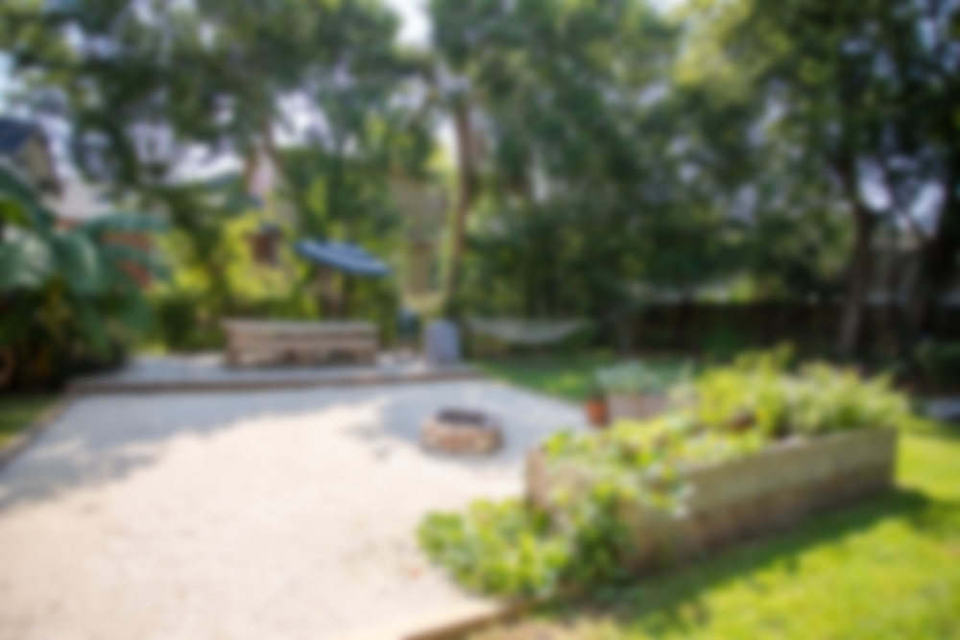
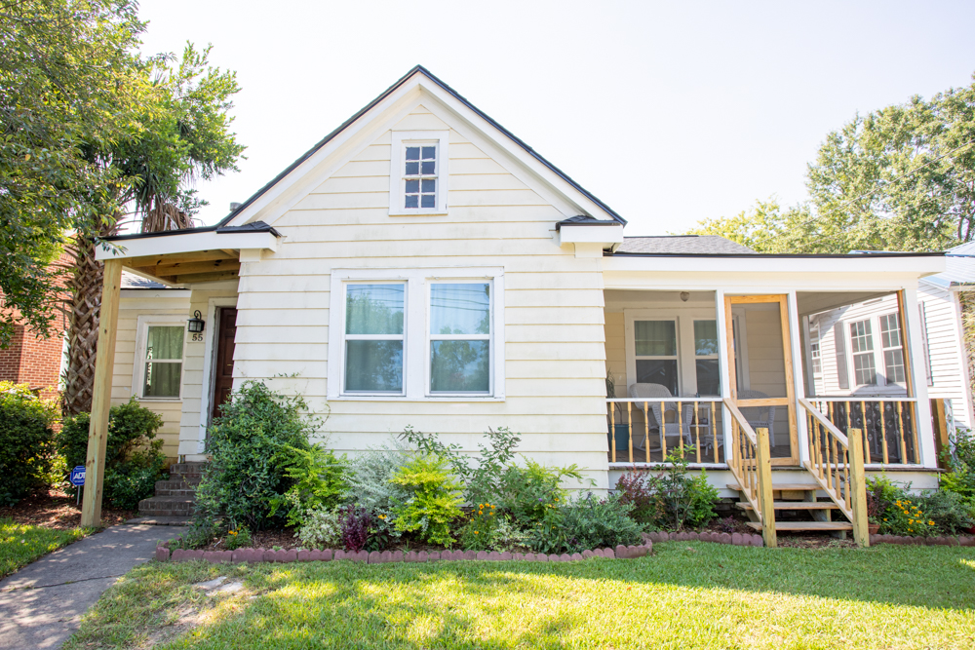
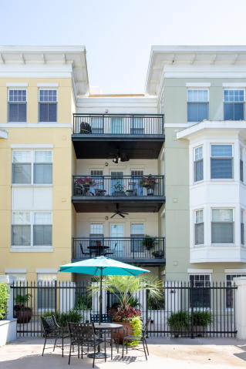
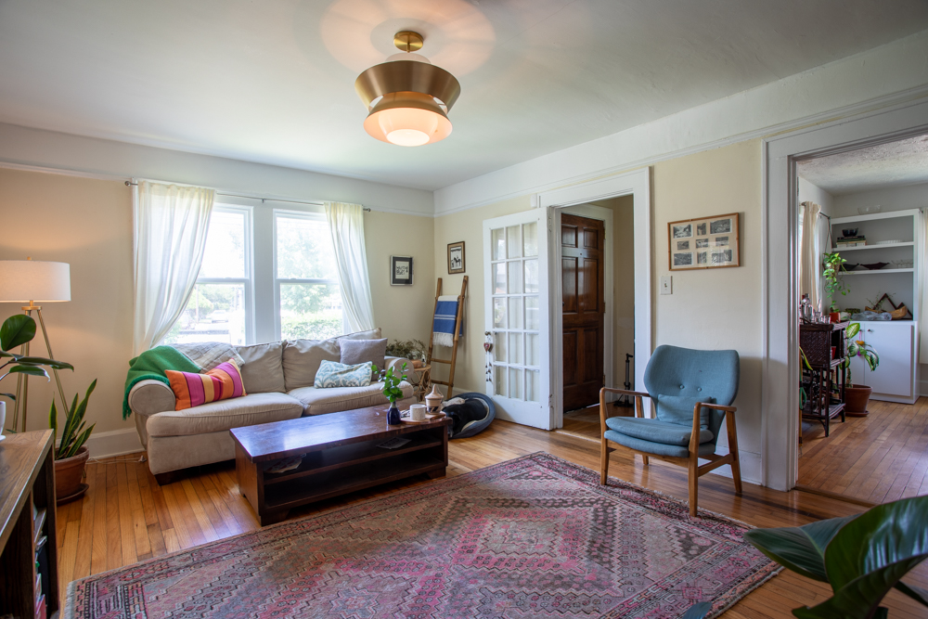
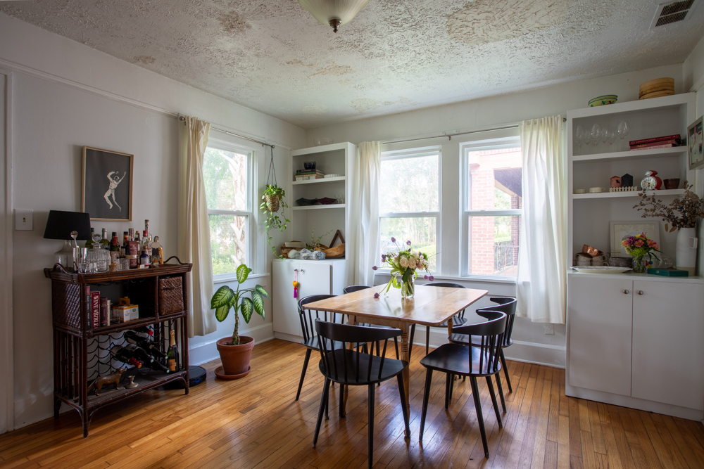

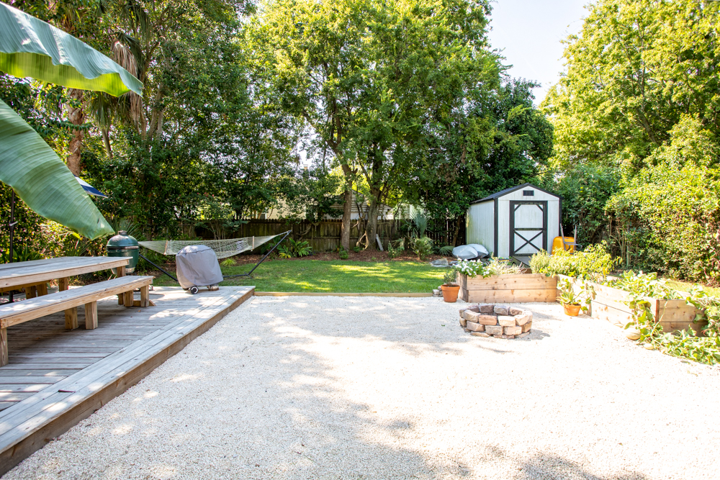
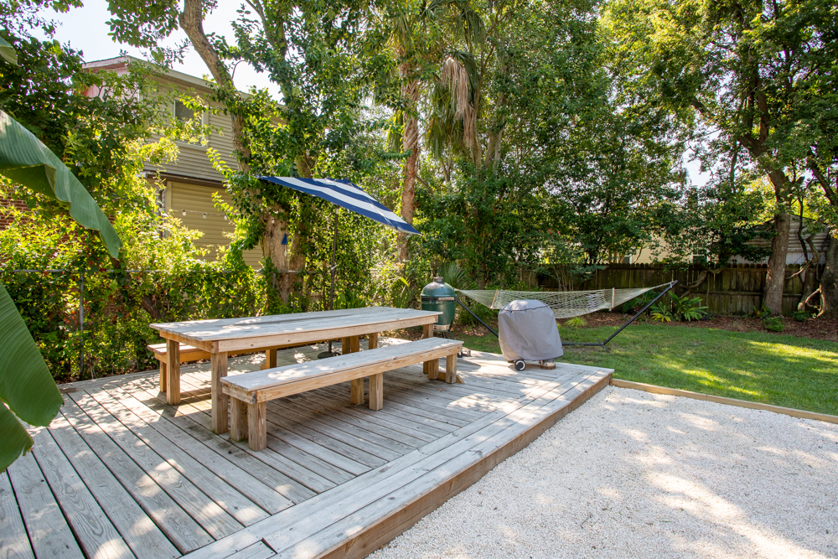
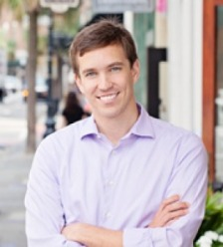

DRAFT
***Off Market North Central/Wagener Terrace Home***
55 San Souci St Charleston, SC 29403
$449,000
3 bed/1 bath
1,300 sq ft
0.15 acres (one of largest lots in neighborhood)
Built in 1938
Greg Gelber
(843) 494-2354
greg.gelber@agentownedrealty.com
AgentOwned Charleston Group | 902 Savannah Hwy | Charleston, SC 29407-7802

