Slide 1

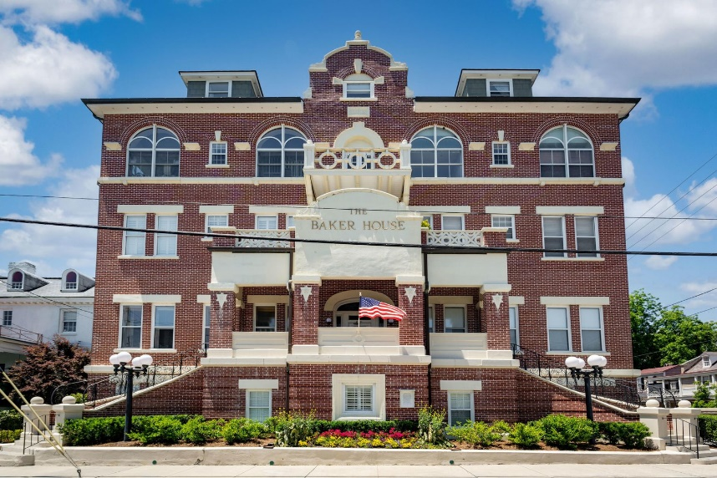
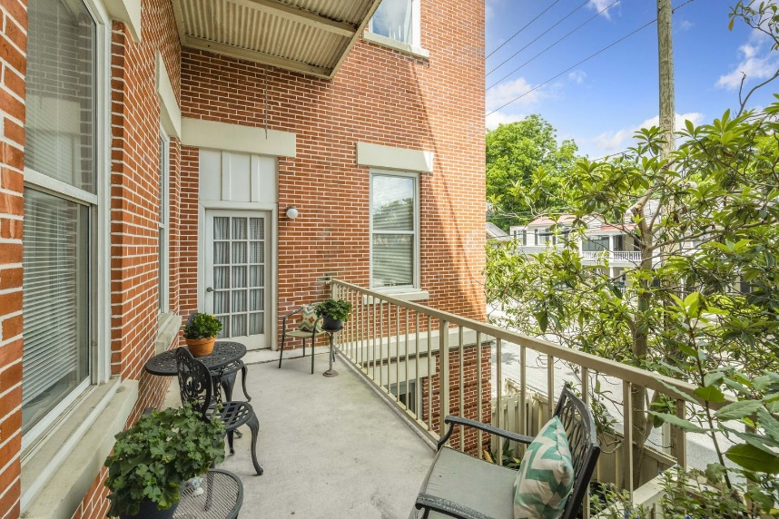
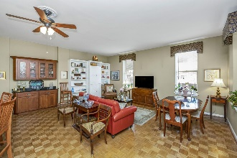
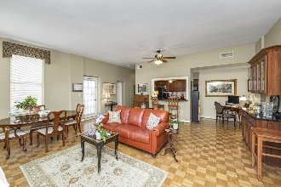
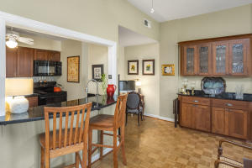
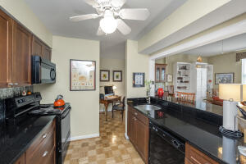
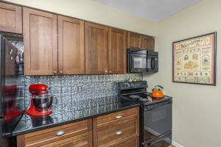
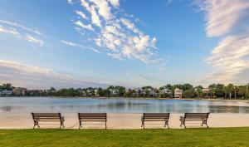
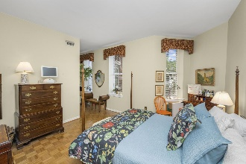
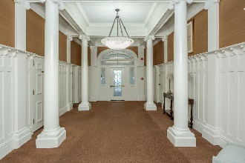
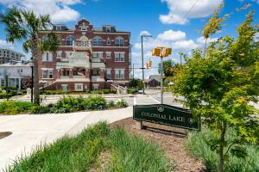
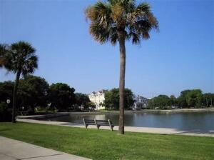


New Downtown Condo Listing!
55 Ashley Avenue #9
Harleston Village | Charleston, SC 29401 | MLS# 21015237 | $535,000
Old World Charm in the heart of Harleston Village. This 1 bedroom 1 bath unit in The Baker House is a great opportunity to enjoy owning a Charleston historic property with all the modern conveniences you’d expect. Spacious living area enjoys 12 ft. ceilings and wood parquet flooring. Oversize windows provide natural light, and the side entry terrace balcony is a perfect city escape. Catch the chiming of church bells across Colonial Lake. Walk, jog or enjoy picnics and fishing on the lake. Minutes to the Charleston Medical Complexes and College of Charleston. Walking distance to shops, art and world-class Charleston dining. The Baker House was built in 1912 with architectural Mission Revival construction. It served as a hospital and nursing school and converted to condominiums in the 1980’s.
Video Tour: https://youtu.be/fJZD8uV4uGg
Joanne Brockway 843-425-8273
jbrockway@kwchs.com
joannebrockway.com
Keller Williams Realty Chas. Islands
1304 Palm Blvd
Isle Of Palms, SC 29451

