Slide 1
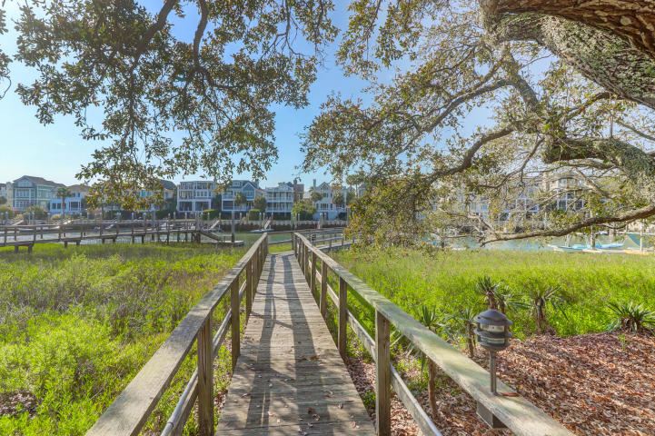
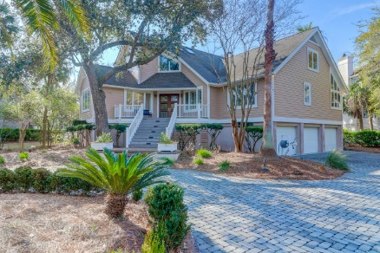
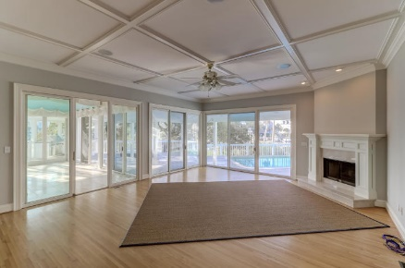
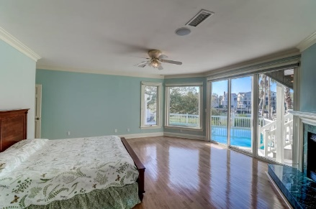
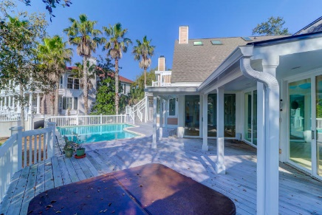


55 Waterway Island Drive
Wild Dunes | Isle of Palms, SC 29451 | MLS# 20008059 | $2,330,000
MOTIVATED SELLER!! REDUCED 150K!
Deep Water Dock, Pool and Custom Home in Wild Dunes
Amazing views of Morgan Creek with Deep Water Dock, heated pool, Jacuzzi and out door kitchen perfect for entertaining with family and friends! Amazing views from most every room. Tons of light streams into this home from the many windows, doors and skylights giving the feel of living outdoors. This spacious home's master suite has magnificent views of the Creek and direct access to the deck to enjoy that midnight swim or the evening breezes. From the beautiful pavers in the circle drive, manicured lawn, the gorgeous entry doors to the spaciousness this home offer--any buyer would be impressed. This sought after location is one that doesn't come around often.
Darlene Smith
Office - (843) 886-8110
Mobile - (843) 696-7824
darlenesmith@carolinaone.com
DarleneSmithTeam.com
Carolina One Real Estate
1503 Palm Blvd Ste
Isle of Palms, SC 29451

