Slide 1
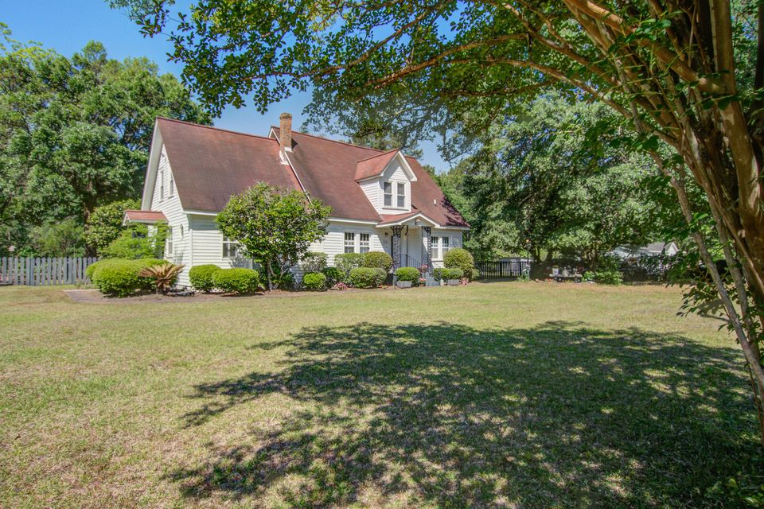
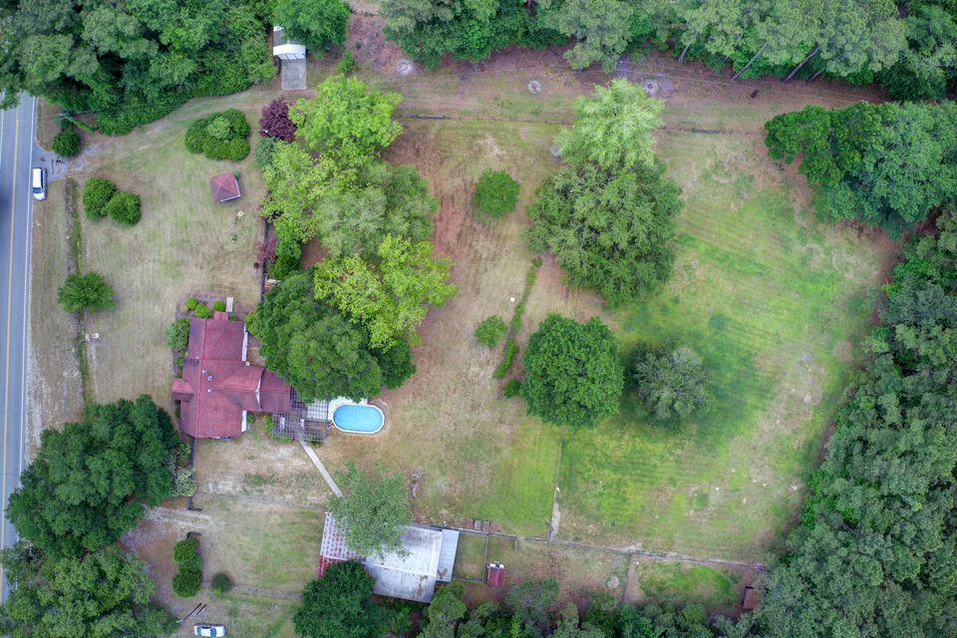
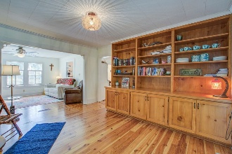
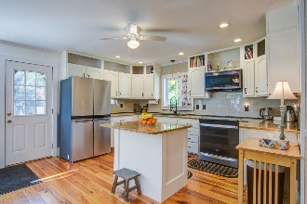
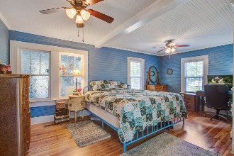
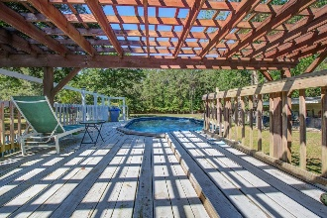
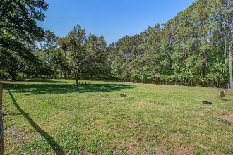


Just Listed with 3.75 ACRES!
5615 Highway 165
Ravenel, SC 29470 | MLS# 25012098 | $824,999
Welcome to country living! Lovely oasis where you can keep your goats, horses, chickens, and other livestock in the beautiful pastures behind this quaint country home. This price also includes TMS# 188-00-00-229 which is 1.88 acres to give the new owner 3.75 acreage total! This 1936 farmhouse has been modernized but still has the old charm of the original home. Entering the front door you're greeted with beautiful heart-of-pine floors, bead board, and built-ins. A cozy front sitting room with fireplace, sun room, dining room, formal living room/parlor, and the updated kitchen blends well with the original features. The owner's suite located on the first floor has a nice sized walk-in closet, dual vanity, garden tub, and walk-in shower. Laundry room conveniently located on first floor.
Upstairs you'll find a large den/family room that makes a great art/media room or man-cave, two secondary bedrooms, and a full bath. The outdoor spaces include large screened porch, deck, and patio area with pergola. A garage/workshop with tons of storage and space for projects. There's a transferable termite bond in place, and crawlspace has had extensive work to support the structure and has been encapsulated with a dehumidifier installed for maximum crawlspace upkeep. Schedule your showing to see this beautiful piece of country living.
Sharee' L. Washington
843-475-0399
sharee@shareewashington.com
www.schomespecialists.com
Carolina Elite Real Estate | 706 N Cedar St | Summerville, SC 29483

