Slide 1
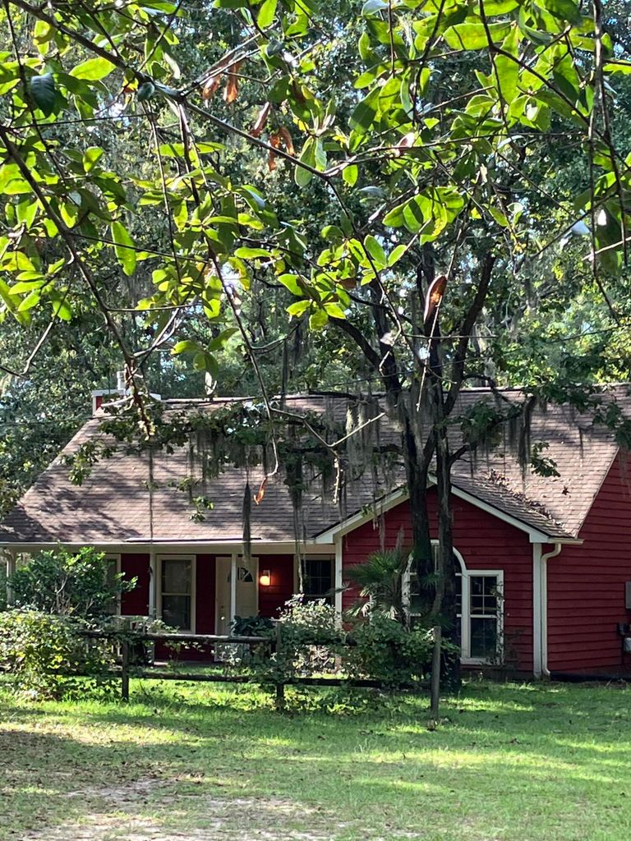
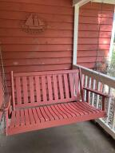
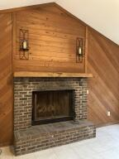
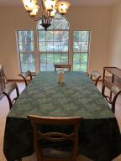
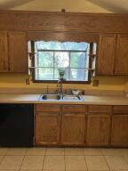
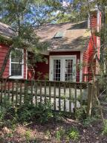
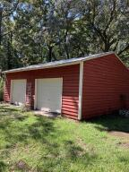
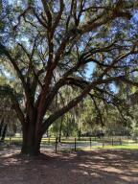


Reduced $25k
5620 Katy Hill Road
Liberia Plantation
Wadmalaw Island, SC 29487
MLS# 22024590
$425,000
This charming red cottage sits serenely among the grand oaks and spanish moss of Wadmalaw Island peacefully waiting for its new owner! Quiet country living at its finest on 2 plus acres (tax map #'s 1970001158 & 1970001159 being sold together) When you enter this charming country home you are are greeted by a brick fireplace surrounded by knotty pine and french doors leading out to a wonderfully wooded backyard and patio.! 4 bedrooms, 2 full baths, an open eat in kitchen, formal dining room. The 4th bedroom is currently set up as an office. There is also a 2 car detached garage on the property which could easily be transformed into a workshop or art studio. If you are an artist, writer, nature lover, or just want to escape the hustle and bustle of city life this place is for you!
John Nugent
(843) 304-2061
john.nugent@carolinaone.com
nugentknowsrealestate.com
Carolina One Real Estate | 628 Long Point Rd | Mt Pleasant, SC 29464

