Slide 1
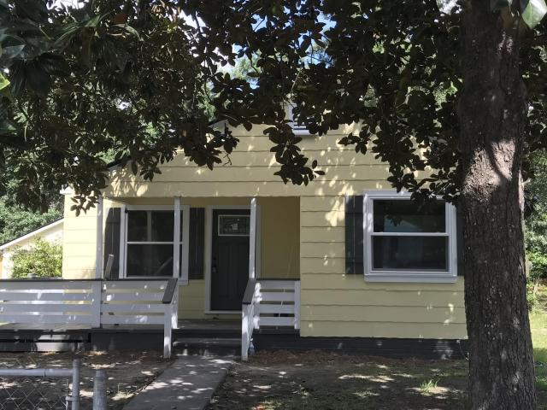

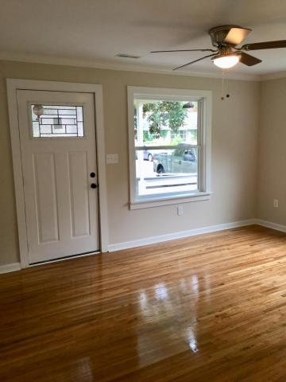
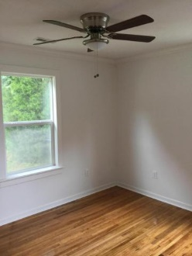
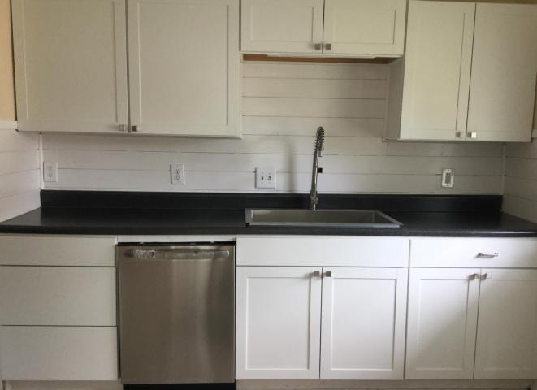
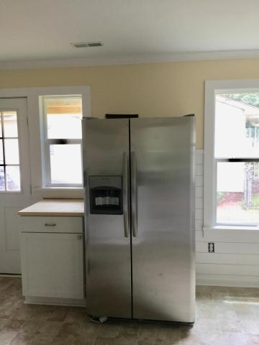
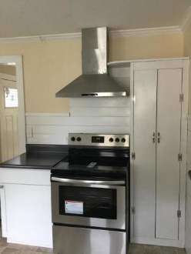
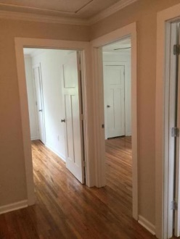
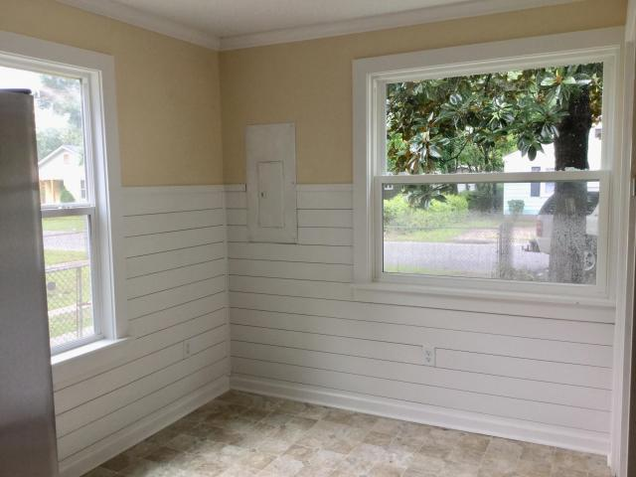
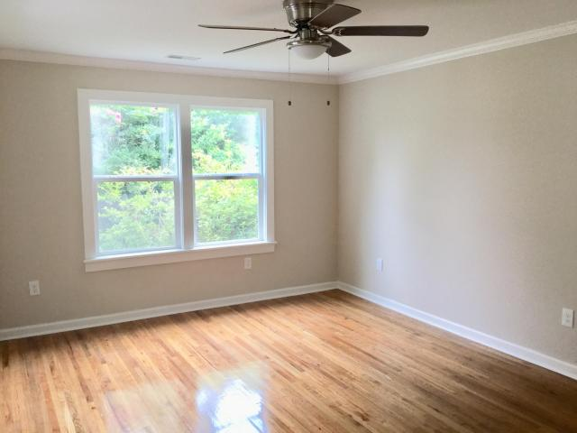
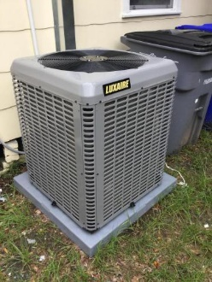
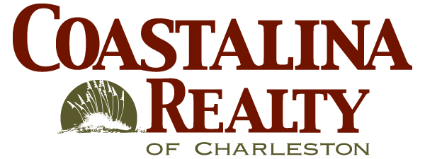
Charleston Farms
Renovated Cottage
5634 Blackwell Ave
Charleston Farms ~ North Charleston ~ MLS# 18023758 ~ $149,900
Perfect for a Couple
Agents, bring your buyers!
Charleston Farms is the next Park Circle and a great investment.
Market values have risen over 5% in the last year and won’t be stopping soon.
This beautiful cottage has been completely renovated and is a definite gem!
Coastalina Realty of Charleston 916 Palm Blvd
Ste 101 Isle Of Palms, SC 29451
Dar Venable, Realtor Mobile - (843) 330-2424 dvislander@bellsouth.net coastalinarealtyofcharleston.com

