Slide 1
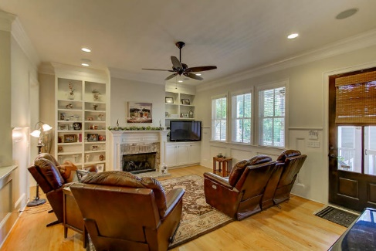
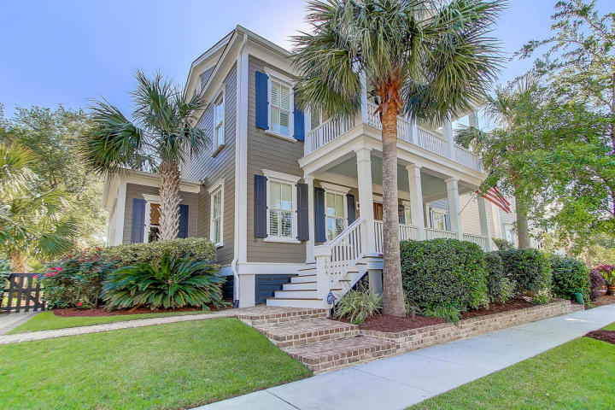
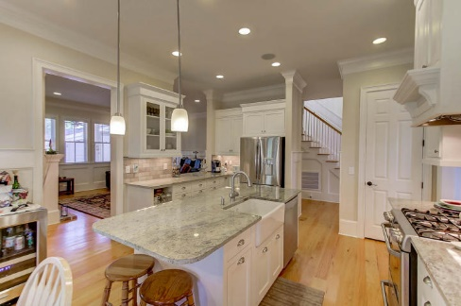
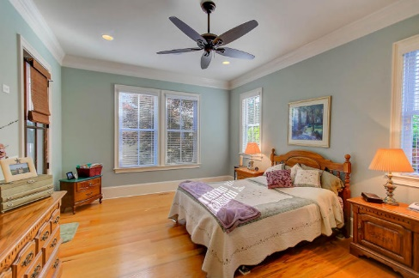
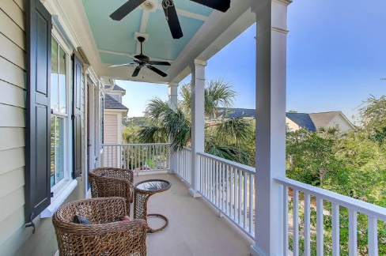
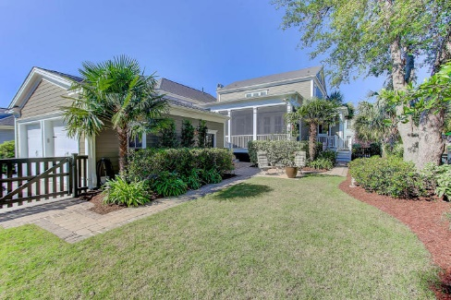


564 Galera Lane Belle Hall Mount Pleasant, SC 29464 MLS# 17011797 $775,000
Just Listed!
Loaded w ith Features
Must See!! This home is located in the very desirable neighborhood of Hibben in the Belle Hall neighborhood. This home is a custom home built by Brian Wells Custom Homes. 5 bedrooms, 3.5 baths, Formal Dining room, Great room, designer kitchen with lots of cabinetry, granite countertops, stainless gas cook top, eat in area is accessible to the Great room. Beautiful hardwood floors throughout this home, handsome office with lots of built in shelving. Screened in porch with cable connection, 2 car detached garage complete with work area, custom shelving, and cable connection. Lots of storage in this wonderful home!! Double front porches, professionally landscaped with irrigation, fenced in backyard, and an additional area off kitchen for grilling. Low E windows, Rinnai instant hot water heater, HERS rating for energy efficiency. Well maintained home with exceptional features and what a lovely location! Exquisite custom front doors, plantation shutters, lots of custom trim and moldings. Absolutely a home that will sell itself! This home has great street appeal and a welcoming entry that is so characteristic of historic Charleston!
Darlene Smith Office - (843) 886-8110
Mobile - (843) 696-7824
darlenesmith@carolinaone.com
DarleneSmithTeam.com
Carolina One Real Estate
1503 Palm Blvd Ste
Isle of Palms, SC 29451

