Slide 1

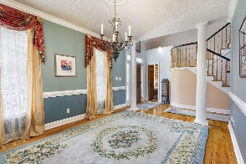
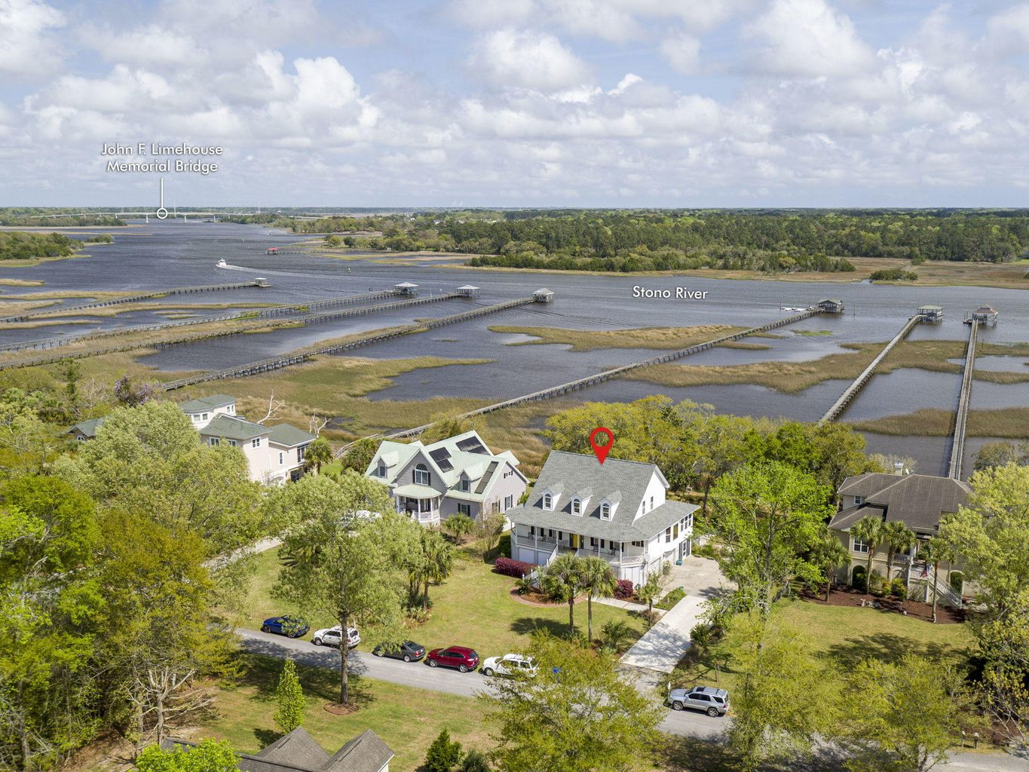
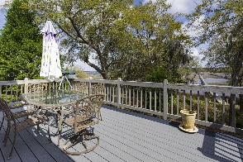
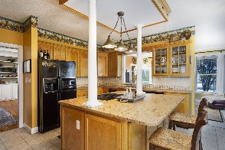
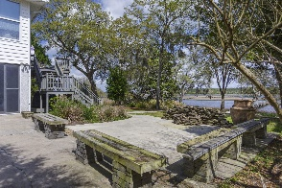
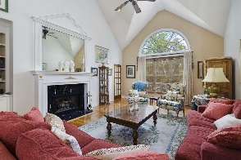
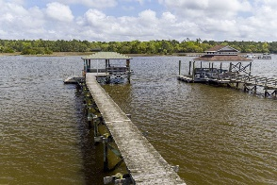
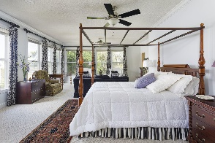
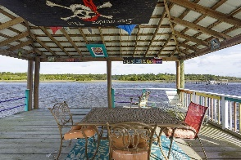


5690 Captain Kidd Road Royal Harbor | Hollywood, SC 29449 | MLS# 21008964 | $999,900
Deep Water Estate Sale!
SCHEDULE YOUR SHOWING TODAY!
One owner home ! 3400 sqft 3br 3.5 baths on .5 acre deep water lot on the Stono River! Elevated Hilton Googe house plan with sea shell stucco piers! Hardwood floors in living room, dining room & hall. Carpet in owner's suite & upstairs bedrooms. Huge owner's suite overlooking the Stono River! Huge jetted jacuzzi tub, stand up glass shower, dual sinks & large walkin closet! Dual access to large living room overlooking the Stono River with 20ft ceilings, gas fire place & custom built in book shelves! Nice eat in kitchen with fossil stone marble counter tops, glass cook top stove, electric double wall overs and large island! Nice sunroom off the kitchen overlooking the Stono River! Dual access to the sunroom from living room & kitchen! 2 additional bedrooms upstairs with Stono views! Upstairs shared bath offers cast iron claw foot tub. Full front porch with new Trex stairs & freshly painted handrails! Large back deck with new Trex decking and stairs! Huge mother-in-law suite/play room/man cave downstairs with full bath, Mitsubishi mini split heating and AC unit and separate rear entrance (Could easily be 4th bedroom if you wanted to add a closet)! 3yr old roof & (2) 8yr old Trane HVAC units! Large screened in porch off of 2 car garage with plastic sliding windows overlooking the Intra Coaster Waterway/ICW! Great for entertaining year around! Deep water dock with 575sqft covered pierhead with 10x20 floating dock with power and water (4/5ft low tide)! Concrete slab is 16ft above sea level with reinforced steel! NO FLOOD INS required! Gated Community! $400 yr HOA! Limehouse Public Boat Landing can be seen from the dock. 5 minutes away by boat or car!!
Amazing sun rises and lots of wildlife!
Rhett Brownlee
(843-209-7755
rhett@rhettbrownlee.com
www.RhettBrownlee.com
Edwards & Assoc
6251 Hwy 162 Ste C
Hollywood, SC 29449

