Slide 1
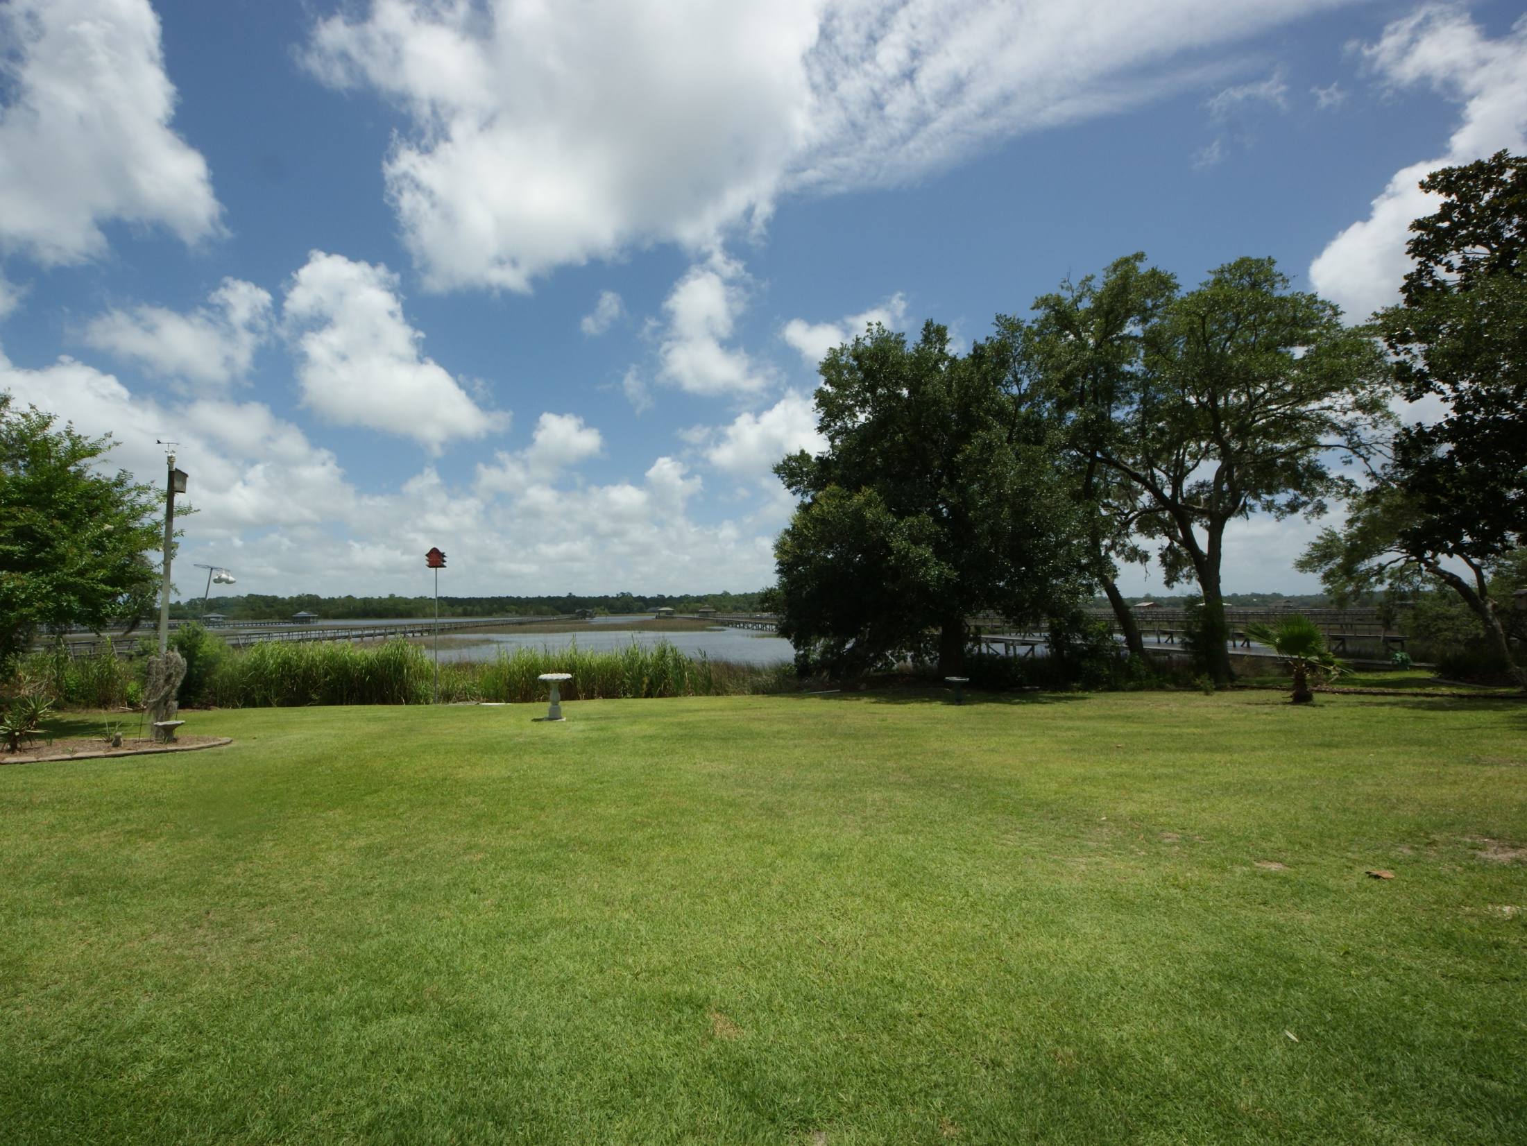
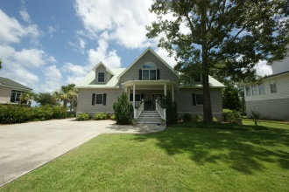
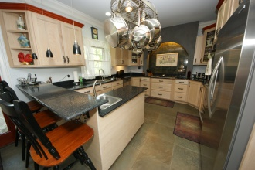
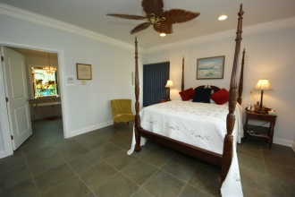
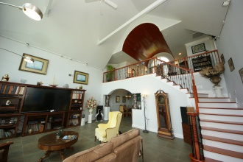
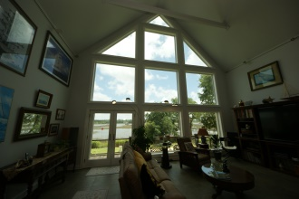
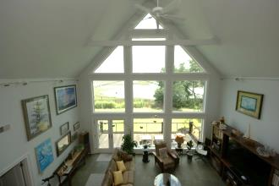
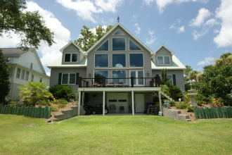
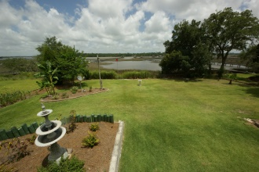
You’re Invited - Open House Sunday, April 19th, from 1 to 4
5694 Captain Kidd Rd Royal Harbor ~ Hollywood MLS 1418791 ~ $899,999
3,106 square foot home on .45 acres located on the IntraCoastal Waterway just across from Johns Island in Hollywood, SC. Tour this lovely property and mingle on the 250 square foot deck where light Lowcountry hors d'oeuvres and wine will be served as you take in the stunning views from this custom built home. No Flood Insurance Required!!!
Jeanette Turner, ABR | (843) 814-1355 | jeanetteturner100@gmail.com | Keller Williams Realty

