Slide 1
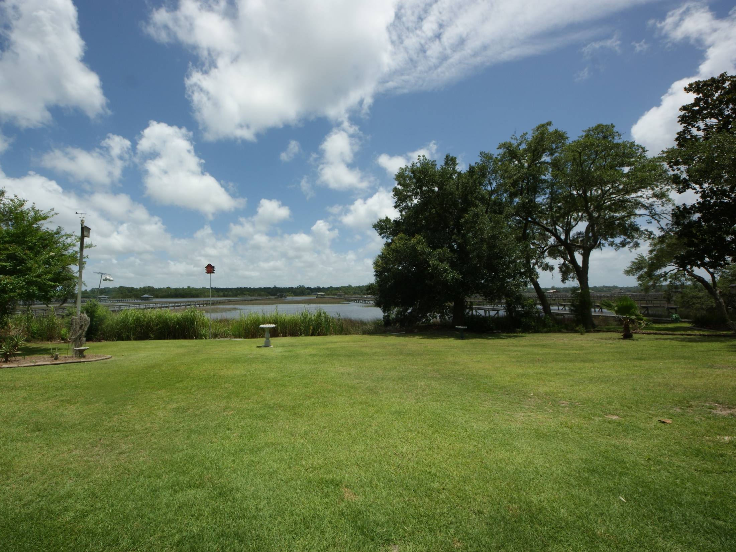
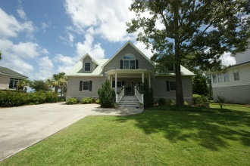
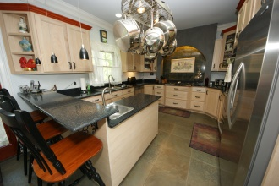
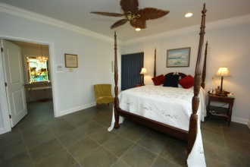
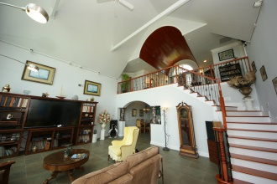
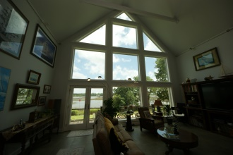
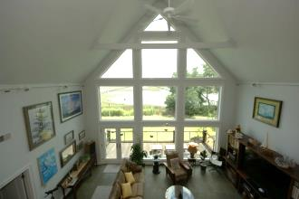
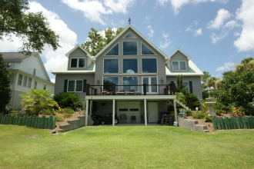
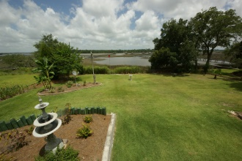
You’re Invited - Agent Open House
Thursday, August 14th, from 1 to 4
5694 Captain Kidd Rd
Royal Harbor ~ Hollywood
MLS 1418791 ~ $1,000,000
Lowcountry cuisine provided by Hamby's Catering, wine, and a $100 drawing for a VISA gift certificate.
3,106 square foot home on .45 acres located on the IntraCoastal Waterway just across from Johns Island in Hollywood, SC. Tour this lovely property and mingle on the 250 square foot deck where light Lowcountry hors d'oeuvres and wine will be served as you take in the stunning views from this custom built home. No Flood Insurance Required!!!
Jeanette Turner, ABR | (843) 814-1355 | jeanetteturner100@gmail.com | Brand Name Real Estate

