Slide 1
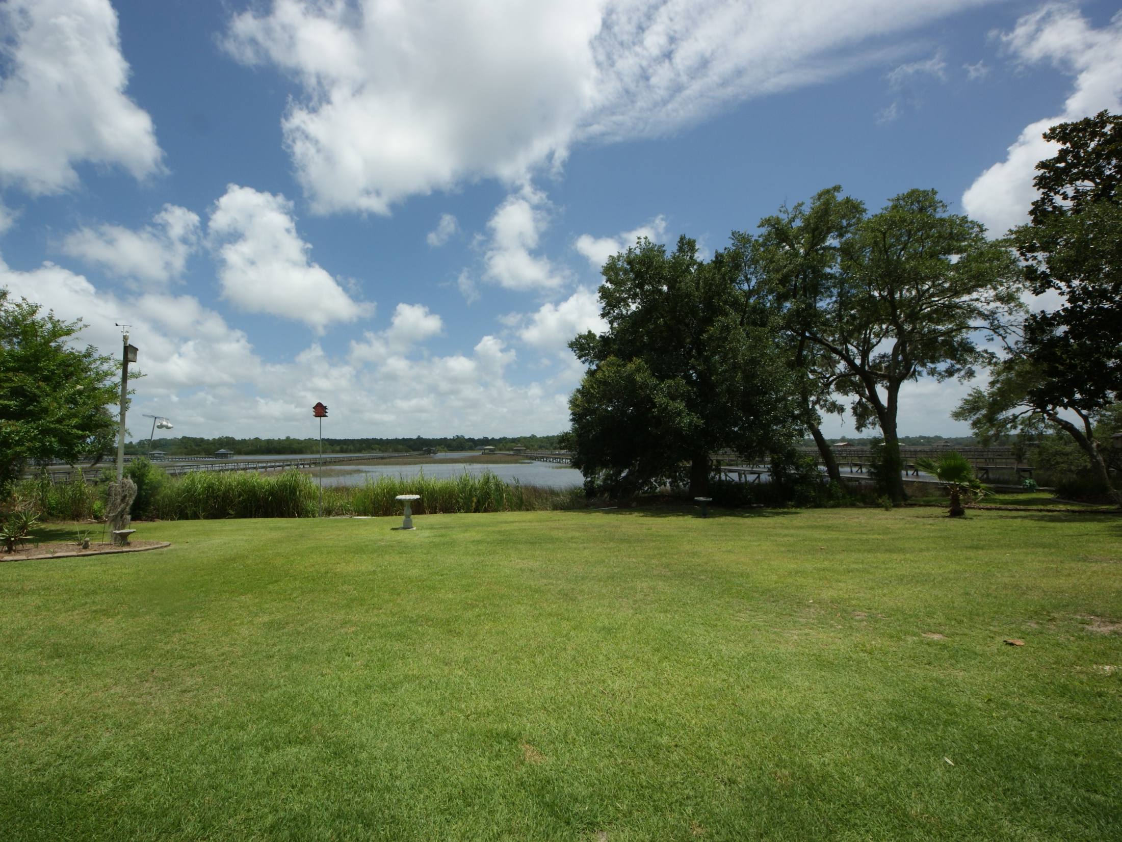
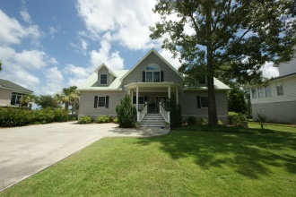
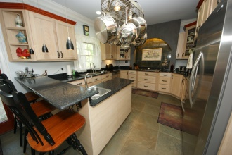
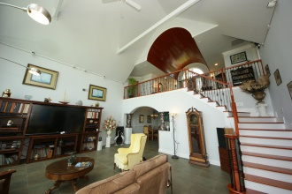
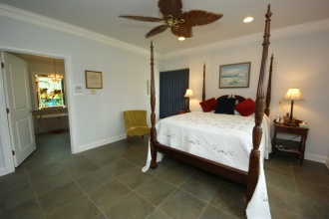
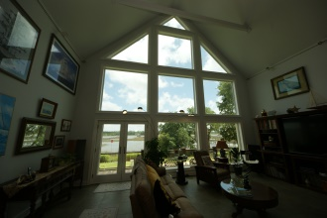
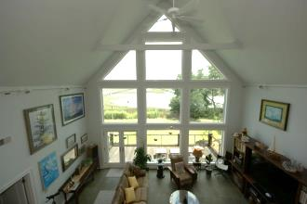
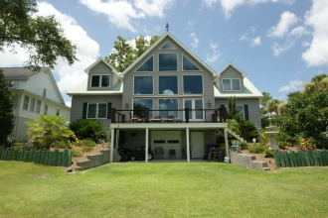
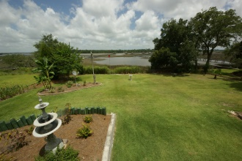
Exclusive Custom Built Home
5694 Captain Kidd Rd Royal Harbor ~ Hollywood MLS 1418791 ~ $1,000,000
Welcome to one of the Lowcountry's finest custom built homes with fabulous features. The Intra-Coastal Waterway backs up to this pristine property. You're only minutes to downtown Charleston, interstates, the airport, shopping, churches, etc. The view from the Great Room is phenomenal as you'll see looking out the Anderson windows that go from floor to 29' ceilings. Tile floors throughout are heated for you in the colder months. You'll love the state of the art kitchen with a GE Profile convection electric oven, an Advantium Convection cooker w/halogen heat, microwave and a warmer. Counters are all Black Diamond, SileStone made w/Quartz which is harder than granite or marble....many amenities in the kitchen......The dining room has a coffered ceiling with Wedgewood blue paint. 3 Bedrooms including the master are downstairs with hall bath. The master bedroom has a great view of the Intra-Coastal; the bath area has 2 walk-in closets w/custom made shelving, shower & a Jacuzzi tub. Going upstairs, there is a lovely barrel ceiling which really sets off the loft along with 2 more bedrooms and bathrooms with plenty of storage. Please go to website to read more about this extremely well built house.
Jeanette Turner, ABR | (843) 814-1355 | jeanetteturner100@gmail.com | Brand Name Real Estate

