Slide 1
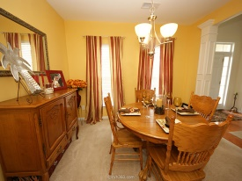
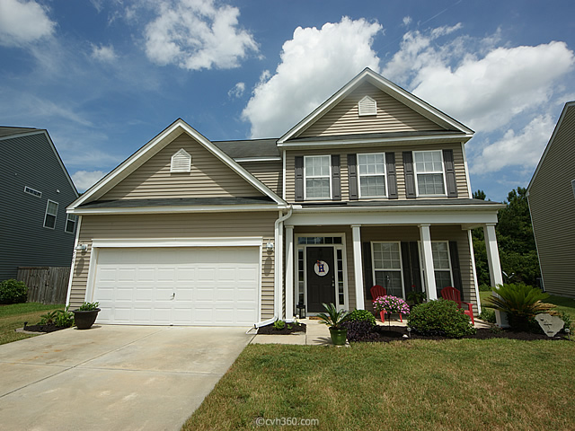
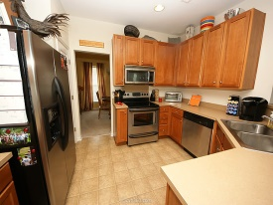
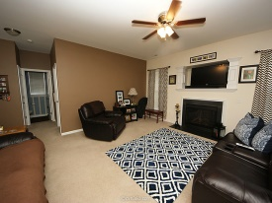
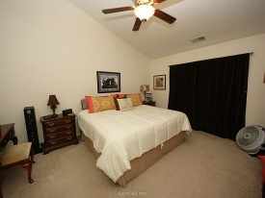
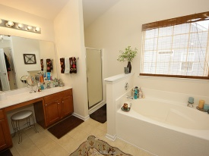
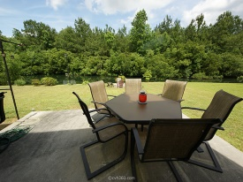

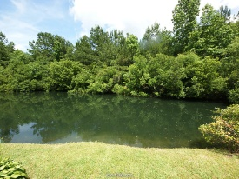


Open House Sunday 12-3
Hosted by:
Kim Thompson
843-901-4044
Kim.Charlestonhomes.us
USDA Financing Available
569 English Oak Circle
Oakley Pointe
Moncks Corner, SC 29461
MLS# 15013998 | $204,000
4 Bed | 2½ Bath
Stunning 4 bedroom 2.5 bath home on a stocked pond. This home is chic and move in ready! The sellers have had the house professionally painted and decorated ready to win your hearts the minute you pull up in the drive way and walk in the door. Open floor plan, screen in porch and a premium lot that has a stocked pond are just a few of the highlighted features. Bonus room down stairs is currently used as the computer/gaming room but could easily become an office or guest room. This home is spectacular! Oakley Point has a neighborhood pool and boat storage area.
Connie White, Broker
C: 843-532-3356
conniesyouragent@gmail.com
Charleston Homes
111 Spring Hall Dr
Goose Creek, SC 29445

