Slide 1
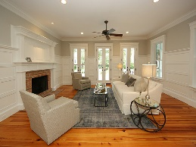
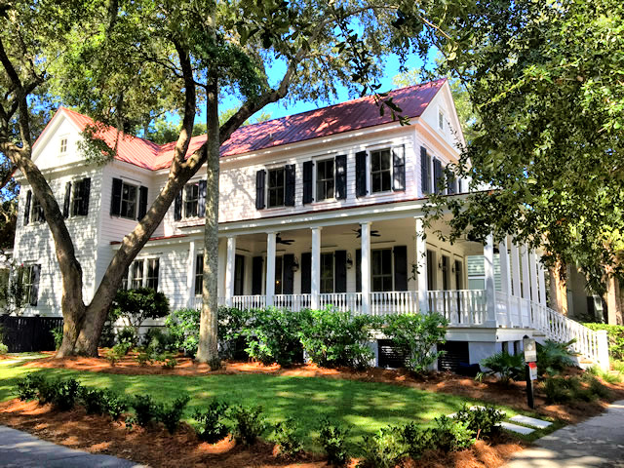
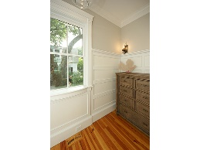
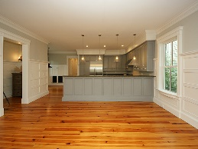
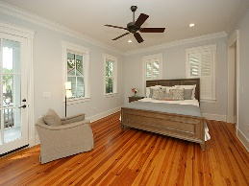
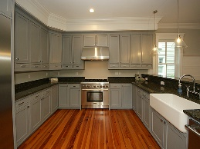
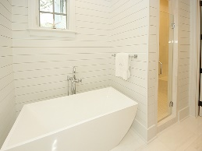
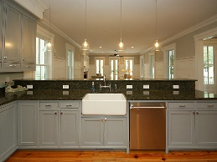
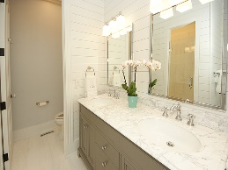


Beautiful Renovated Home on Spacious Corner Lot in I'on
Reduced!!
56 Montrose Road
Mount Pleasant, SC 29464
MLS# 16022201 ~ $1,095,000
This "like new" home has a great floor plan and is situated on a large, spacious corner lot in I'on. It even has parking for 2-3 cars in the back and lined spaces out front! The interior of the home has neutral colors and high end finishings. When you walk into the foyer, you will see the gorgeous refinished wood floors, a beautiful kitchen and an open family room with a fireplace. The granite countertops, all new stainless steel Thermador appliances, and gas range make up the perfect kitchen for any cook. The owner's suite is located on the main floor and has a nice screened porch--a great place to enjoy your morning coffee or to relax with a book. The totally renovated master bath features marble floors, a marble tiled shower, dual vanity w/ a marble top, and a freestanding tub
The master suite also has two separate closets. The second floor features three spacious bedrooms--a "jack and jill" setup and a third bedroom with a private bath. There is also a landing at the top of the stairs that could be used as a sitting area or computer/study area.
The home features beautiful woodwork including the new shiplap added in the Master Bath.
The exterior of the home is amazing! The landscaping was totally designed and installed by DIG. It features beautiful plants and grasses. The side yard is partially fenced for privacy and would be a perfect place for your pets to play. The wrap around porch is also a great place to relax and gives the house that southern charm.
Things to note:
Make an appointment today to see this fabulous home!
Buyer and/or Buyer's Agent to verify all information deemed important including square footage, schools, insurance, and tax information.
Buyer pays .0015 x sale price to I'On Assembly
*Home has been totally painted--inside and outside
*2 new HVACs have been installed
*New Lighting and Plumbing Fixtures
*New Cabinet Hardware
*Encapsulated underneath the house and added a climate control dehumidifier
*New insulation under the house
*Added a Termite Bond to the house
Kea Whatley
Mobile 843-408-8704
keawhat@aol.com
AgentOwned Preferred Group | 824 Johnnie Dodds Blvd | Mt Pleasant, SC 29464

