Slide 1
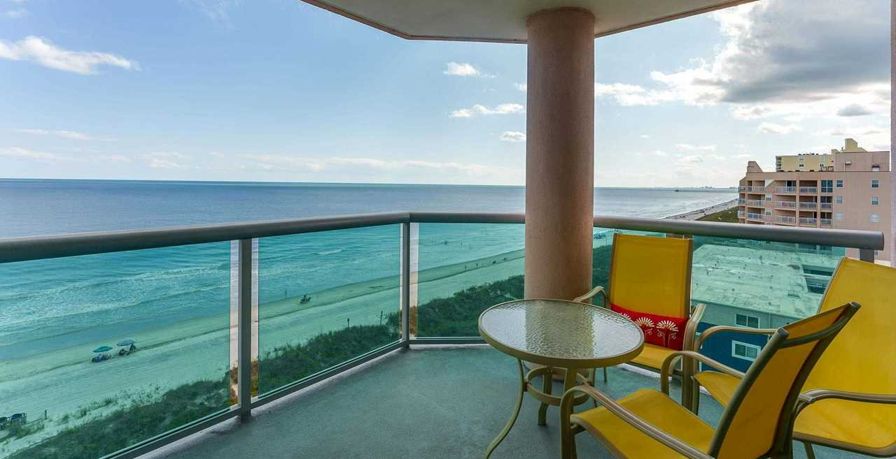
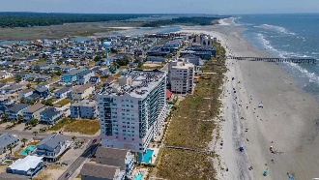
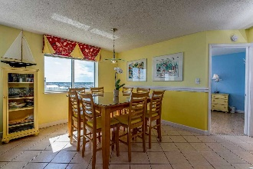
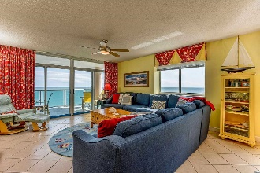
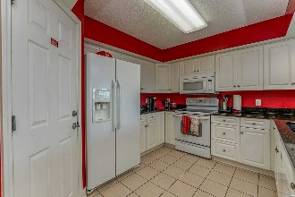
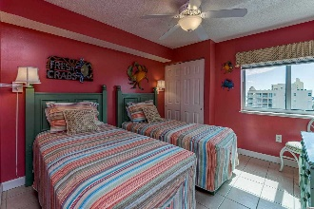
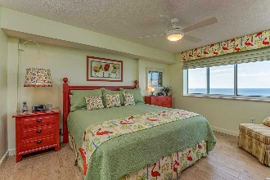
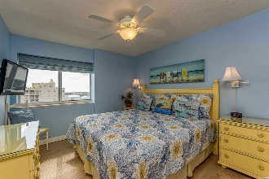
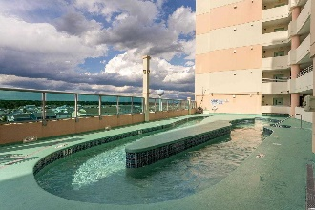
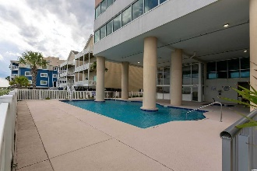


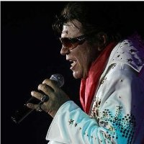
IT'S ALL ABOUT
THE VIEWS!
5700 N Ocean Blvd. #811
Laguna Keyes | North Myrtle Beach, SC 29582
MLS# 2112978 | $549,900
IT'S ALL ABOUT THE VIEWS! Gorgeous and immaculate Laguna Keyes 811 is a rare, luxurious North Myrtle Beach vacation home in an extraordinary oceanfront high rise. It is magnificent, spacious, beautifully decorated and is being sold fully furnished, including 5 flatscreen CCTVs & DVD players, appliances and newer washer/dryer, a GE stacked laundry center. This deluxe upscale second home and investment rental property has a new HVAC system with 3-ton heat pump system/flush kit/thermostat, installed in 2021! There is no hot water unit in the individual condos. A central boiler provides hot water for the condos and is maintained by the HOA, and the cost is included in the monthly fee. Highly desirable Laguna Keyes is located in the Cherry Grove section of North Myrtle Beach, South Carolina, a popular, safe community famous for the Cherry Grove Fishing Pier and uncrowded, wide, white-sand beaches. The Cherry Grove Beach is also touted as the 11th best in the nation, and North Myrtle Beach is a top-ten beach town and best family beach in the U.S.
This cheerful sought-after beauty is bathed in natural light and features three bedrooms and three baths. Laguna Keyes 811 is an extra-large end-unit condo. The patriotic blues and reds in this North Myrtle Beach vacation rental are accompanied by a sunny yellow hue for an inviting color balance, well suited for a comfortable relaxing getaway or permanent home.
The living room boasts private, stunning oceanfront balcony access. Its curved balcony is unique with its tinted, heavy duty glass railing providing unimpeded infinity views of the spectacular Atlantic Ocean. There is a LG 65" LED Smart TV & DVD player, a new sofa that pulls out to a queen bed and which can seat eight and a large ceiling fan in the living room, which is flexibly designed, too, for fun, for comfort and for those VIEWS! The dining room table also seats eight, perfect for a family or foursomes. The kitchen pops with a color palette of red, white and black; and it has everything you want, including coveted upscale granite countertops and double granite sink, full-size appliances, plenty of counter space, pantry, and breakfast-bar seating with its own TV. The black granite countertops are a nice focal point for the entire living area. There are king beds in two of the three bedrooms and twin beds in the third. All bedrooms have ocean views, ceiling fans and TVs. The oceanfront master is an extraordinary en suite featuring a large master bath with stand-up shower, double sinks, separate vanity and even has a linen closet. The bedroom area has two closets, a guest closet and the big owners' walk-in closet which also functions as an owners' lock-out
Amenities are on two levels: The 6th floor is for sunning, enjoying the lazy river, two hot tubs and a kiddie pool; the first level features the heated indoor pool and the outdoor pool and another kiddie pool.
Be dazzled onsite at Laguna Keyes as well! In summary, you can find three high-speed elevators for convenience, a fitness center, heated indoor and an outdoor pool, lazy river, outdoor shower, gathering areas, covered parking, easy access to the beach and much more. In close proximity to this oceanfront treasure you can easily discover championship golf courses, Sea Doo rentals, water slides, shopping, dining and live entertainment theatres. Do it all, or nothing at all. Relaxation is welcome. And you are warmly welcome to the Best of the Beach on the North Strand of Myrtle Beach, where it's all about the VIEWS: Expansive panoramic views of the Atlantic Ocean East to West and the Little River Neck Inlet and Coastal Marshland to the North – a view that will never be obstructed by any new construction. Breathtaking!
Video Tour: https://www.youtube.com/embed/gDWGtnSZGe8
Virtual Tour: https://my.matterport.com/show/?m=s2TCGEXBpCW
Connie Ross-Karl
702-306-2643
conniesross@aol.com
Ronnie Nichols
Realtor
Broker in Charge
NEW WAY PROPERTIES MYRTLE BEACH

