Slide 1
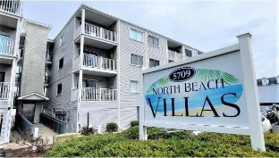
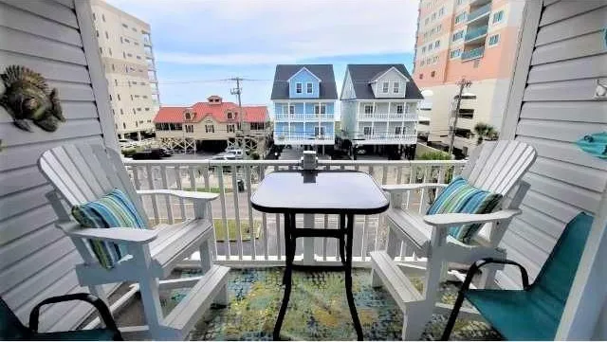
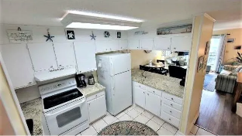
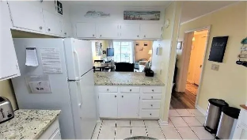
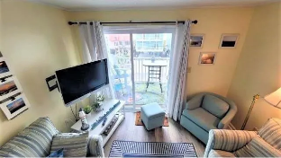
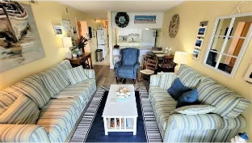
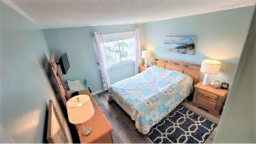
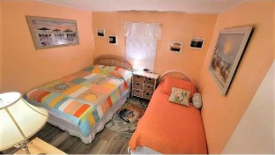
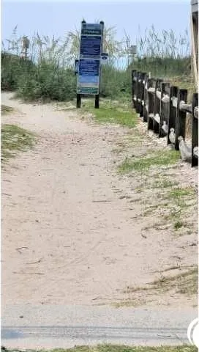



Isn't it time you treated yourself and your family to a wonderful Cherry Grove Beach SC Condo with direct beach access!
5709 N Ocean Blvd #306
North Beach Villas | North Myrtle Beach SC 29582 | MLS# 2316769 | $339,900
Isn't it time you treated yourself and your family to a wonderful Cherry Grove Beach Condo with direct public beach access from both ends of the well located building, across the street from the Tidewater Plantation beach cabana. Did we say Cherry Grove? Is it time for your family to start making unforgettable memories? And this rare find is a top-floor unit in an ELEVATOR building on the highly desirable north end of Cherry Grove Beach. Plus, a spacious balcony with views and peeks of the ocean. This unit has been used as a second home and a light seasonal rental. It is well cared for. It has lots of updates, including new LVP flooring, granite counters in the kitchen, new vanities in both baths with bead board, fresh paint and new living area furniture. Full-size washer and dryer in unit in a dedicated laundry room. Ample storage in the unit, too, including a linen closet in the hallway. Speaking of storage... there is a HUGE (12'x25') ground level storage room for all the beach necessities, chairs, coolers, umbrellas, bicycles, kayaks, fishing supplies and anything else you and your guests may need. Conveniently located near shopping, dining and entertainment if you want to go out, and a nice grilling and picnic area next to the pool if you would rather stay in. North Beach Villa has been well maintained as well and has a strong HOA. Monthly fees are low and include everything but interior electric and HO6 policy. Don't wait on this one, it is extraordinarily well priced for a premier two bedroom, two bath beauty. Come in the unit looking out toward the balcony and with a large laundry room and kitchen on the left with a really roomy main living area... very pretty, simple and charming. The bedrooms are split by a long hall and a full hall bath, nice privacy, extending to the master with en suite and views! A must see, must enjoy family-pleaser.
Video Tour: https://youtu.be/yFnrK1MOugs
Connie Ross-Karl
702-306-2643
conniesross@aol.com
Ronnie Nichols
Realtor / BIC
ronnienichols8@aol.com
NEW WAY PROPERTIES MYRTLE BEACH

