Slide 1
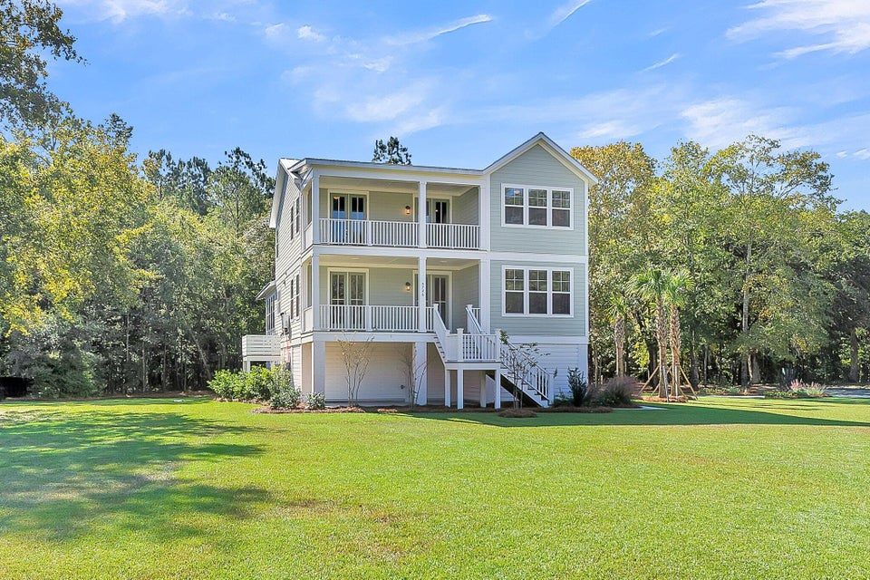
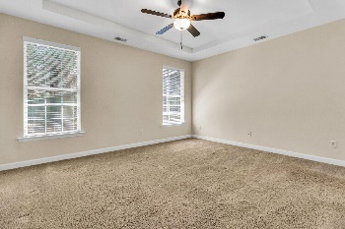
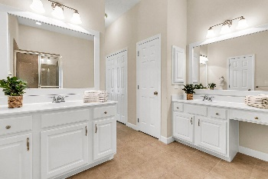
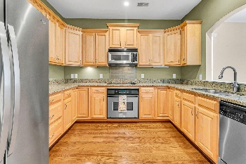
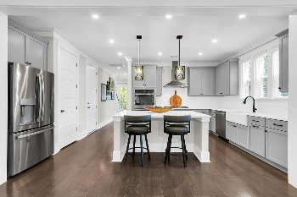
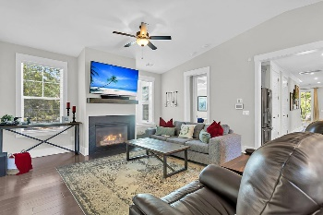
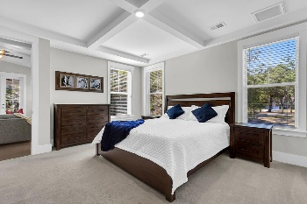
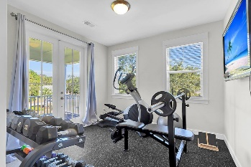
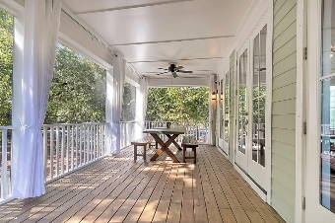

5726 Whistle Stop Lane
Whistle Stop · Ravenel, SC 29470 · MLS# 24026958 · $975,000
Just Listed in Ravenel! 1.28 Acres!
Stunning 5 bedroom 4.5 bath elevated home with metal roof on a large 1.28 acre wooded lot. Looking for privacy and being away from it all while only being a half hour to the airport? This is your gorgeous new home! Only one year old and shows like new! Upon arriving you notice a sense of calmness, the awesome curb appeal, large yard, professional landscaping, oversized stacked front porches, and the HUGE screened-in porch! Inside you are greeted with handsome floors, soaring ceilings, 7 sets of dazzling 8 foot glass double entry doors-a must see, coffered ceilings, and an abundance of natural light. The flex room is to your left and could be an office, dining room, or second living area. There is a private powder room for guest to the right. Continuing in is the chef inspired gourmet kitchen featuring a gas cooktop, double ovens, quartz countertops, deep single bowl farmer's sink, stainless steel appliances, large island, white tile backsplash, eat-in area, and 2 jumbo walk-in pantries! This kitchen was made for cooking and entertaining! The kitchen is open to the large charming family room with gas fireplace, vaulted ceiling, and has views of the peaceful backyard. The luxurious primary bedroom suite is on the main level, has a coffered ceiling, multiple windows and has a spa-like ensuite bath with freestanding relaxing soaking tub, dual vanities, separate tiled shower with seat and frameless glass, and a gigantic walk-in closet. Upstairs there are 4 additional nicely sized bedrooms all with generous closets. The first has its own private full bath and overlooks the private backyard, the second and third bedrooms share a Jack-n-Jill bath and the fourth bedroom has double doors leading to the second floor balcony and is perfect for an office, bedroom, gym, or den! Additional features of the upstairs are separate large storage closets in the hallway and another full bathroom. The magnificent oversized screened-in porch has room for a dining table and seating area and has stairs that lead down to the patio area which is good for grilling or relaxing in the shade! The elevated construction home has a 3 car garage and TONS of room for storage. Foam panels have been added which allows the underneath to stay clean from debris blowing in. This home is ideal for the entertainer, gardener, nature lover, or someone looking for a lovely home in the country away from the hustle and bustle of city life.
Call today for a showing, it will not last long!
Stan Huff
843-670-2835
stan.huff@agentowned.com
Jill Marcacci
843-297-5590
jill@agentowned.com
www.agentownedrealty.com
AgentOwned Realty Co. Preferred Group, Inc. | 824 Johnnie Dodds Blvd | Mt Pleasant, SC 29464

