Slide 1
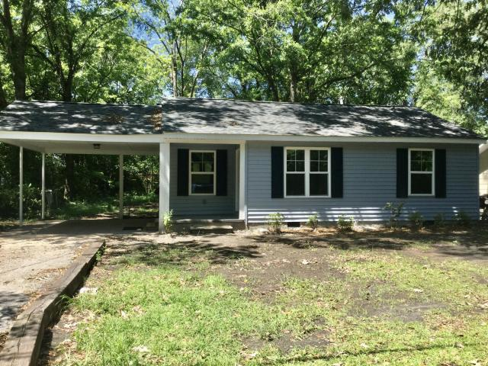
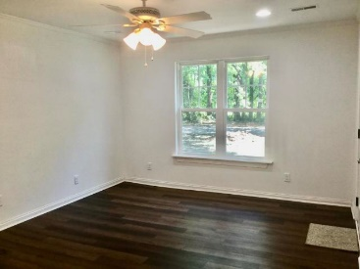
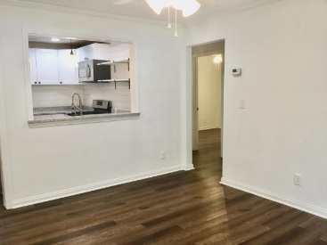
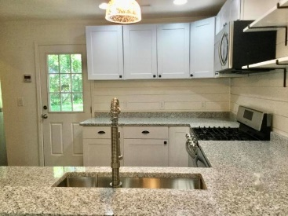
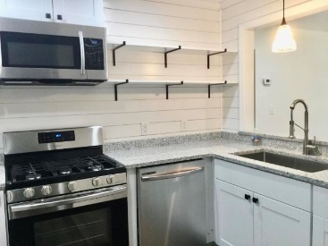
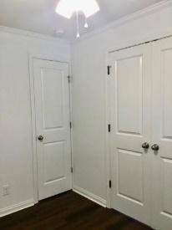
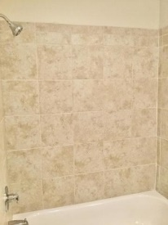
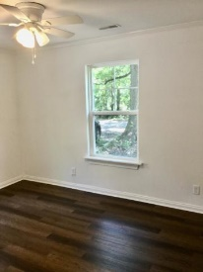
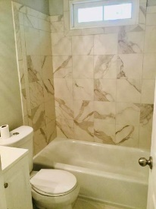
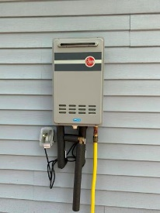
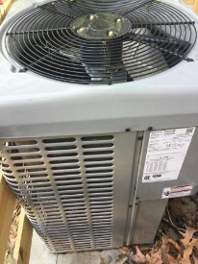

Renovated Cottage in Hanahan
5727 Edison Avenue
Charleston Farms ~ Hanahan, SC 29410 ~ MLS# 20015691 ~ $189,000
This 3 bedroom and 2 bath cottage has been completely renovated! EVERYTHING IS BRAND NEW! New roof, paint, floors, ac, windows/doors, kitchen, appliances, ceiling fans, light fixtures, laundry room, bathrooms.
MLS Document on the listing has a list of everything that is new you cannot see.
Coastalina Realty of Charleston 916 Palm Blvd
Ste 101 Isle Of Palms, SC 29451
Dar Venable, Realtor Mobile - (843) 330-2424 dvislander@bellsouth.net coastalinarealtyofcharleston.com

