Slide 1
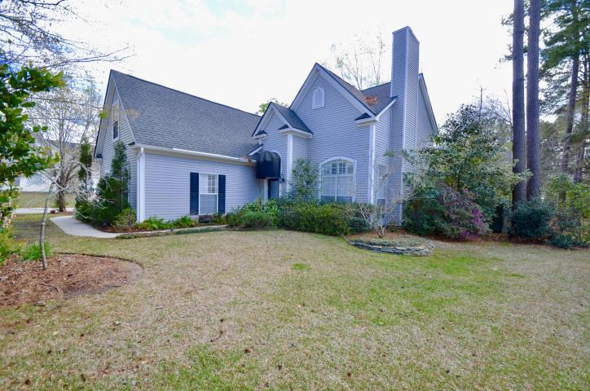
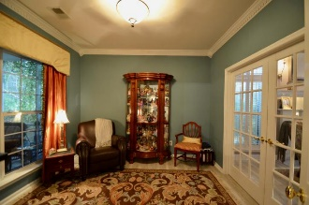
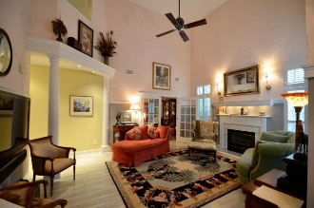
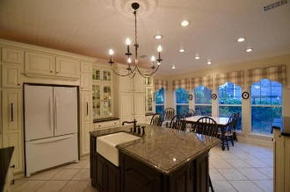
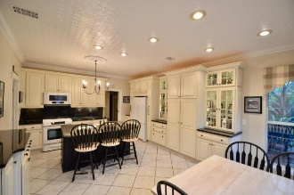
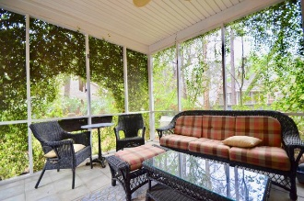
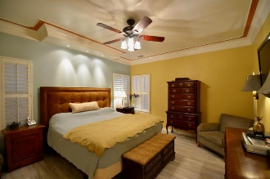
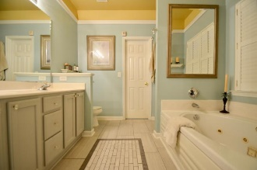
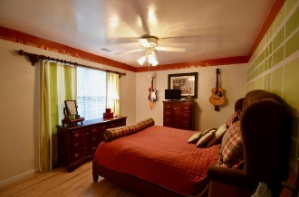
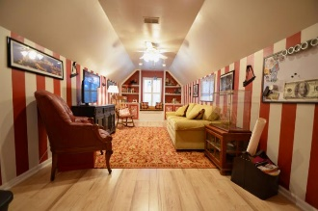



576 Pointe Of Oaks Road
Legend Oaks Plantation
Summerville, SC 29485
MLS# 17007204
$319,000
Just Reduced!
Just Listed!
An elegant home! With beautiful accents and hints of historic charm, this home is warm and inviting. It is equipped with four bedrooms, 2.5 bathrooms, and much more. The kitchen features tall cabinets that are complimented with a deep black granite, beautiful accent lighting, and a sea of windows to gaze into the secluded backyard. Between the huge living room, study, and FROG, there is plenty of room for entertaining, and raising a family.
Andrew Sorrentino
(843) 371-6218 | andrew.sorrentino@agentowned.com
www.AgentOwned.com
The AgentOwned Realty Co | 902 Savannah Hwy | Charleston, SC 29407
Real Estate • Mortgage • Insurance

