Slide 1
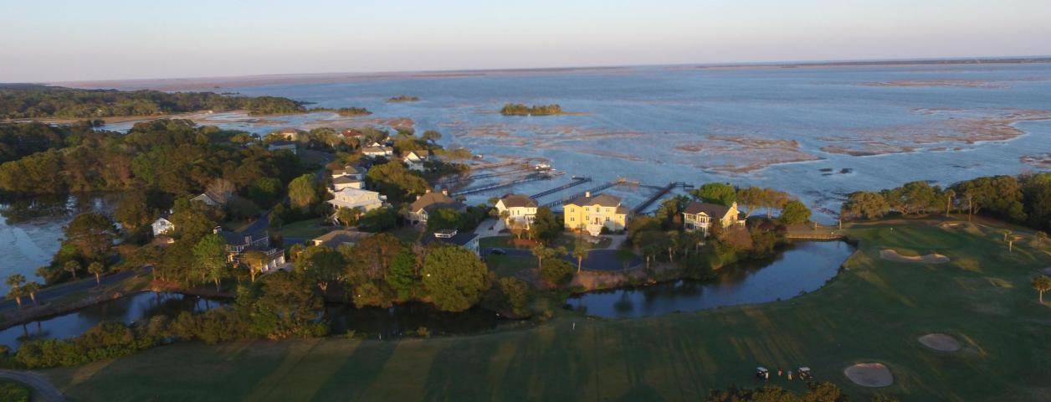
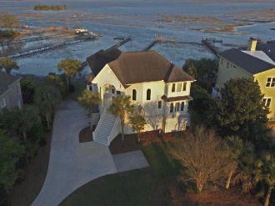
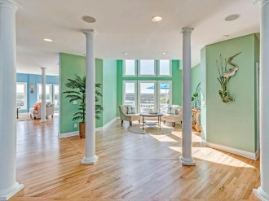
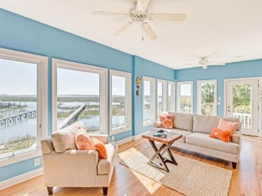
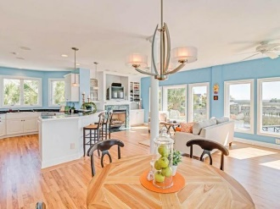
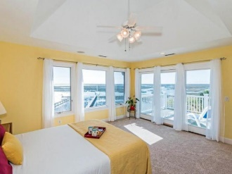


577 Marshgrass Boulevard Heron Pointe ~ Mount Pleasant, SC 29464 ~ MLS# 17010241 ~ $749,900
Features, Renovations and Improvements
Kitchen
. Lake view
. Kitchen renovation with granite countertops, backsplash, stainless steel stove, refrigerator, built-in microwave, Bosch dishwasher, garbage disposal, refurbished kitchen cabinets, new doors and hardware, light fixtures, under cabinet lighting, custom ceiling mural
. Reverse osmosis water purification system which feeds kitchen sink, ice maker and Master Bathroom
Sun Room
. Lake view
. Wide openings between Kitchen, Dining Room and Living Room
. Installed UV film (Miami/Dade hurricane certified) on windows for protection of fabrics and reduction in heat/cold
. Added 2 HVAC registers and new ducts under the house when HVAC replaced. Kept baseboard heaters for 15 degree weather. Temperature consistent throughout first floor
. Installed beadboard ceiling, ceiling fan, recessed lighting, tile floor
Living Room
. Lake view
. Vaulted ceiling 20'
. Installed marble fireplace surround 2015
. Added cabinets behind fireplace with glass front doors with lighted shelving and closed bottom cabinets
. Propane gas logs
. Two round skylights
Dining Room
. Lake view
. Installed ceiling molding, chair molding and wainscoting
Master Suite-Downstairs
. Lake view
. Installed in Master Bath seamless glass shower, tub, tile, toilet, knobs, faucet and hardware, custom vanity with mirrored cabinets in and out, lighting, granite countertops, extra electrical receptacle
. Installed two bedside reading lamps wall mounted, ceiling fan
. Installed in Master sitting room his/her custom closets, French door and hardwood flooring Powder Room
. Installed toilet, sink, lighting, faucet and hardware
Fourth Bedroom/Recreation Room/Home Office
. Installed recessed lighting
. Two closets
. 13' x 21' large room
Guest Bedrooms with Plantation Shutters
. One with bath en suite with new faucet, hardware and lighting
. Renovated Hall Bath with toilet, granite countertops, lighting, faucet and hardware for 3rd and Fourth Bedroom/Recreation Room/Home Office
Spa Pool/Greenhouse/Screened Porch
. Lake view
. Indoor exercise pool/spa
. Area for greenhouse plants, sitting
. Screens on windows, tile floor
. Replaced sheetrock walls with stained wood siding and enhanced support under spa
. Installed recessed lighting
. Two HVAC registers in room, two ceiling fans
Garage
. In two car garage, extra space for workbench and shelves
Exterior
. Irrigation system water from lake, pump in garage
. Installed landscape lighting front and back yards on timer
. Installed mosquito misting system for deck area
. Installed seawall soon after moving-in. Natural foliage in buffer area is a wildlife habitat forfish and birds.
. Deck renovation with built-in benches and plant stands, trellises
. Tree trimming 2017
. Roof new 2007
. Exterior painted 2015.
Flooring
. Hardwood floors throughout including staircase except tile in Spa/Pool Room, Den/Sunroom, Laundry, Baths
Storage
. Extra storage space with walk-in storage from side eaves in 4th Bedroom/Home Office, coat
closets at front door and on second floor, storage at both dormer windows, walk-in storage off guest bedroom, linen closet on second floor, built-in shelving in pantry/laundry room off kitchen
Installed Doors for Spa/Pool Room
. To Den/Sun Room, Living Room and Master Suite, exterior right pedestrian door, exterior left French door
Installed Ceiling Fans
. Spa/Pool Room, Den/Sun Room, Master Bedroom, 4th Bedroom/Home Office, two Guest Bedrooms
Installed Plantation Shutters . Kitchen, hallways, Master Bedroom, Master Bathroom, 2 Guest Bedrooms, 4th Bedroom/Home Office
Kay Kennerty MBA, ABR, CRS, GRI
843-345-5011
KKennerty@aol.com www.KayKennertyHomes.com
The AgentOwned Realty Company
824 Johnnie Dodds Blvd, Mt. Pleasant, SC 29464

